Slide 1
Infrastructure LA
Sustainable Waste and Recycling Management
Thank you for joining us the meeting will start in a few moments
REMINDERS
Please mute your line during the call
There will be a Q&A session at the end of the meeting
Use the chat feature to ask questions and comments
You can also raise your hand during the Q&A and we will call on you to unmute and share
The meeting is scheduled for one hour

Slide 2
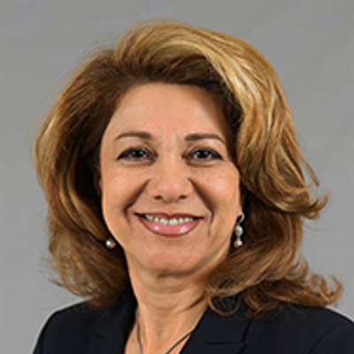
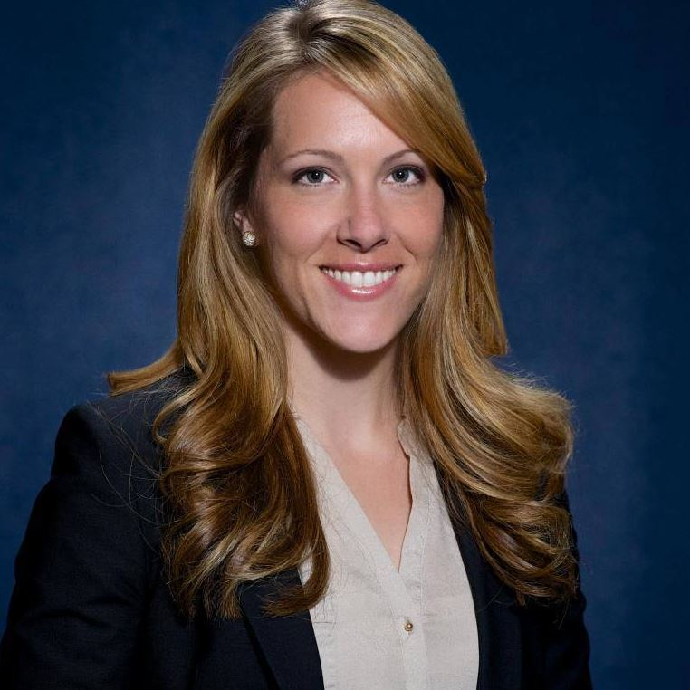
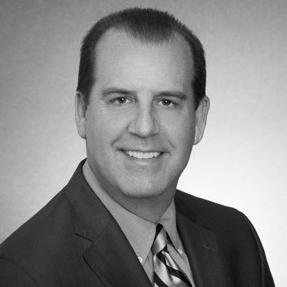
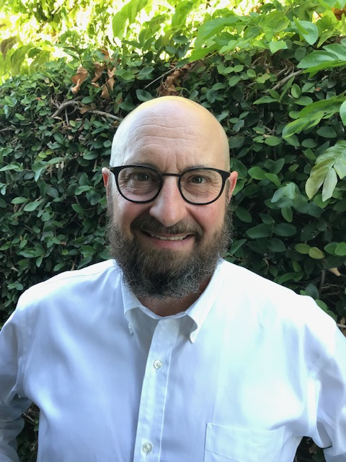
Infrastructure LA
Sustainable Waste and Recycling Management
  Challenges to Compliance and Regulatory Relief
  Shari Afshari
  Deputy Director
  LA County Public Works
  SAfshari@pw.lacounty.gov
  Faith Conley
  Legislative Representative
  County of Los Angeles
  FConley@ceo.lacounty.gov
  Kelly Astor
  General Counsel to Los Angeles County Waste Management Association
  JKA@Astor-Kingsland.com
  Bob Asgian
  Department Head,
  Solid Waste Management
  LA County Sanitation Districts
  RAsgian@lacsd.org

Slide 3
Infrastructure LA
Thank you for joining today’s call!
For more information on Infrastructure LA and to sign up for email updates about future calls visit the website at: www.infrastructurela.org
Email: InfrastructureLA@pw.lacounty.gov

