Slide 1
Food Waste Infrastructure
SWARM Subcommittee Meeting
Bob Asgian
Department Head
July 21, 2020

Slide 2
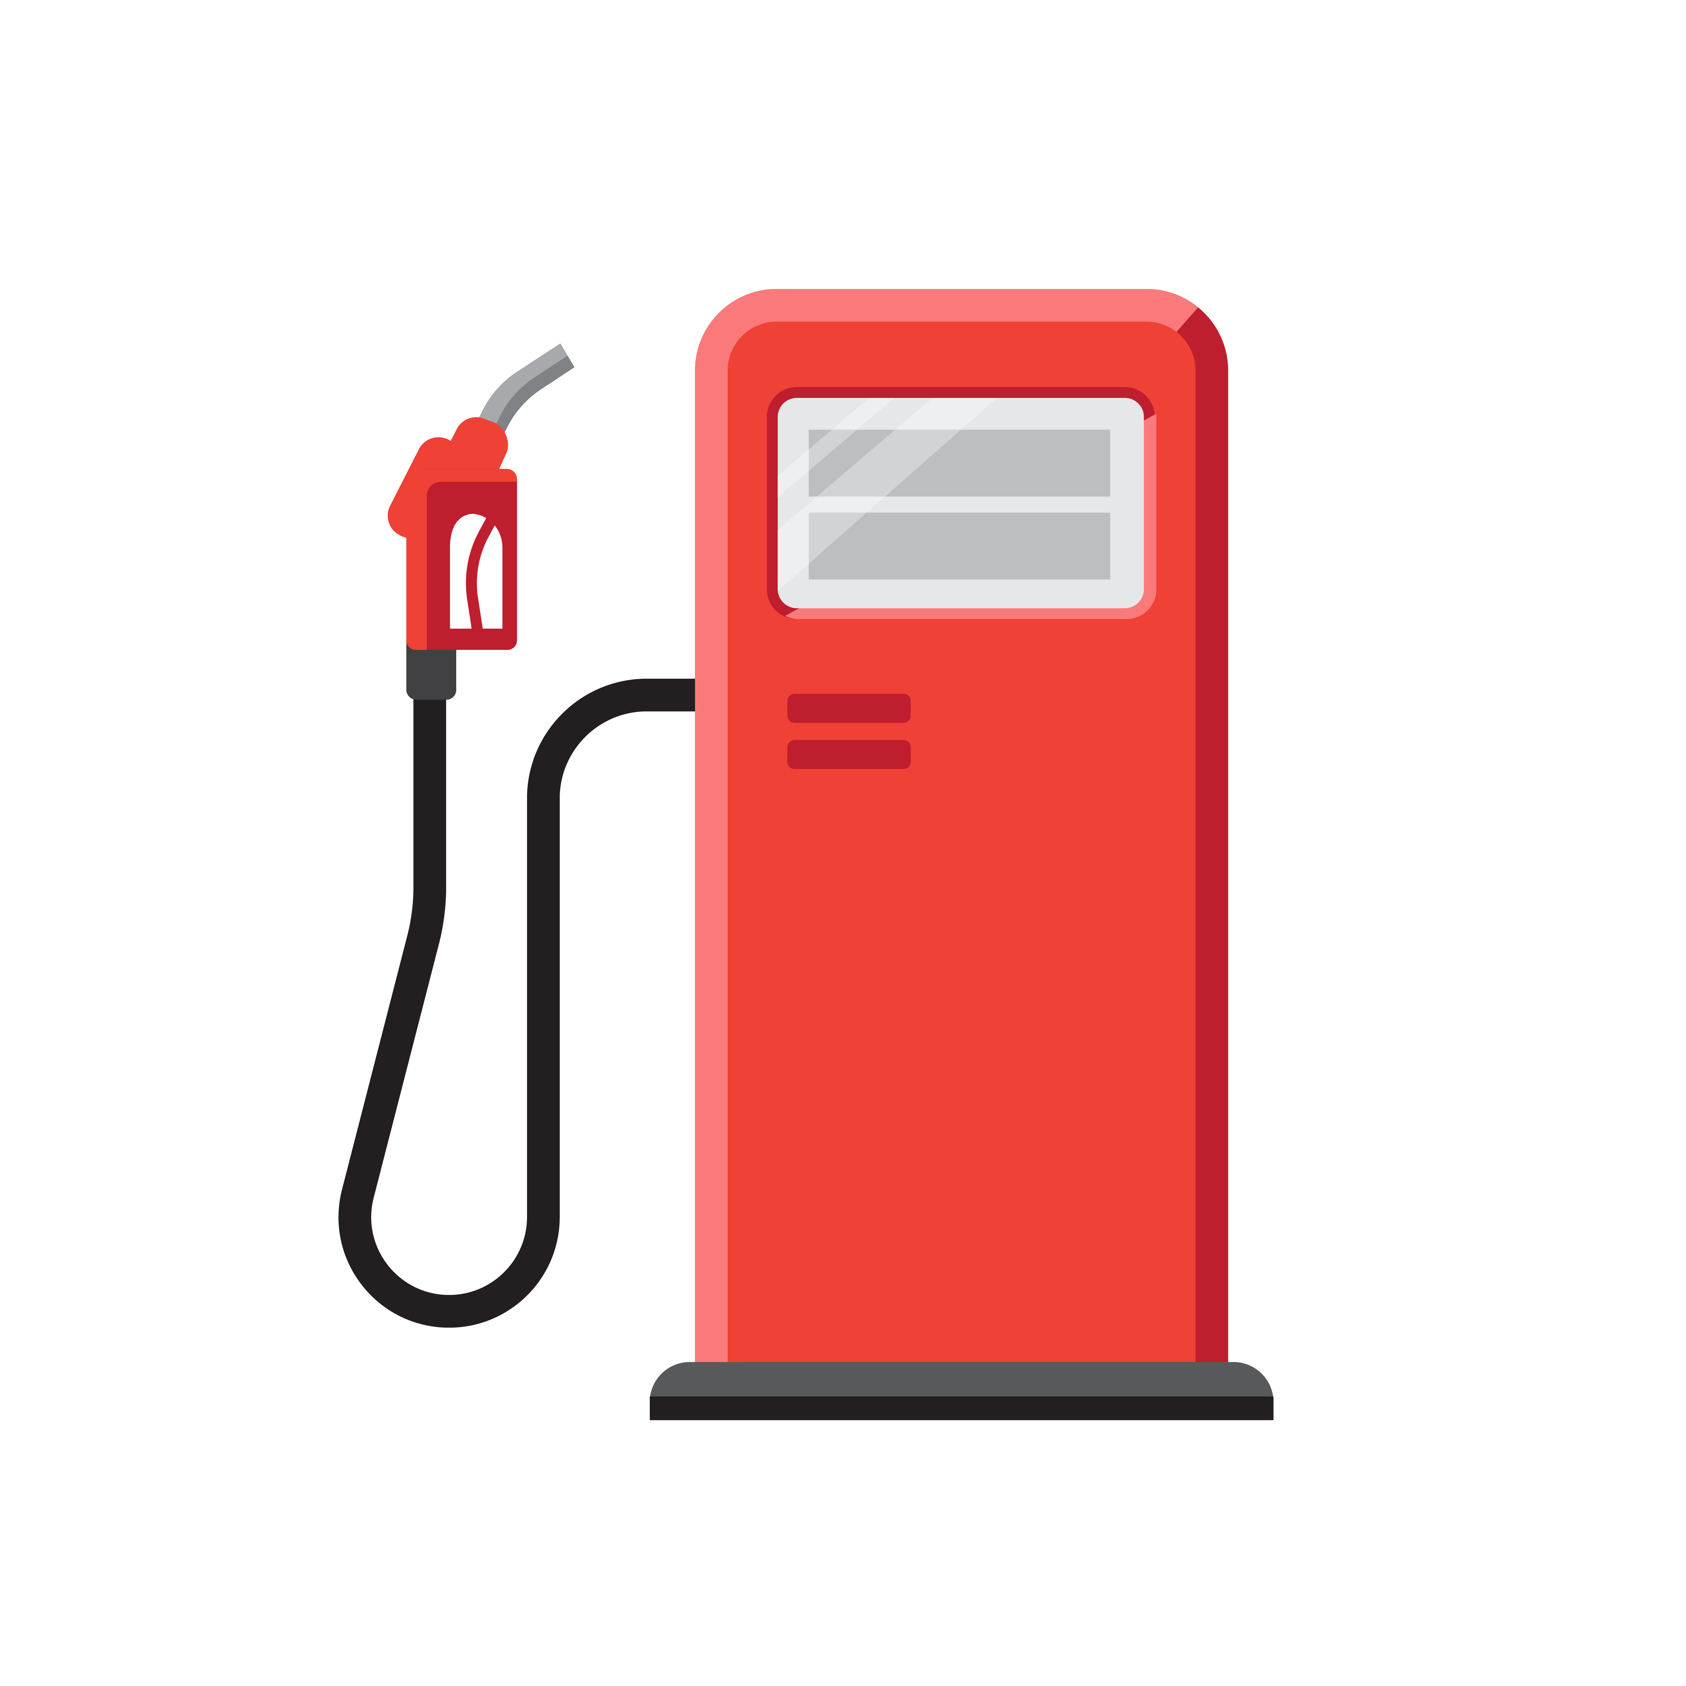
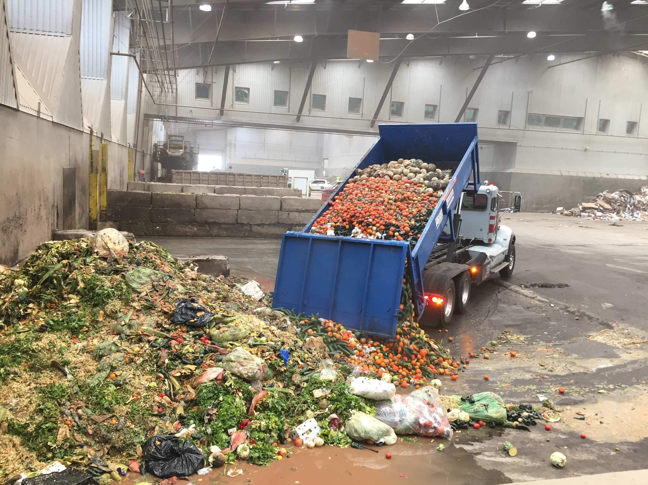

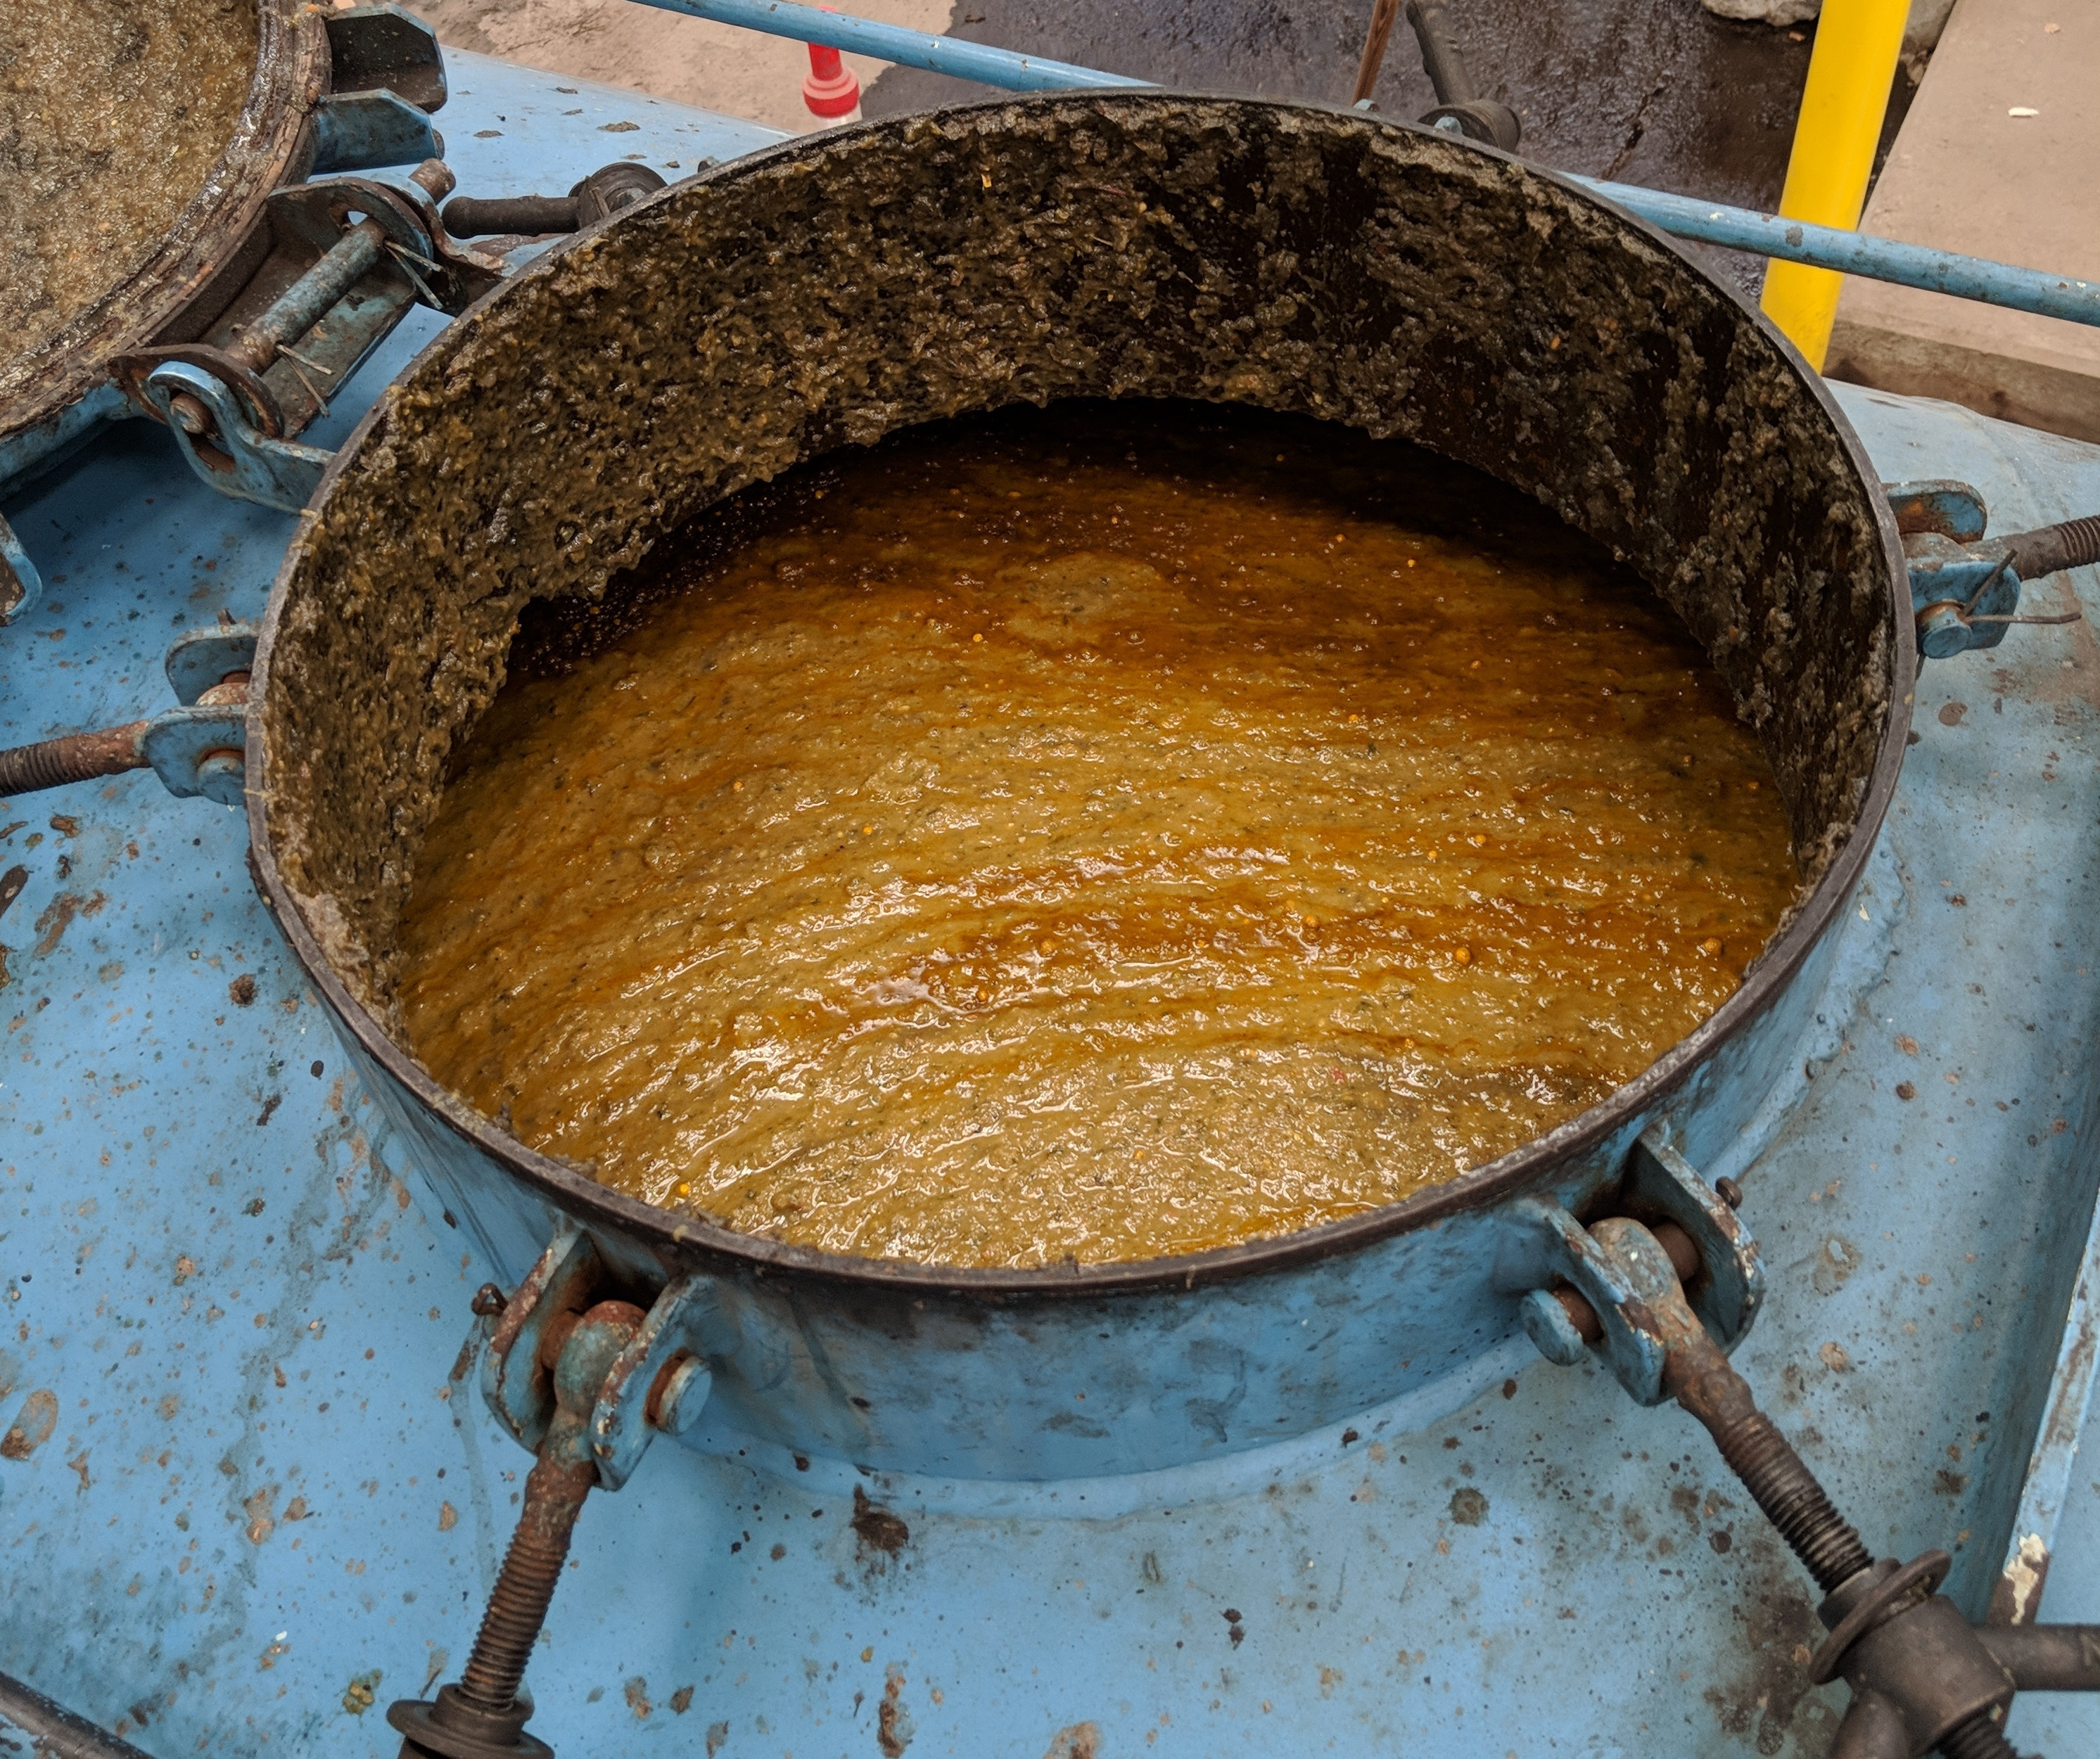
Steps to Diversion of Food Waste
Collection & Delivery
Gas
Cleanup
Energy
Project
Digester
Slurry

Slide 3
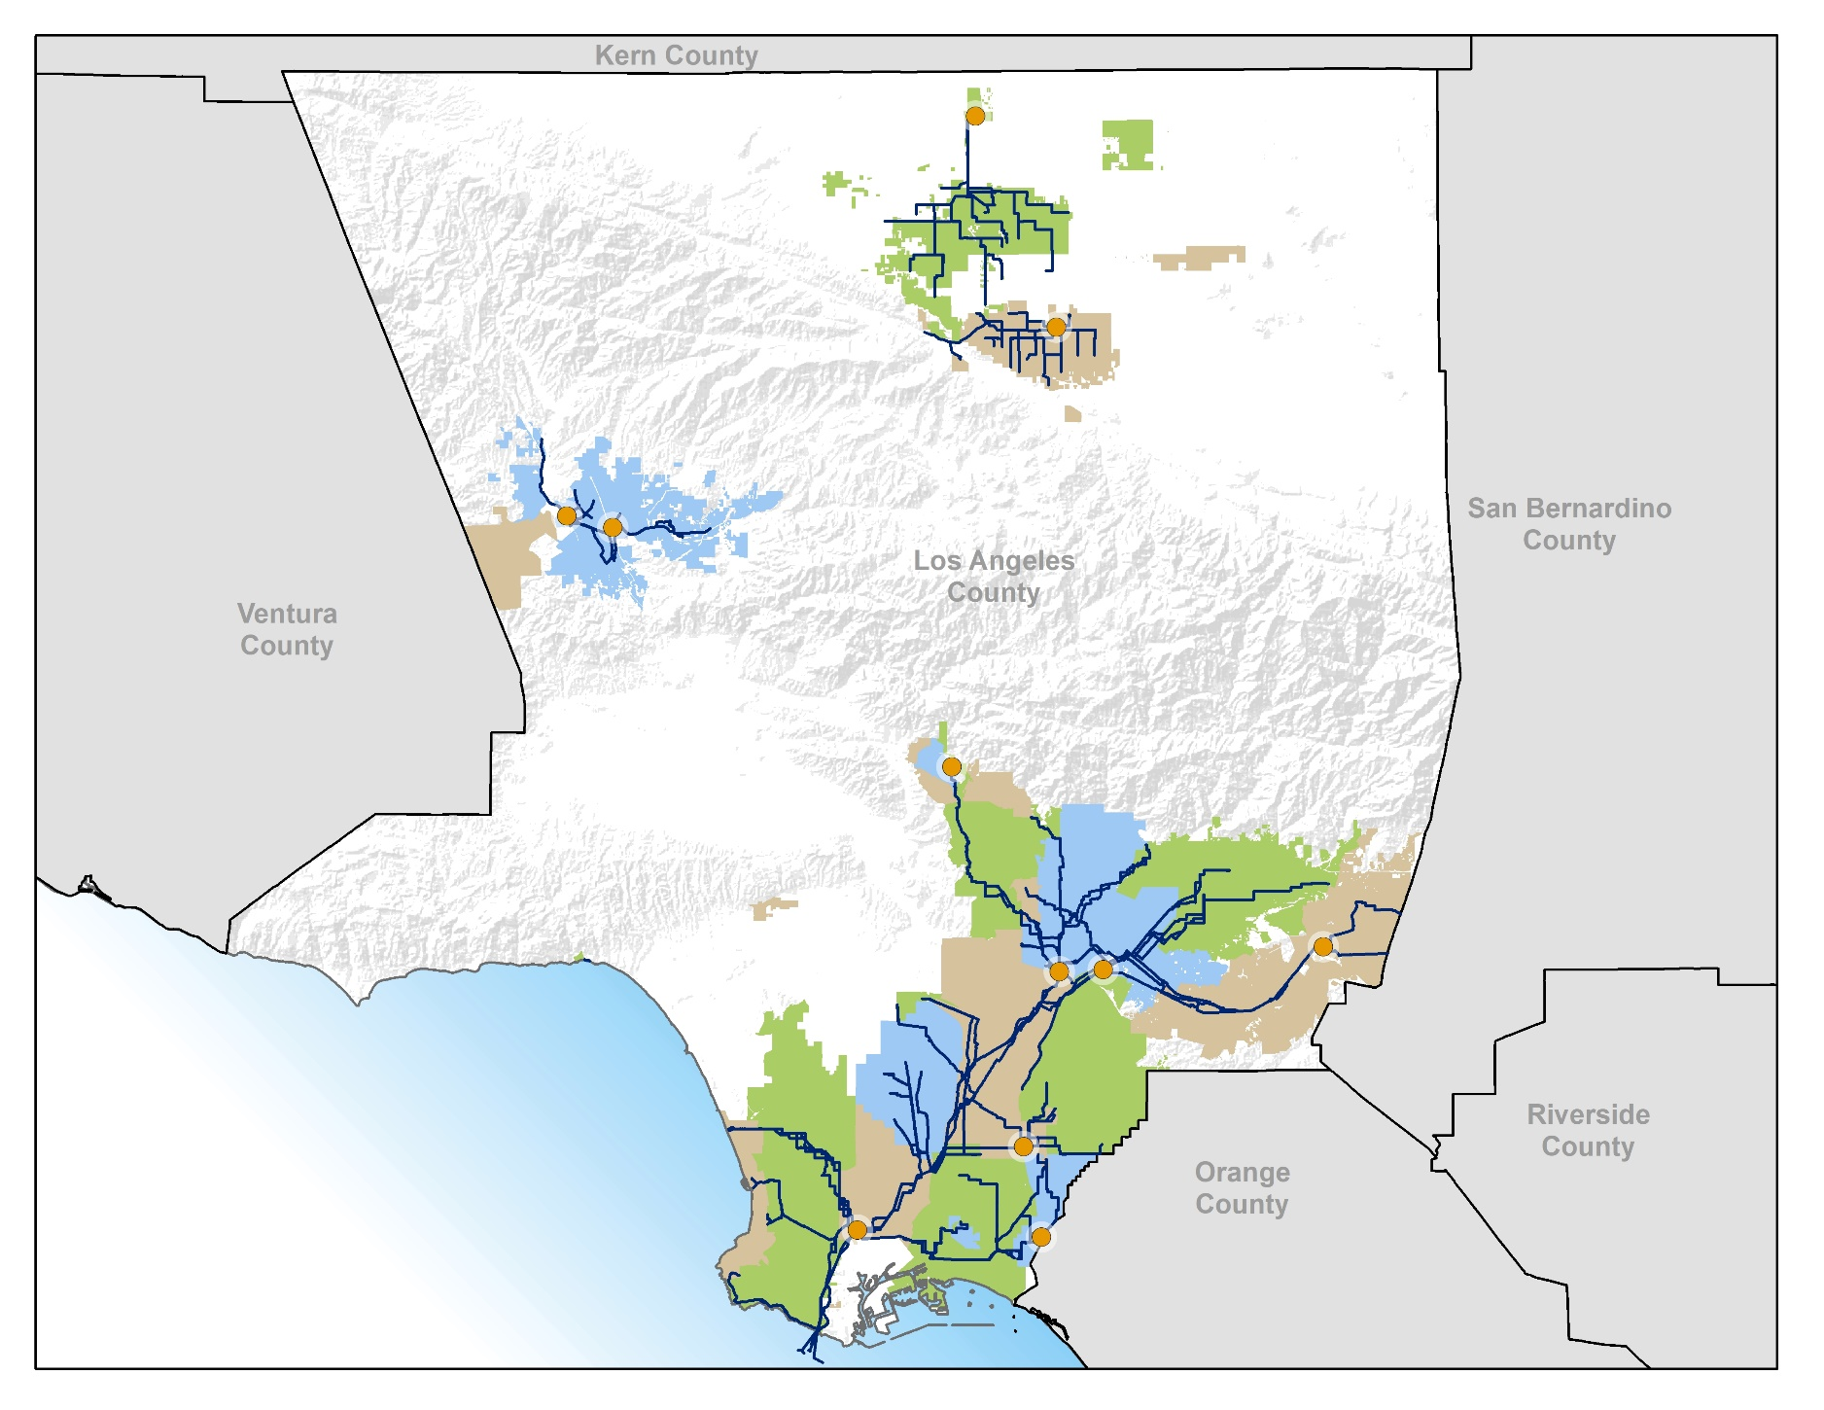
Districts’ Wastewater &
Solid Waste Facilities
Wastewater Treatment Facility
Materials Recovery Facility
JWPCP

Slide 4
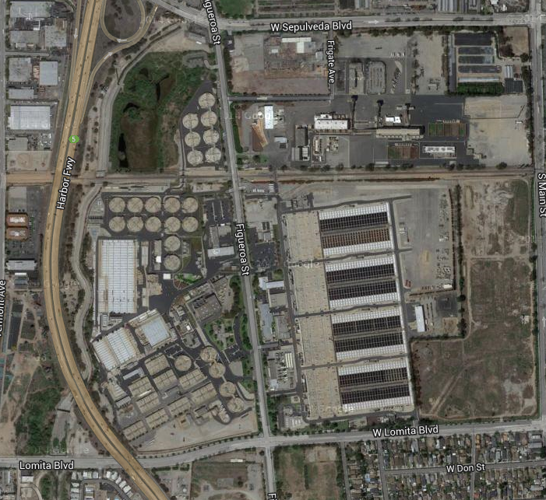
Joint Water Pollution Control Plant in Carson
Natural Gas Vehicle Public Fueling Station
N
24 Anaerobic Digesters (3.7M gallons each)
20 MW Digester Gas-to-Energy Facility

Slide 5
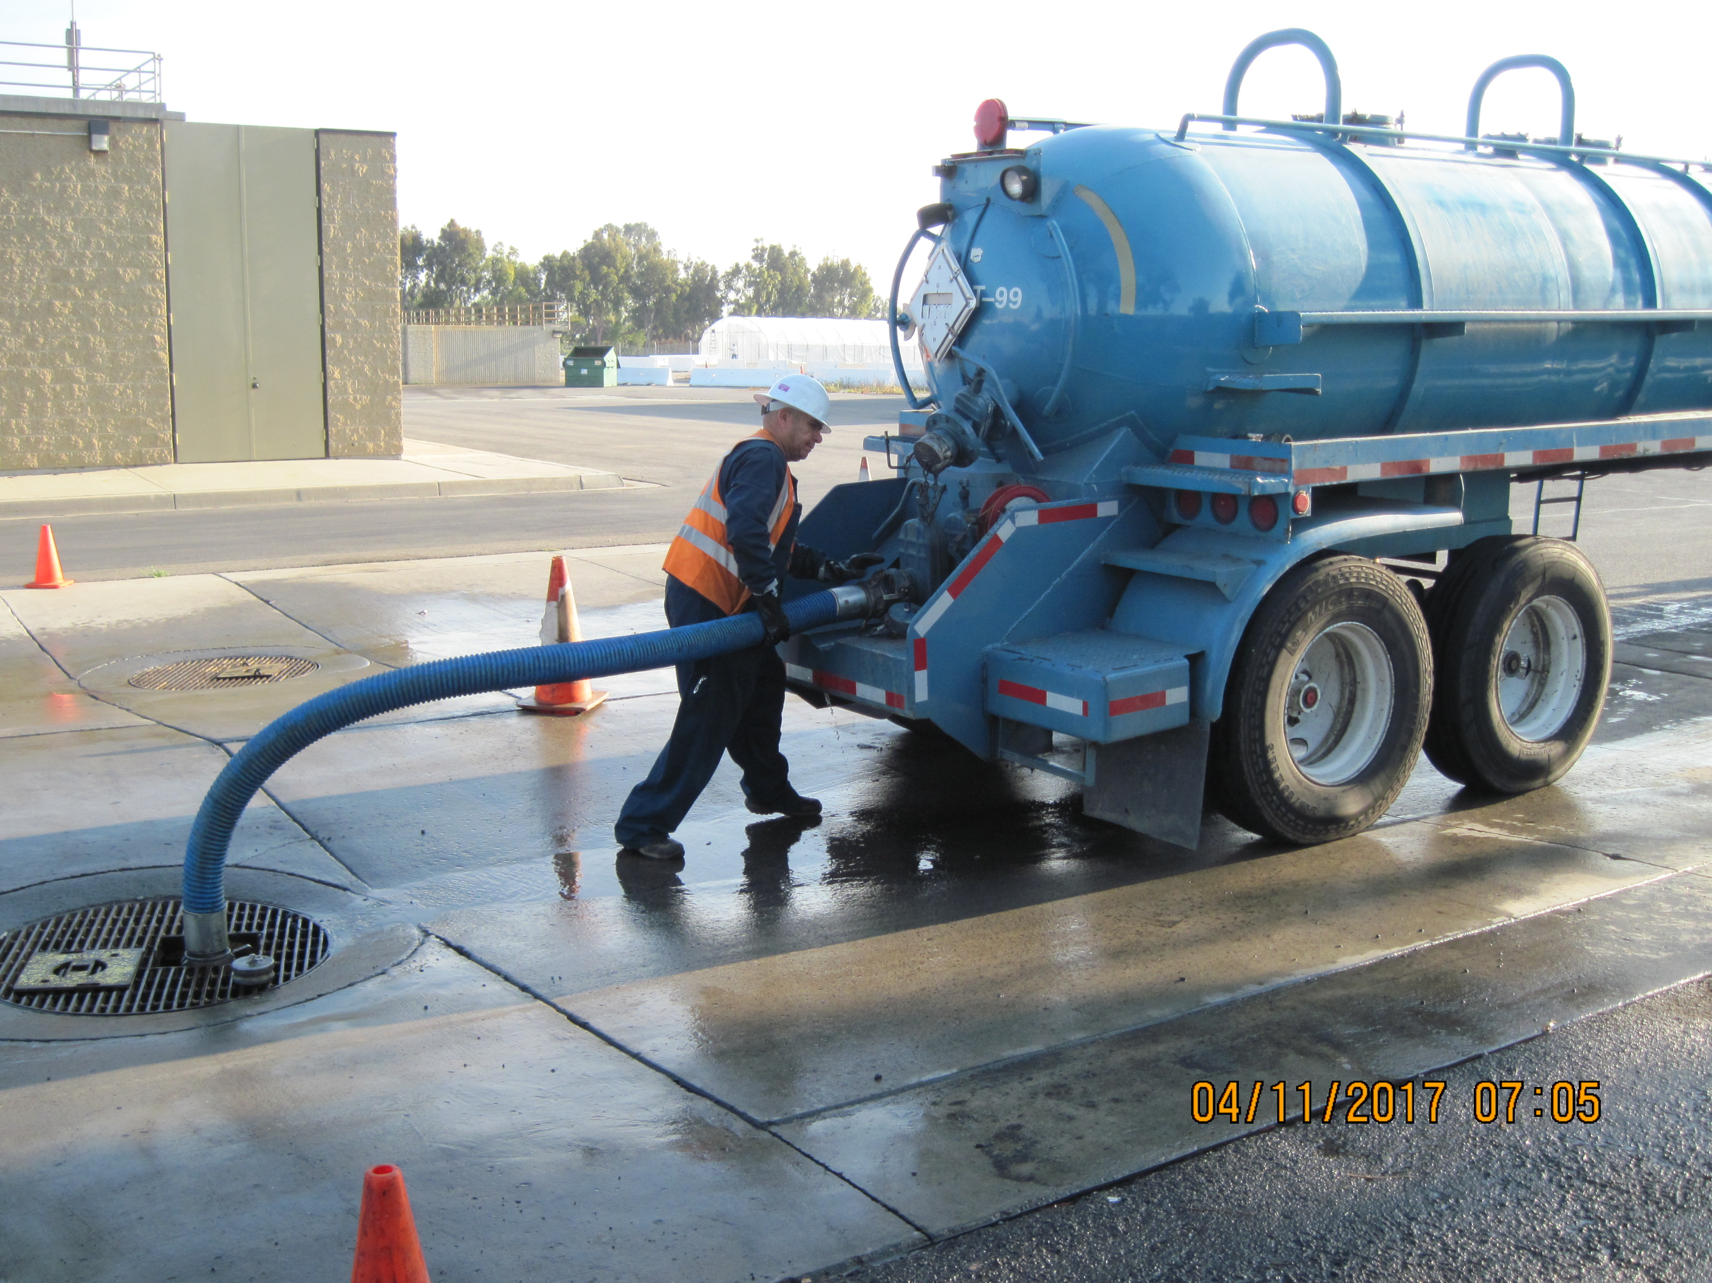
For Now, Feeding Food Waste at Treatment Plant Headworks
JWPCP Liquid Waste Disposal Station

Slide 6
Food Waste Slurry Received at JWPCP
Supplied by 8 contracts plus PHMRF

Slide 7
Infrastructure Development Projects
DODA Pre-Processing Facility (Slurry - PHMRF)
Slurry Receiving Facilities (JWPCP)
Biogas Conveyance Pipelines (JWPCP)
Biogas Conditioning System 1 (JWPCP)

Slide 8
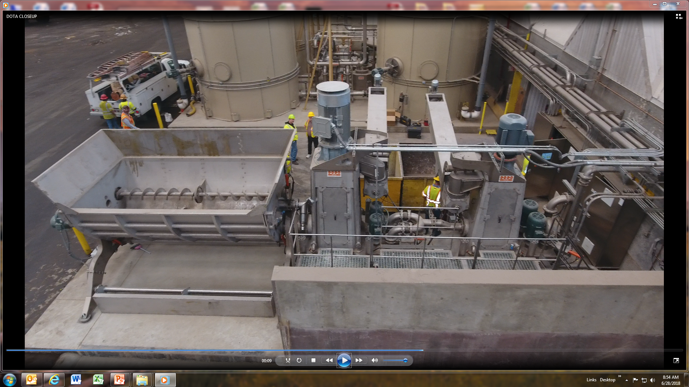
DODA Pre-Processing Facility
Cost: $1.9 Million
Completed: April 2018
Primary Bioeparator
Secondary Bioeparator
Feed Hopper
Currently accepting source-separated food waste
System can process up to 160 tons per day
Utilizes District’s renewable electricity and reclaimed water to produce Slurry

Slide 9
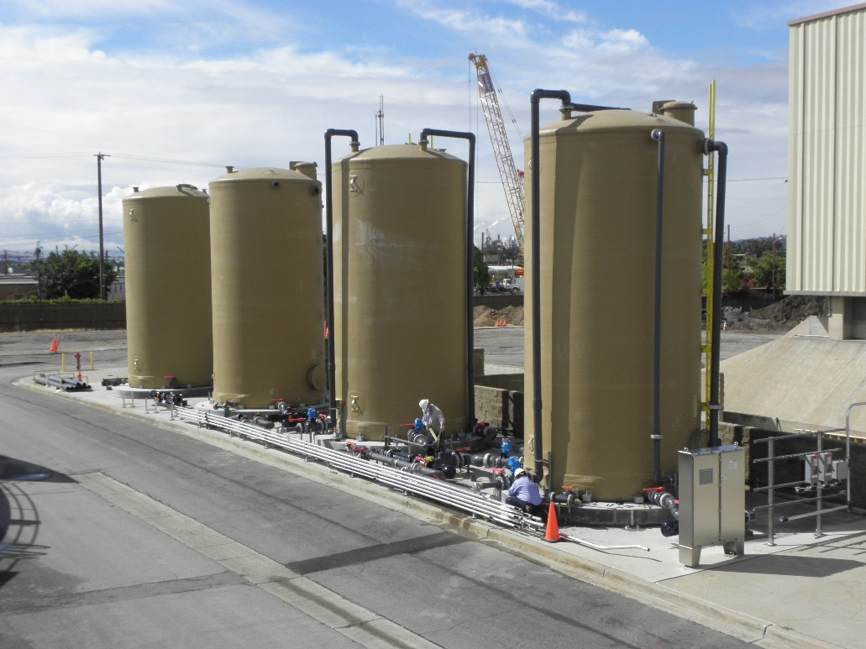
Slurry Receiving Facilities
Cost: $3 Million
Target Completion: Aug/Oct 2020
Original design was for one large station at a cost of $9M
Updated design is simplified and split into two smaller stations
  SRF 1: 2 Digesters / 166 TPD
  SRF 2: 3 Digesters / 249 TPD
Total: 5 Digesters / 415 TPD
Designed/Built in-house

Slide 10
Biogas Conveyance Pipelines
Cost: $2.4 Million
Target Completion: August 2020
2,800 ft of new HDPE Pipe
  18” Ø Supply Line
  12” Ø Tail Gas Line
BCS

Slide 11
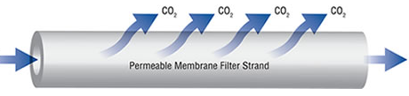
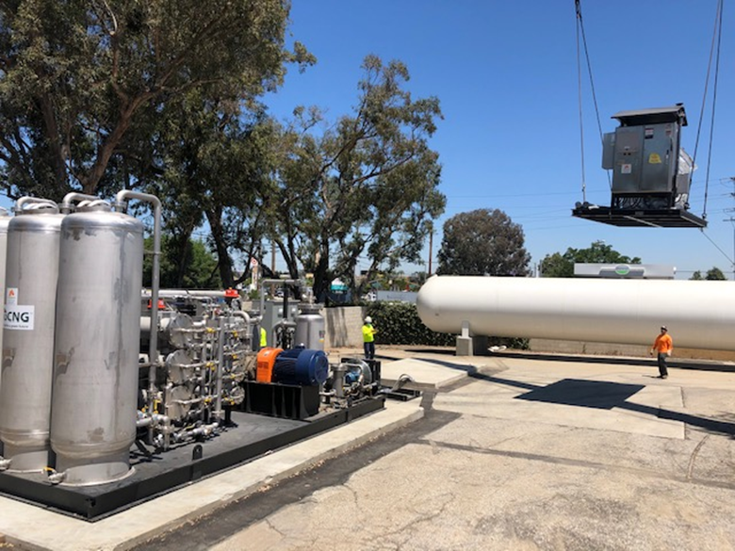
Biogas Conditioning System 1
Cost: $3.1 Million
Target Completion: August 2020
Biogas
62% CH₄
RNG
90% CH₄
Design-build contract with TetraTech
Convert up to 400 scfm of digester gas into 2,000 GGEs of RNG as vehicle fuel
Single-pass membrane filtration
Utilize existing District-owned fueling station

Slide 12
Capital Costs & Grants

Slide 13
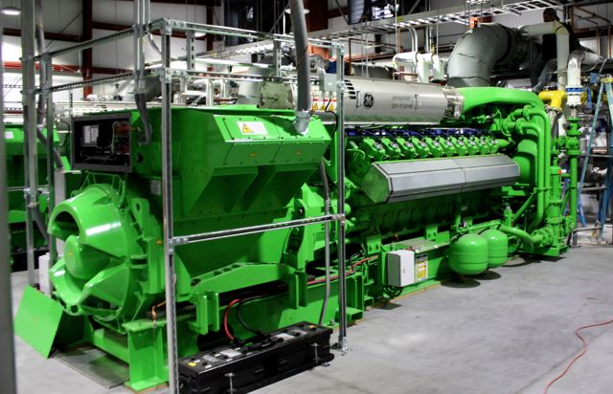
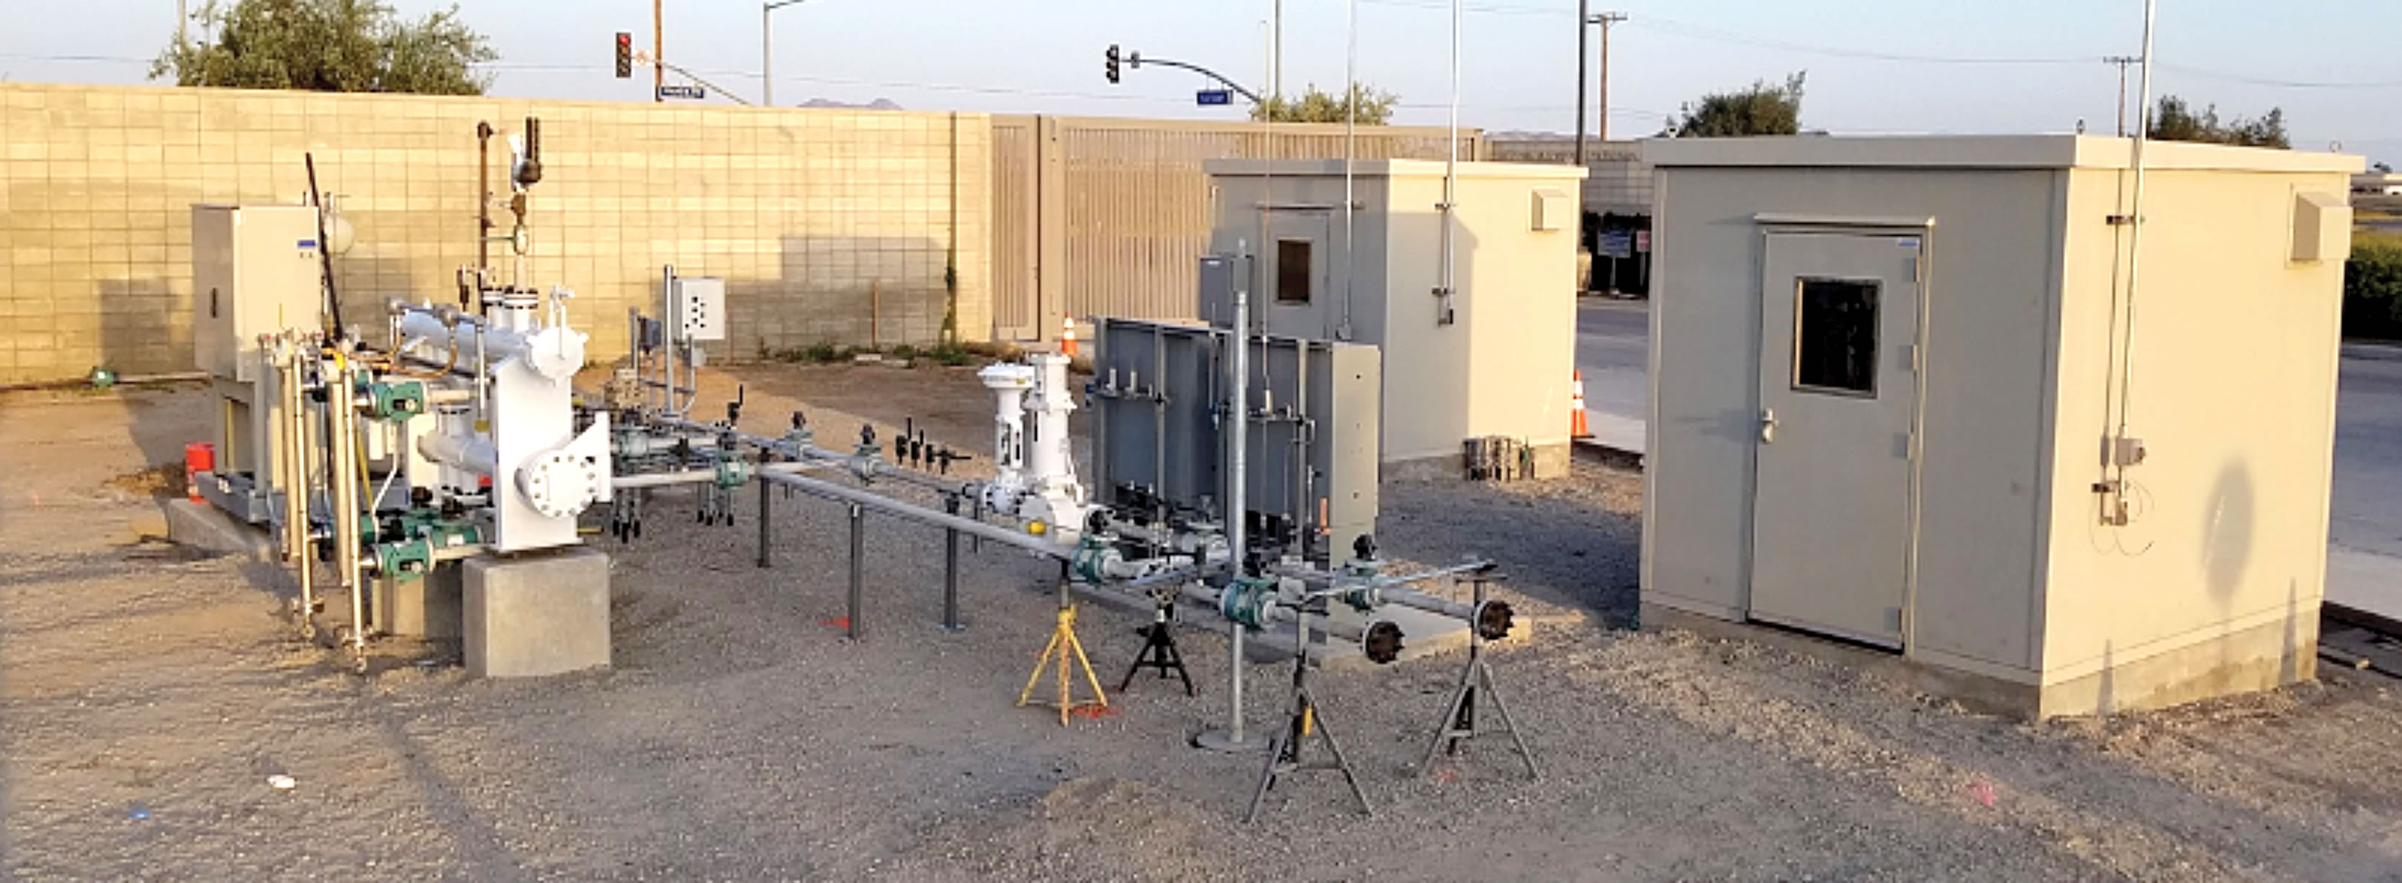
Phase 2 Energy Recovery
Potential technologies and options
  Pipeline Injection ($8.7 million)
  Power Generation ($9.3 million)
  Additional RNG for Vehicle Fuel ($8.4 million)
Considerations:
  Market Risk (including food waste supply)
  Capital Investment (including grants)
  Operational Costs
  Utility Interconnection
  Permitting Requirements

