Slide 1
Infrastructure LA
Sustainable Waste and Recycling Management
Thank you for joining us the meeting will start in a few moments
REMINDERS
Please mute your line during the call
There will be a Q&A session at the end of the meeting
Use the chat feature to ask questions and comments
You can also raise your hand during the Q&A and we will call on you to unmute and share
The meeting is scheduled for one hour

Slide 2
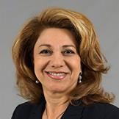
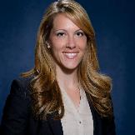
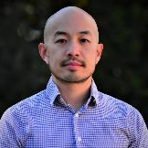
Infrastructure LA
Sustainable Waste and Recycling Management
  Shari Afshari
  Deputy Director
  LA County Public Works
  SAfshari@pw.lacounty.gov
  Faith Conley
  Legislative Representative
  County of Los Angeles
  FConley@ceo.lacounty.gov
  Will Chen P.E., BCEE
  Supervising Engineer
  Solid Waste Energy Recovery
  Los Angeles County Sanitation Districts
  WChen@lacsd.org

Slide 3
FOOD WASTE PROGRAM UPDATE
Will Chen P.E., BCEE
Supervising Engineer
Solid Waste Energy Recovery
December 3, 2020

Slide 4
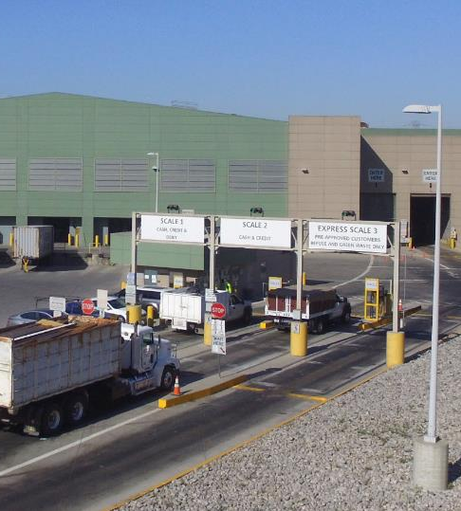
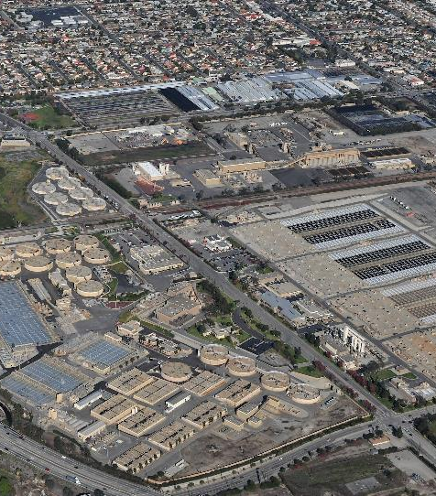
Our food waste program can help cities/businesses.
9
Puente Hills Materials Recovery Facility
Joint Water Pollution Control Plant

Slide 5
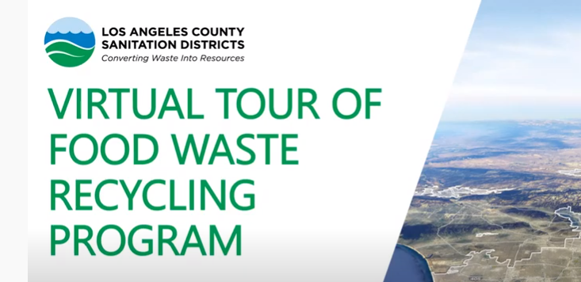
www.youtube.com/watch?v=cCBXhY06oCw
9

Slide 6
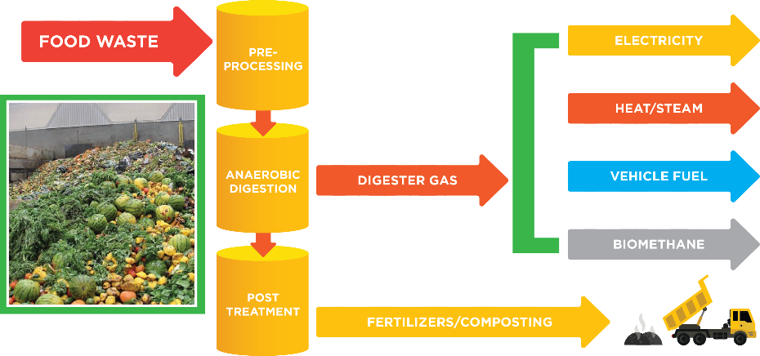
Our recycling program has several steps.
Notes:
22

Slide 7
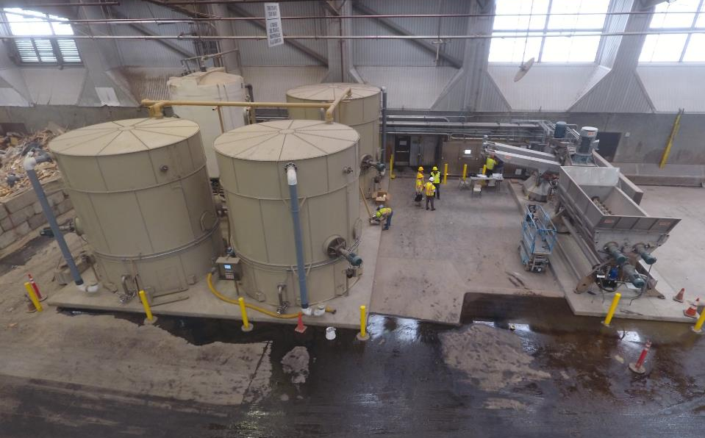
30 tons/day of food waste is processed at PHMRF.
30 tons/day of food waste is slurried at PHMRF.

Slide 8
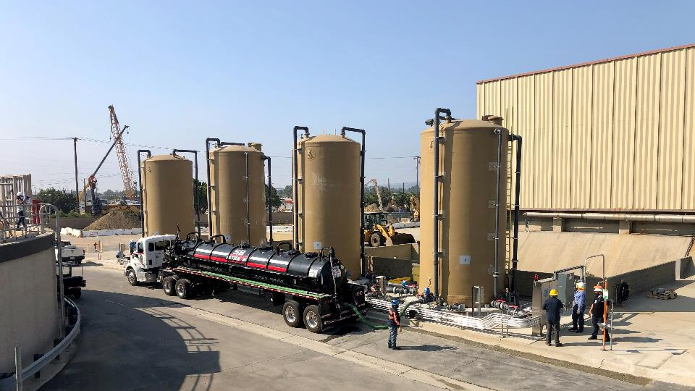

Slurried food waste is then delivered to JWPCP.
Notes:
22

Slide 10
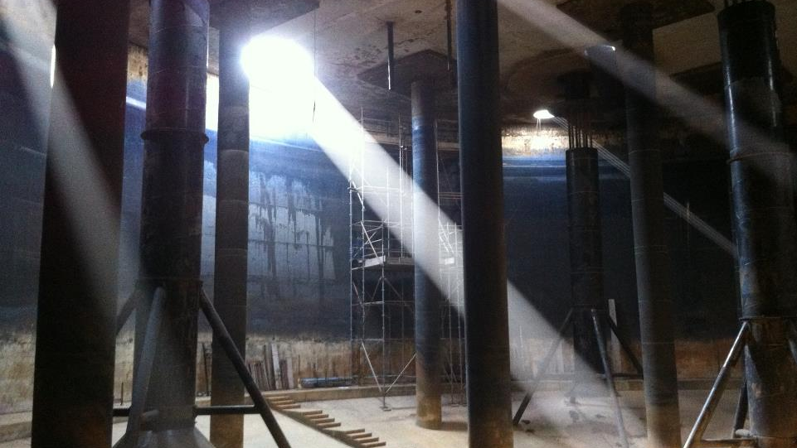
Food waste and wastewater solids are digested.

Slide 11
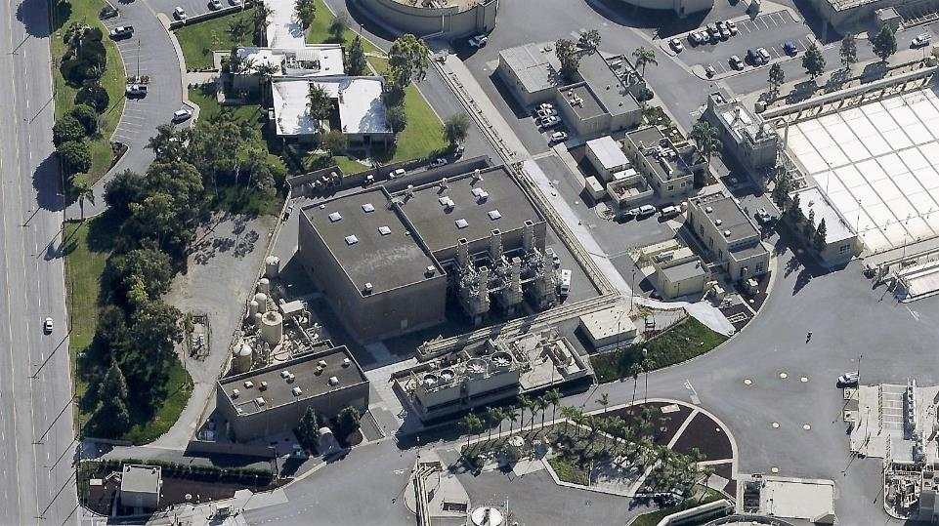

Our power plant produces 20 MW of energy.
20 MW
Enough for 20,000 homes

Slide 12
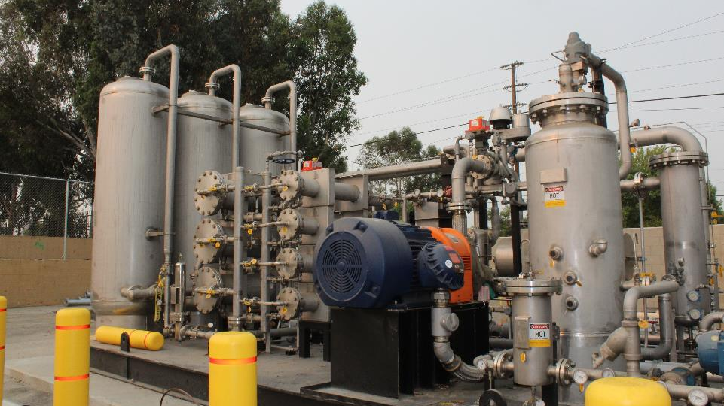
The biogas is refined.

Slide 13
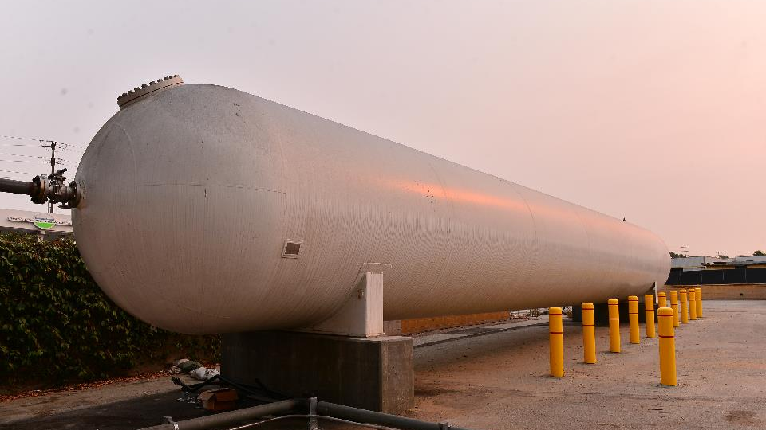
Renewable natural gas is stored.

Slide 14
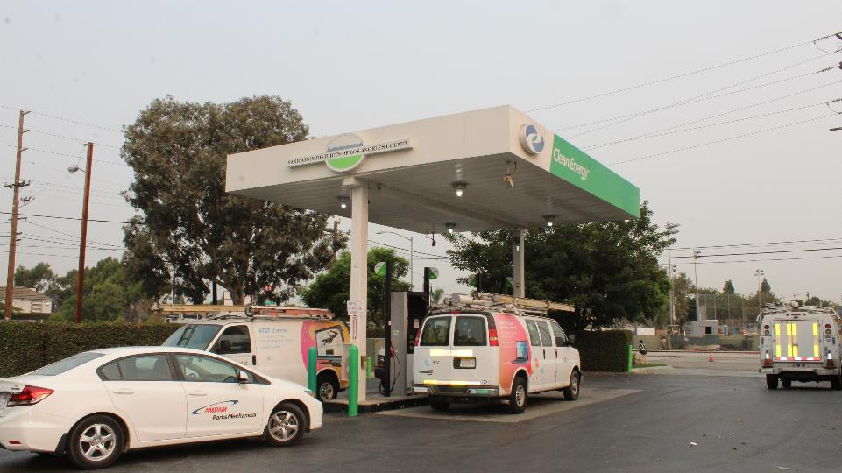
It will supply our existing fueling station.

Slide 15








We’re processing about 300 tons/day of slurry.
Notes:
22

Slide 16
Today’s Program Status
We are receiving and recycling processed and unprocessed food waste.
We have 600 tpd capacity today with low, competitive rates.
Source separated food waste at Puente Hills MRF, tipping fee $70/ton. No contract required.
Processed slurry in Carson at JWPCP, $27/ton slurry. Contract required.
Seeking long term contracts that can provide us certainty to build out our infrastructure and provide cities certainty of an outlet

Slide 17
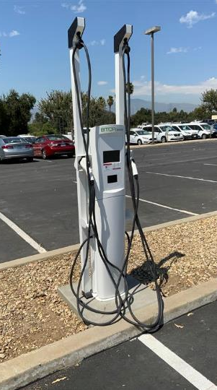


Phase II Biogas Project currently being evaluated
Generation of electricity
Vehicle fuel
Injection into natural gas pipelines

Slide 18
For more information:
William Chen, Supervising Engineer
562-908-4288 ext. 2431; wchen@lacsd.org
www.lacsd.org/foodwaste

Slide 19
Infrastructure LA
Sustainable Waste and Recycling Management
  Shari Afshari
  Deputy Director
  LA County Public Works
  SAfshari@pw.lacounty.gov
  Faith Conley
  Legislative Representative
  County of Los Angeles
  FConley@ceo.lacounty.gov
  Will Chen P.E., BCEE
  Supervising Engineer
  Solid Waste Energy Recovery
  Los Angeles County Sanitation Districts
  WChen@lacsd.org

Slide 20
Infrastructure LA
Thank you for joining today’s call!
For more information on Infrastructure LA and to sign up for email updates about future calls visit the website at: www.infrastructurela.org
Email: InfrastructureLA@pw.lacounty.gov

