Slide 1
Infrastructure LA Sustainable Waste and Recycling Management
Thank you for joining us the meeting will start in a few moments
REMINDERS
Please mute your line during the call
There will be Q&A opportunities during the meeting
Use the chat feature to ask questions and comments
You can also raise your hand during the Q&A and we will call on you to unmute and share
The meeting is scheduled for one hour

Slide 2
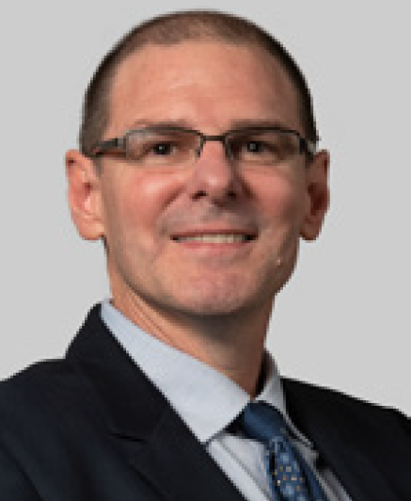
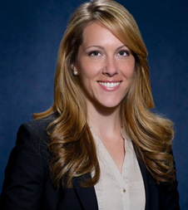
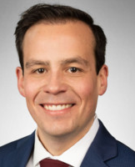
Infrastructure LA Sustainable Waste and Recycling Management
Legislative Update and SB 1383 Capacity Planning
Keith Lilley
Deputy Director
LA County Public Works
KLilley@pw.lacounty.gov
Faith Conley
Legislative Representative
County of Los Angeles
FConley@ceo.lacounty.gov
Derek Dolfie
Legislative Representative
CA League of Cities
DDolfie@cacities.org

Slide 3
SWARM March Subcommittee Meeting
Los Angeles County SB 1383 Capacity Planning

Slide 4
Overview
SB 1383 Letter to jurisdictions on Organics Capacity Planning
https://infrastructurela.org/wp-content/uploads/2021/03/SB-1383-Letter-to-Cities-and-Enclosures.pdf
Current state of organic waste in Los Angeles County
Requirements of SB 1383 regulations
Collaboration with cities to meet SB 1383 requirements

Slide 5
How Much Organic Waste is Disposed?
Waste Stream | Amount of Organic Waste (tons)
Generation | 6.8 million
Disposal | 5.4 million
Diversion | 1.4 million

Slide 6
How Much Organics Capacity is There In LA?
Maximum Potentially Available Capacity ≈ 479,000 tons/year
Facility/Operation Type | Potentially Available* Organics Capacity (tons per year)
Composting | ≈ 235,000
Chip and Grinding | ≈ 225,000
Anaerobic Digestion/ Co-Digestion | ≈ 19,000
*Available capacity is rounded to the nearest 1,000 and is based on survey responses received from facility operators.
In-County

Slide 7
How Much Organics Capacity is There Outside of LA?
Maximum Potentially Available Capacity ≈ 4.7M tons/year
Facility/Operation Type | Potentially Available* Organics Capacity (tons per year)
Composting | ≈ 4.1 million
Chip and Grinding | ≈ 618,000
Anaerobic Digestion/ Co-Digestion | ≈ 31,000
*Available capacity is rounded to the nearest 1,000 and is based on survey responses received from facility operators.
Out-of-County

Slide 8
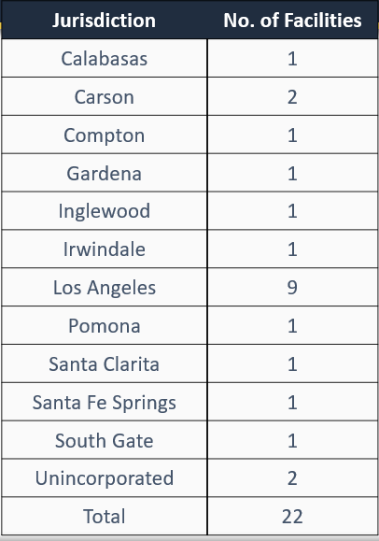
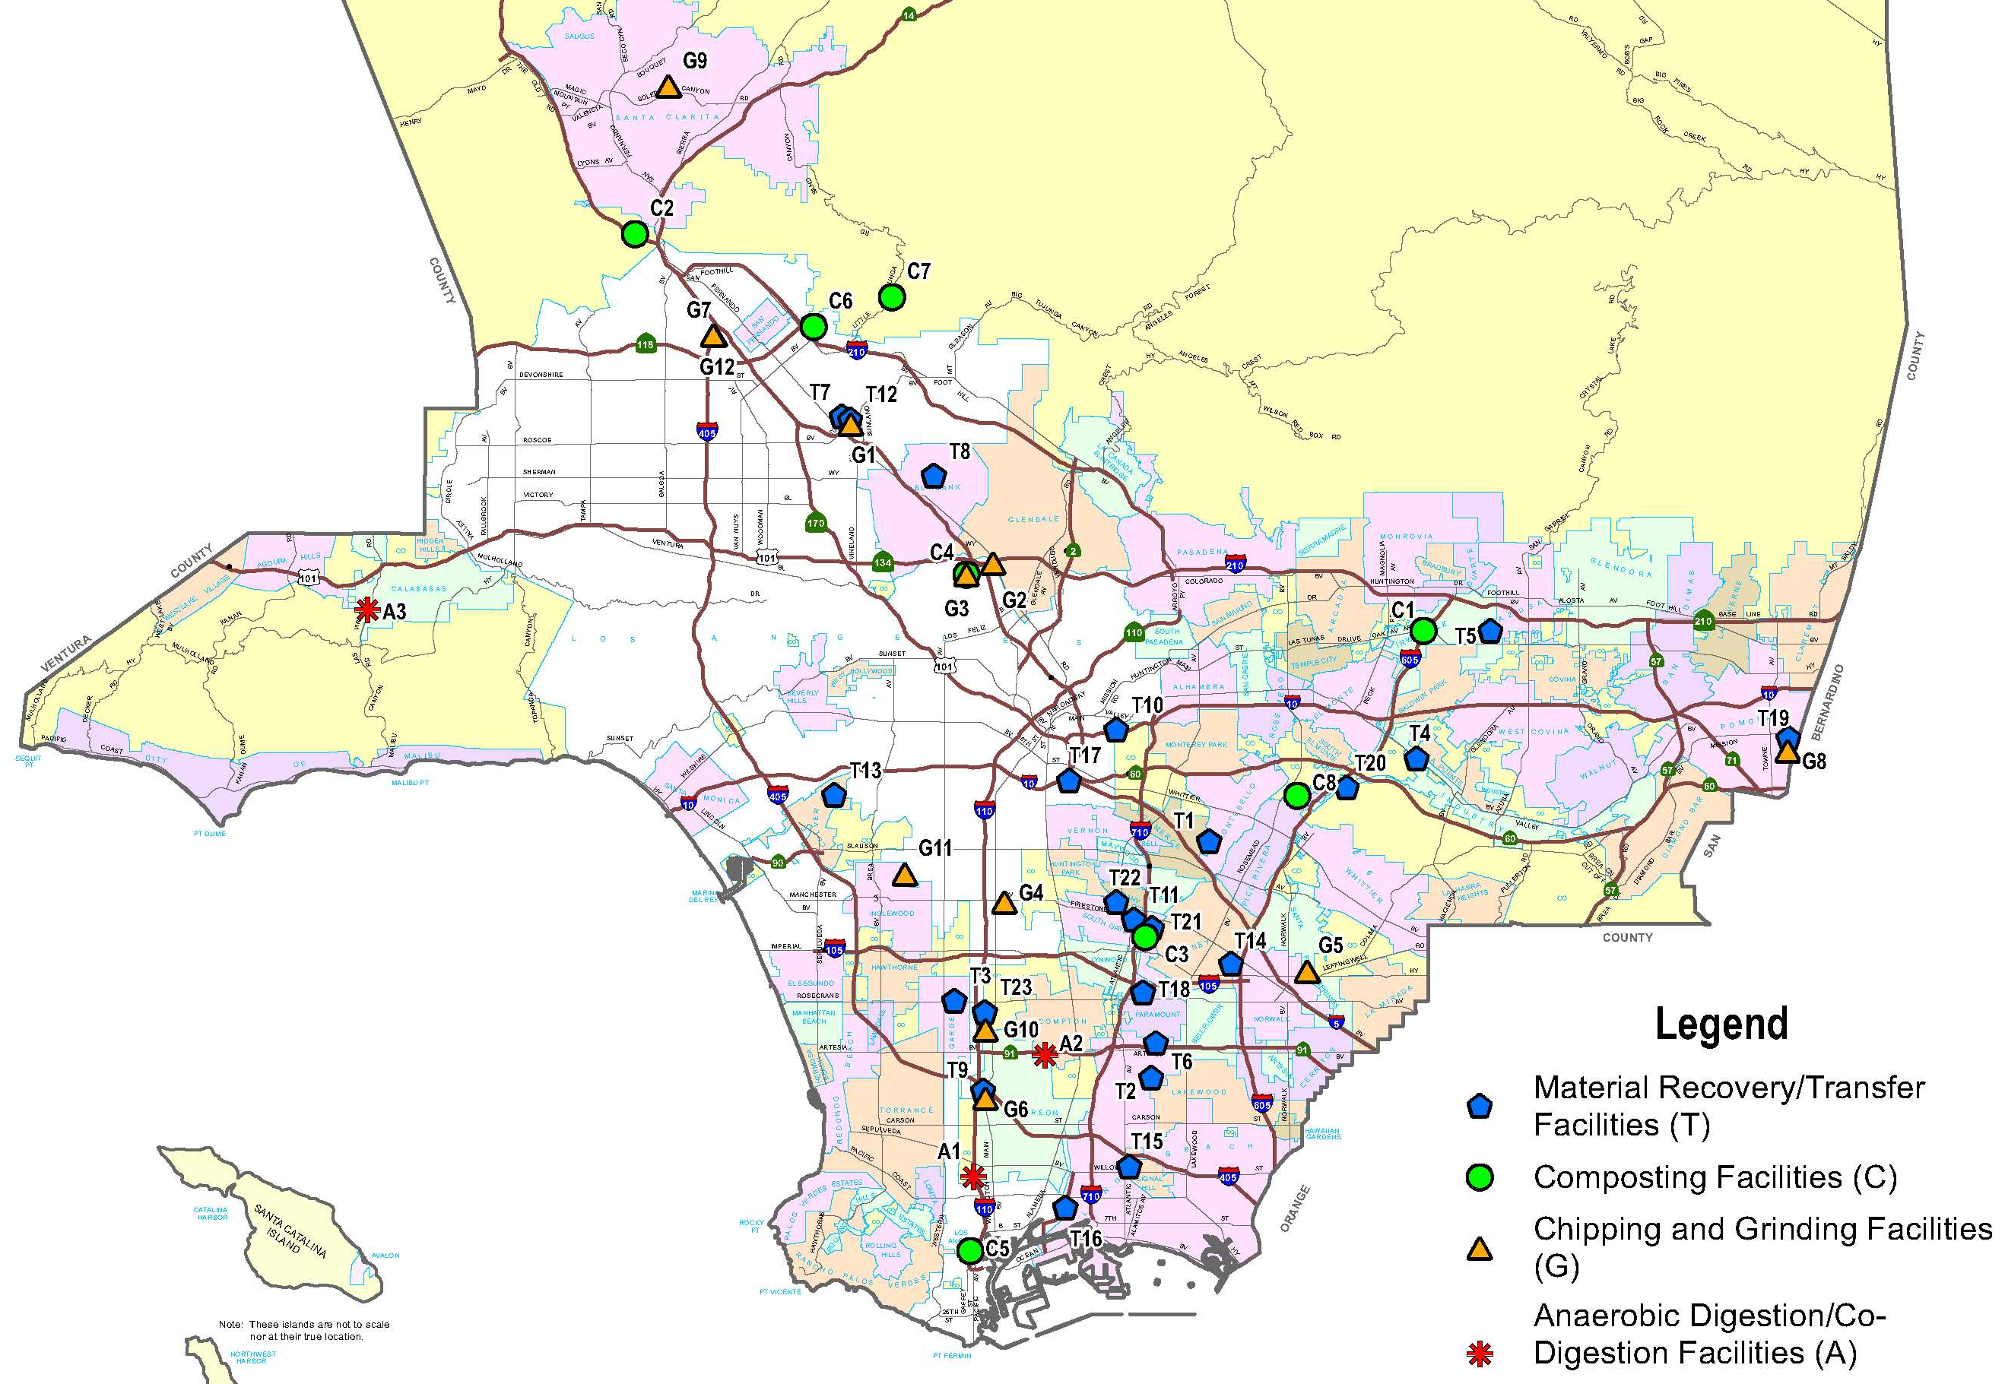
Where are Organics Processing Facilities Located?
Link to Report with Map: https://pw.lacounty.gov/epd/swims/ShowDoc.aspx?id=14371&hp=yes&type=PDF

Slide 9
Request for Information Survey For Organic Waste Processing Capacity
Public Works recently released a Request for Information (RFI) to gather information on existing and planned organic infrastructure.
The RFI (BRC0000249) with specifications and instructions for preparing and submitting a response may be accessed at the following link: http://dpw.lacounty.gov/brcd/servicecontracts/
The deadline to submit responses is Tuesday, April 6, 2021, by 5:30 p.m.
For questions, contact:
Mr. David Pang at (626) 458-7167 or dpang@pw.lacounty.gov
Mr. Danny Medina at (626) 458-4080 or dmedina@pw.lacounty.gov

Slide 10
How Much More Capacity Do We Need?
Total Additional Organic Waste Capacity Needed* ≈ 5.1 million tons
Material Type | Additional Capacity Needed* (tons per year)
Food | 1.55 million
Green Waste (includes Landscape & Pruning) | 386,000
Wood | 1.02 million
*This capacity is what is needed in-County, in order to divert what is currently being sent to landfills.

Slide 11
Senate Bill 1383 - Section 18992.1
Organic Waste Recycling Capacity Planning
The County will work collaboratively with each City to:
Estimate the amount of organic waste that will be disposed
Identify existing organic waste recycling infrastructure capacity that is verifiably available
Estimate the amount of new or expanded organic waste recycling capacity needed

Slide 12
Senate Bill 1383 - Section 18992.2
Edible Food Recovery Capacity Planning
The County will work collaboratively with each City to:
Estimate the amount of edible food that will be disposed by Tier 1 and 2 commercial edible food generators
Identify existing capacity at food recovery organizations and services
Identify proposed new or expanded food recovery organizations and services that will be used
Identify, if any, the amount of new or expanded capacity needed

Slide 13
Plans to Work with the Cities
Collaboration Activity | Timeline
Letter to Cities explaining SB 1383 capacity planning requirements | February 2021
SB 1383 capacity planning kick-off meeting with CalRecycle as guest speaker | April 2021
Meetings/workshops with Cities to introduce database for submitting capacity information | April 2021 – September 2021
Provide template survey for Cities to provide to local community composters | July 2021

Slide 14
Plans to Work with the Cities
Collaboration Activity | Timeline
If new or expanded facilities are being proposed within a City, begin to discuss strategies for community outreach within that City. | July 2021 – September 2021
Roll out new database for organic waste capacity data collection | September 2021
Begin community outreach in communities where new or expanded facilities are being proposed | October 2021

Slide 15
Plans to Work with the Cities
Collaboration Activity | Timeline
Cities submit organics capacity data and community composting surveys to the County | March 2022
If a City has insufficient capacity, County notifies the City that it must submit an Implementation Schedule to CalRecycle | No later than August 1, 2022
Cities must submit Implementation Schedule to CalRecycle | 120 days after being notified

Slide 16
Timeline for Reporting Organic Waste Capacities to CalRecycle
The County will report to CalRecycle, on behalf of the Cities, on the following dates:
On August 1, 2022 for the planning period of January 1, 2022 - December 31, 2024
On August 1, 2024 for the planning period of January 1, 2025 - December 31, 2034
On August 1, 2029 for the planning period of January 1, 2030 - December 31, 2039
On August 1, 2034 for the planning period of January 1, 2035 - December 31, 2044

Slide 17
Questions & Discussion
Contact Information:
Chris Sheppard
CSHEPPARD@pw.lacounty.gov
Martins Aiyetiwa
MAIYET@pw.lacounty.gov
Charles Darensbourg
CDARENSBOURG@pw.lacounty.gov

Slide 18
Infrastructure LA Sustainable Waste and Recycling Management
Legislative Update and SB 1383 Capacity Planning
Keith Lilley
Deputy Director
LA County Public Works
KLilley@pw.lacounty.gov
Faith Conley
Legislative Representative
County of Los Angeles
FConley@ceo.lacounty.gov
Derek Dolfie
Legislative Representative
CA League of Cities
DDolfie@cacities.org

Slide 19
Infrastructure LA
Thank you for joining today’s call!
For more information on Infrastructure LA and to sign up for email updates about future calls visit the website at: www.infrastructurela.org
Email: InfrastructureLA@pw.lacounty.gov

