Slide 1
Infrastructure LA Sustainable Waste and Recycling Management
Thank you for joining us the meeting will start in a few moments
REMINDERS
Please mute your line during the call
There will be a Q&A session at the end of the meeting
Use the chat feature to ask questions and comments
You can also raise your hand during the Q&A and we will call on you to unmute and share
The meeting is scheduled for one hour

Slide 2
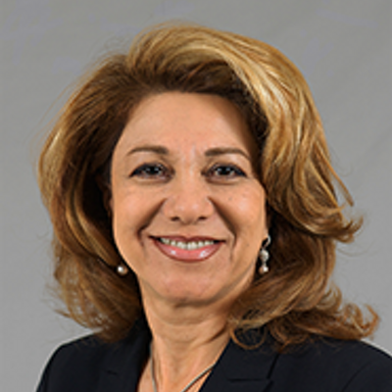
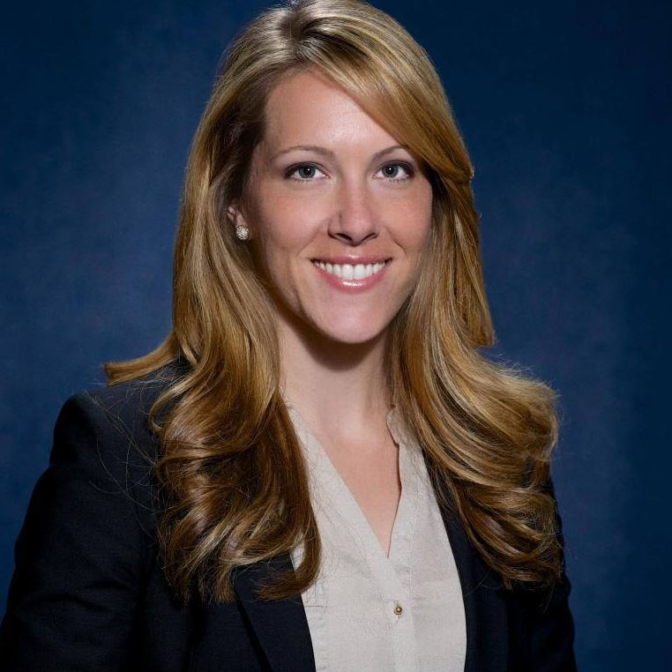
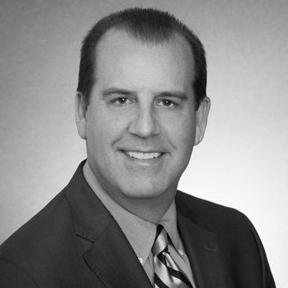
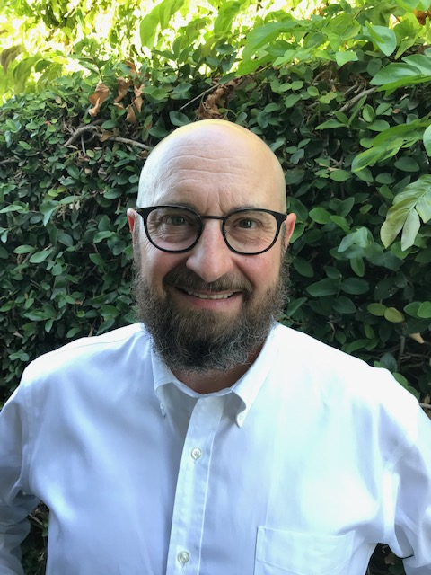
Infrastructure LA Sustainable Waste and Recycling Management
Challenges to Compliance and Regulatory Relief
Shari Afshari
Deputy Director
LA County Public Works
SAfshari@pw.lacounty.gov
Faith Conley
Legislative Representative
County of Los Angeles
FConley@ceo.lacounty.gov
Kelly Astor
General Counsel to Los Angeles County Waste Management Association
JKA@Astor-Kingsland.com
Bob Asgian
Department Head,
Solid Waste Management
LA County Sanitation Districts
RAsgian@lacsd.org

Slide 3
Infrastructure LA
Thank you for joining today’s call!
For more information on Infrastructure LA and to sign up for email updates about future calls visit the website at: www.infrastructurela.org
Email: InfrastructureLA@pw.lacounty.gov

