Slide 1
Infrastructure LA
Sustainable Waste and Recycling Management
Thank you for joining us the meeting will start in a few moments
REMINDERS
Please mute your line during the call
There will be a Q&A session at the end of the meeting
Use the chat feature to ask questions and comments
You can also raise your hand during the Q&A and we will call on you to unmute and share
The meeting is scheduled for one hour

Slide 2
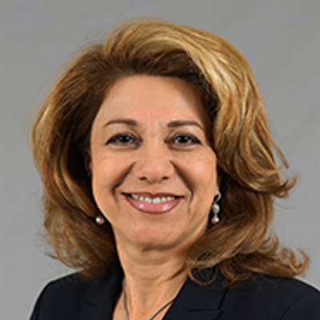
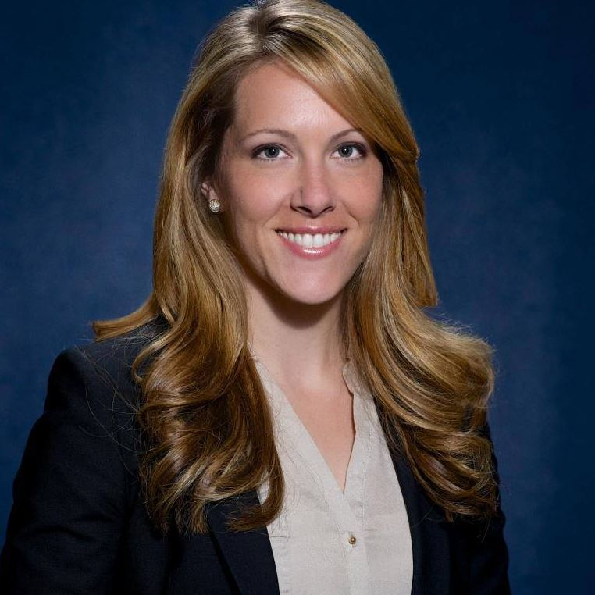
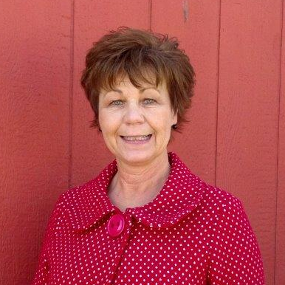
Infrastructure LA
Sustainable Waste and Recycling Management
  Shari Afshari
  Deputy Director
  LA County Public Works
  SAfshari@pw.lacounty.gov
  Faith Conley
  Legislative Representative
  County of Los Angeles
  FConley@ceo.lacounty.gov
  Kim Braun
  Environmental Programs & Operations Manager
  City of Culver
  Kim.Braun@culvercity.org

Slide 3
Landfill Diet
City of Culver City
Presented by: Kim Braun

Slide 4
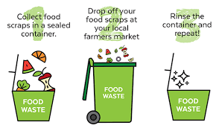
1.1 County Food Waste Drop Off Center
Challenges:
Food Waste needs supervision
Limited capacity
If drop off is allowed during after hours or at night = High probability of contamination
High contamination = increased disposal costs

Slide 5
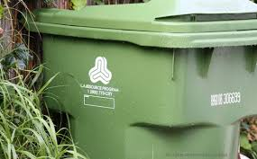
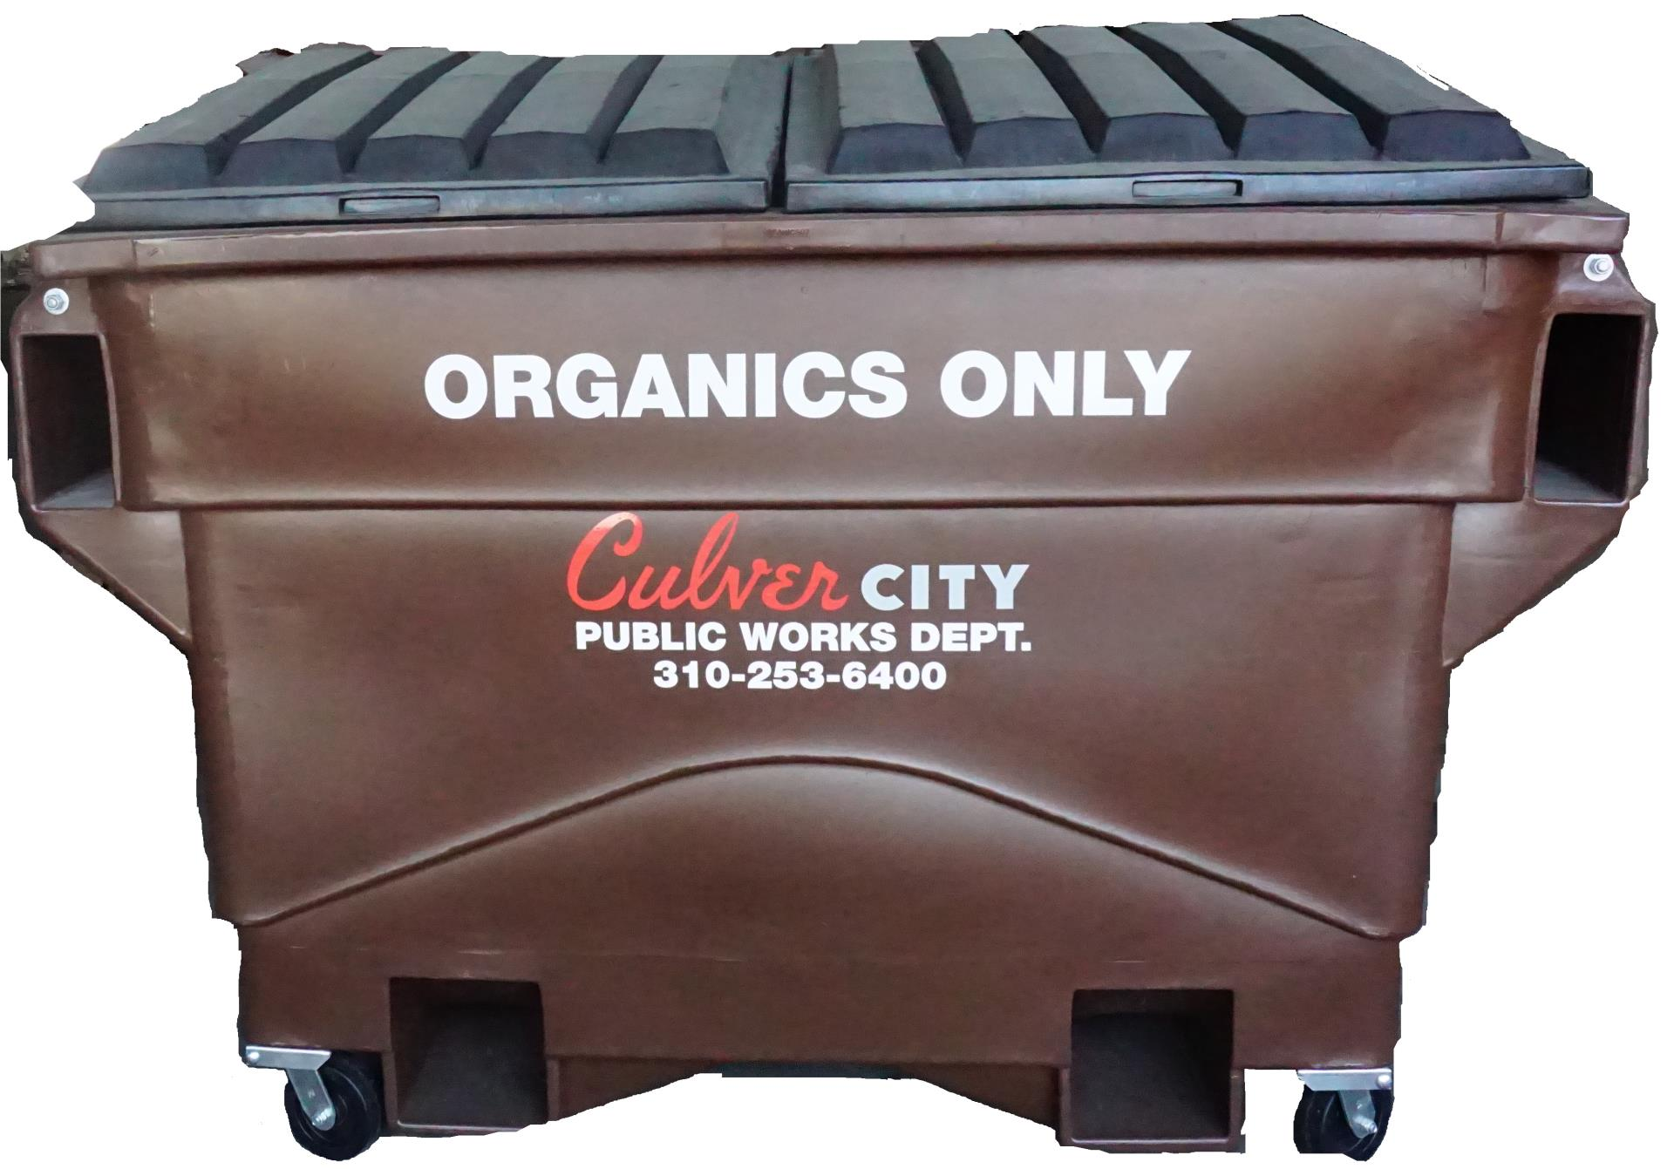
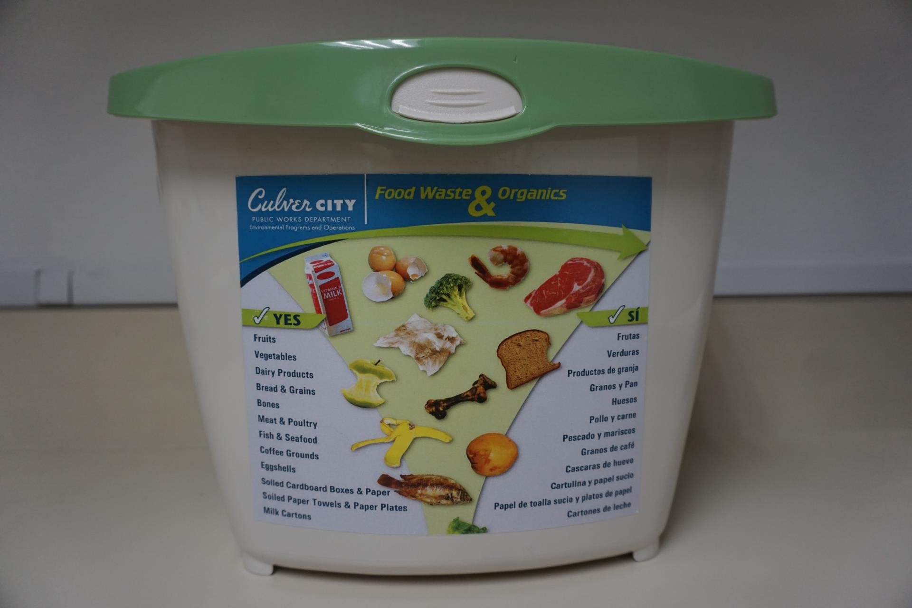
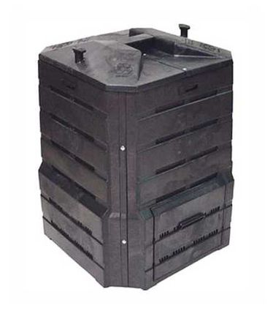
1.1 Drop Off Continued
Recommendations:
Organics Drop-off for Small communities only
Provide service for residents and businesses
Encourage at-home composting
Try to find organics composting facility that accepts food & food-soiled paper

Slide 6
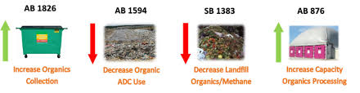
1.3 Incentive Program Encouraging Food Waste Separation
Existing Legislation
Reduction in trash
Fines or cart takeaway is last option, but may be necessary
Outreach and education is key to success!

Slide 7
1.6 The Food Drop Brochure
Challenges:
Municipal organics recycling programs will vary so the brochure needs to be very generic.
Recommendation:
Brochure should advise of the new regulations and advise to contact local municipality or hauler for further information.

Slide 8

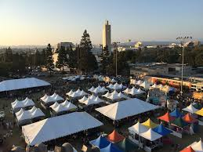
1.8 Special Events
The City has implemented a similar recommendation.
All special events permitted in the City are required to have both a recycling and food waste plan submitted as required for the permit.
The City provides waste, recycling and organics containers for the event and charges a fee for this service.

Slide 9
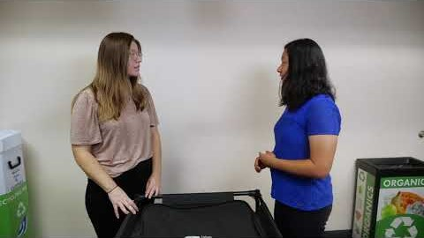
1.12 School Garden/Compost Program
Challenges:
Space Constraints for a garden or small compost area
Funding to Maintain a garden or small compost area
Recommendations:
Create garden/compost area on one larger school site to use as food recovery and/or education
Cities to provide small composter/vermicomposter bins to sites that want to participate but do not have space requirements
Culver City created a Squirmy Wormy Video

Slide 10
1.14 County’s Suggested Organic Waste Management Options
The Following Slides
are Comments on the 11 Options outlined in the County’s
2018 Countywide Organic Waste Management Plan

Slide 11




Commercial & Residential Recycling Ordinance
Challenges:
When to enact ordinance? Currently in economic downstream due to the pandemic.
Focus is on recovery for both jurisdiction and businesses.

Slide 12
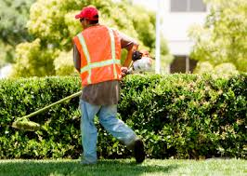
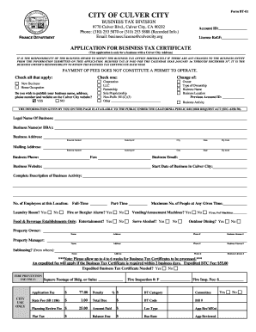
Self-Haul Standards:
Challenges:
Cities with no hauling franchise
  How to monitor services?
  How to collect data?
Recommendation:
Culver City Polystyrene Ordinance
  Businesses required to sign off that they are in compliance with Culver City’s Polystyrene Ordinance.

Slide 13
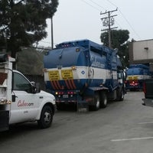
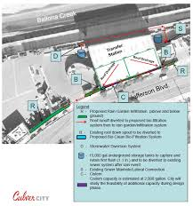
Flow Control:
Challenges:
Agreements with facilities to accept materials
Requiring non-franchise haulers to use those facilities.
Recommendation:
Establish a reporting mechanism for the cities to require all haulers to send monthly or annual reports with proof of where materials collected were processed.

Slide 14

Contract Modification & Exclusive Commercial Hauling:
Challenges:
Fiscal
Requires additional contracts, extension of contracts or separate contracts
Municipalities will have to pay for these services or burden will be on the business or resident/property owner through hauler rates

Slide 15
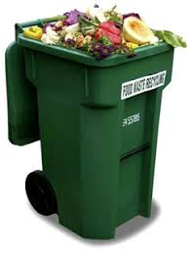
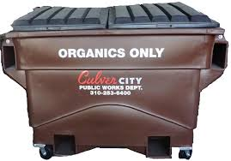
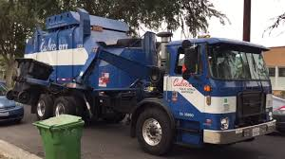
Source Separated Organics Collection:
Challenges:
Fiscal
  Costs associated with containers
  Vehicles
  Staff
  Routes
  Further hauling miles from transfer stations
  Organics processing fees
  Infrastructure to process organics

Slide 16
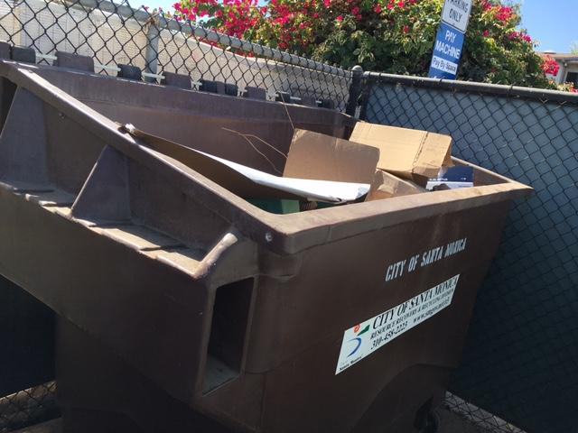
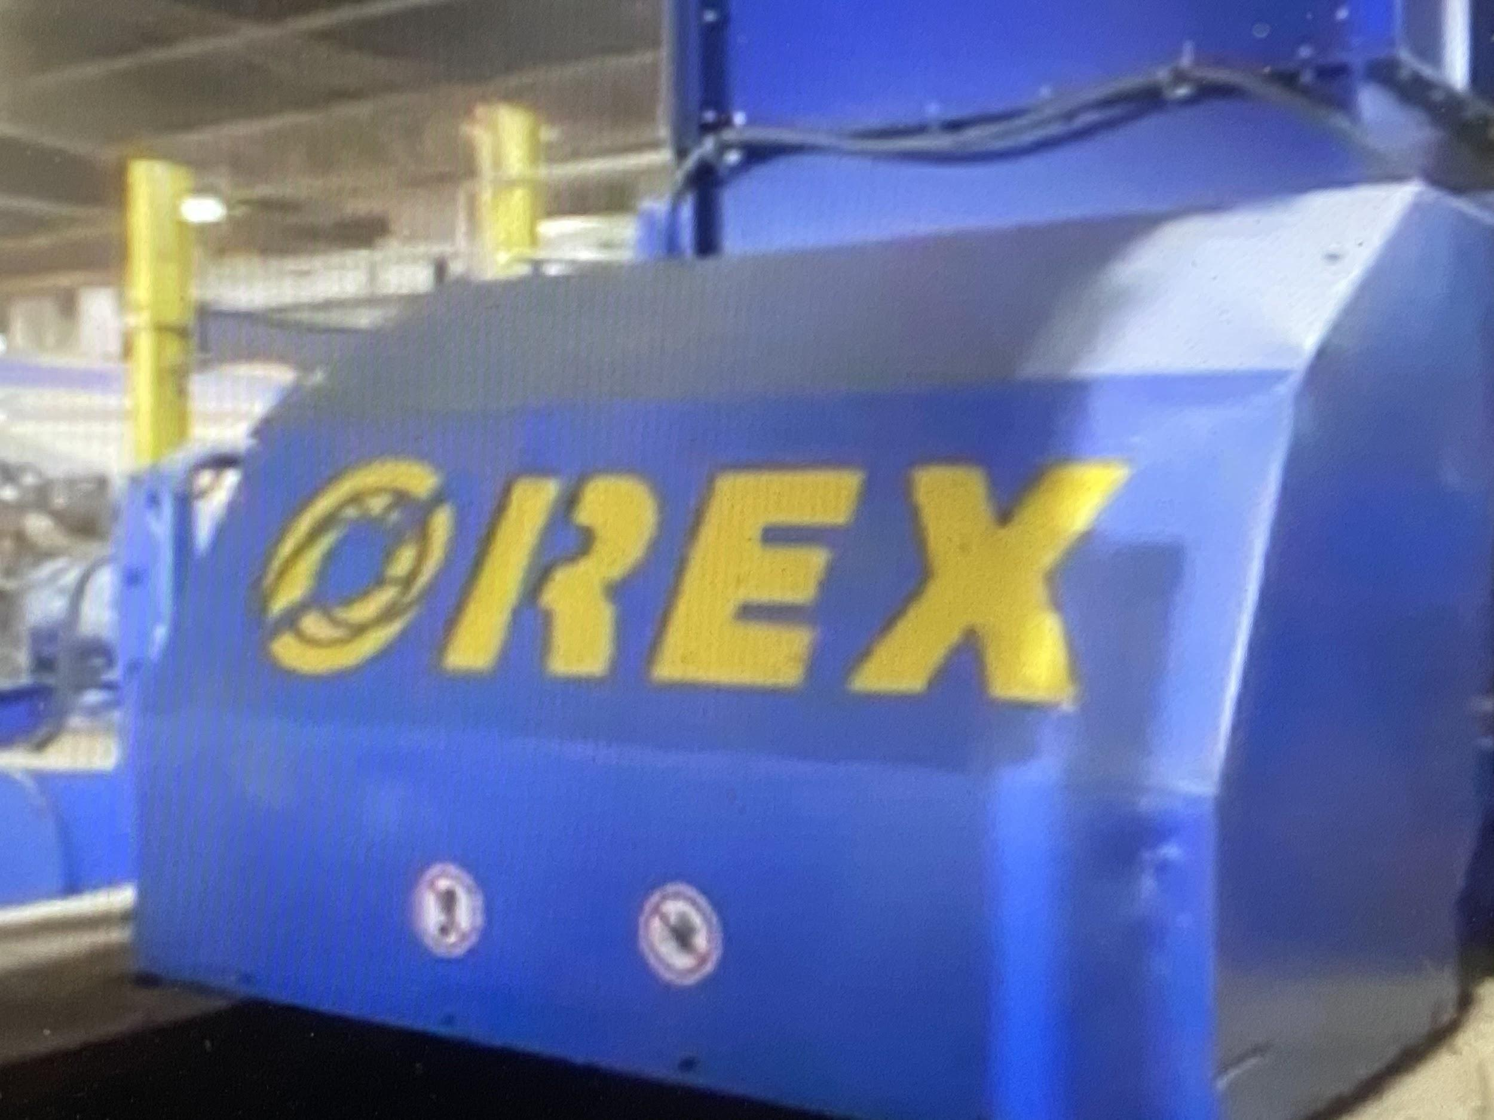
Wet/Dry Collection:
Challenges:
Santa Monica Main Street Pilot
  Collection and disposal. Challenges with Dry material due to contamination as Processors implement stringent standards for recycling.
  Contamination.
  Routing
Lack of availability of this type of Processing
  There’s only one in Rialto and Simi Valley

Slide 17
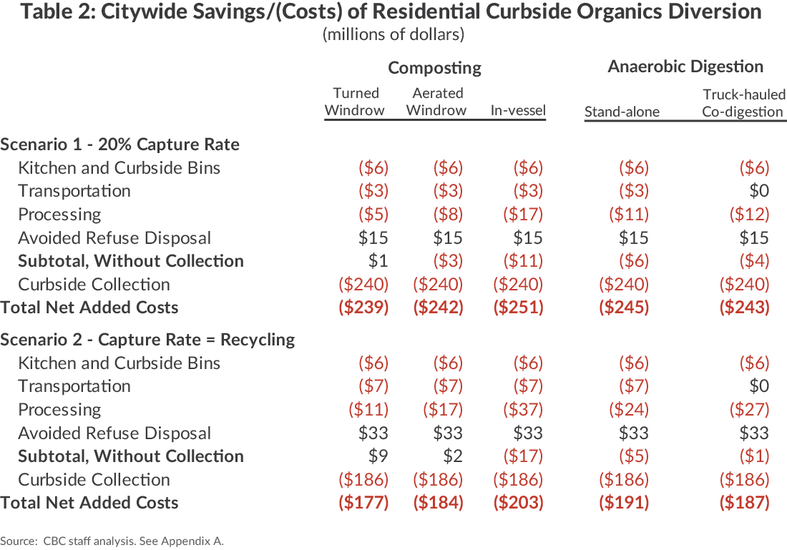
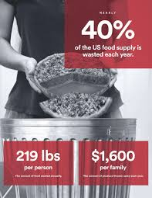
Incentives:
Challenges:
Processing organics is very expensive
Providing incentives on top of an already inflated system will have a bigger financial impact on the cities and haulers
Benefits:
Reduction of trash
GHG emission reduction
In compliance with current legislation
Community benefits (i.e. free compost giveaway)
Study from New York

Slide 18
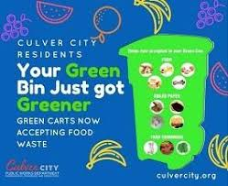



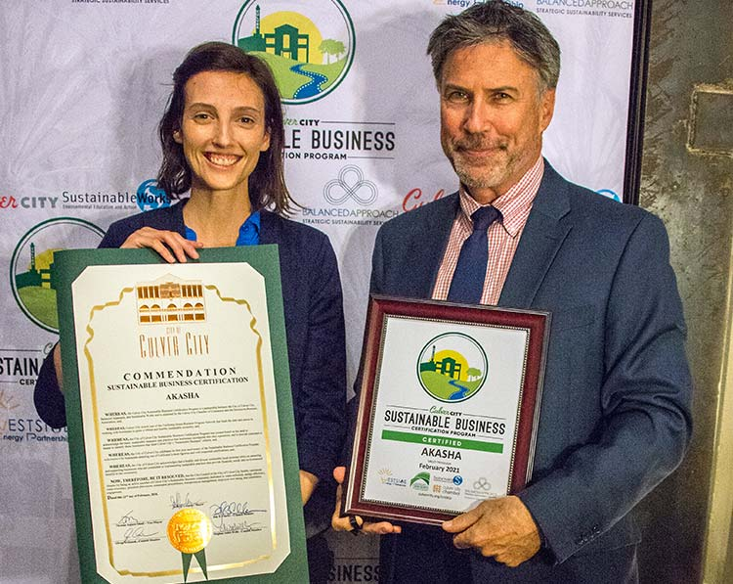
Education Only:

Slide 19
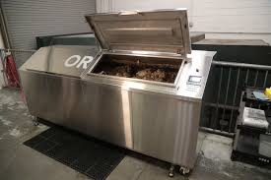
On-Site Management:
Benefit:
Decrease collection (i.e. sending a truck)
Decrease Disposal costs
Challenges:
Space constraints
Consider who’s responsible for equipment? Perhaps create a Franchise.
Data tracking
Business willingness to consider
Increase wastewater usage

Slide 20
In Conclusion
The recommendations are beneficial and will help plan for SB 1383. The biggest challenges:
Lack of infrastructure to process materials creates fiscal and logistical challenges.
  For example, 100 miles (1 way) is the closest organics processing facility to Culver City.
Lack of funding to develop programs is also a challenge.
  Under current fiscal challenges, are cities willing to raise rates to pay for these programs.
  As stated earlier organics is expensive, approx, 3x’s more expensive than disposal/landfill
Due to pandemic’s economics effect, is this the perfect time to require municipalities to implement all of these programs?

Slide 21
Thank you. Q & A
For additional information please contact:
Kim Braun, Public Works Environmental Programs & Operations Manager
kim.braun@culvercity.org
310-253-6421

Slide 22
Infrastructure LA
Sustainable Waste and Recycling Management
  Shari Afshari
  Deputy Director
  LA County Public Works
  SAfshari@pw.lacounty.gov
  Faith Conley
  Legislative Representative
  County of Los Angeles
  FConley@ceo.lacounty.gov
  Kim Braun
  Environmental Programs & Operations Manager
  City of Culver
  Kim.Braun@culvercity.org

Slide 23
Infrastructure LA
Thank you for joining today’s call!
For more information on Infrastructure LA and to sign up for email updates about future calls visit the website at: www.infrastructurela.org
Email: InfrastructureLA@pw.lacounty.gov

