Slide 1
Infrastructure LA
Sustainable Waste and Recycling Management
Thank you for joining us the meeting will start in a few moments
REMINDERS
Please mute your line during the call
There will be Q&A opportunities during the meeting
Use the chat feature to ask questions and comments
You can also raise your hand during the Q&A and we will call on you to unmute and share
The meeting is scheduled for one hour

Slide 2
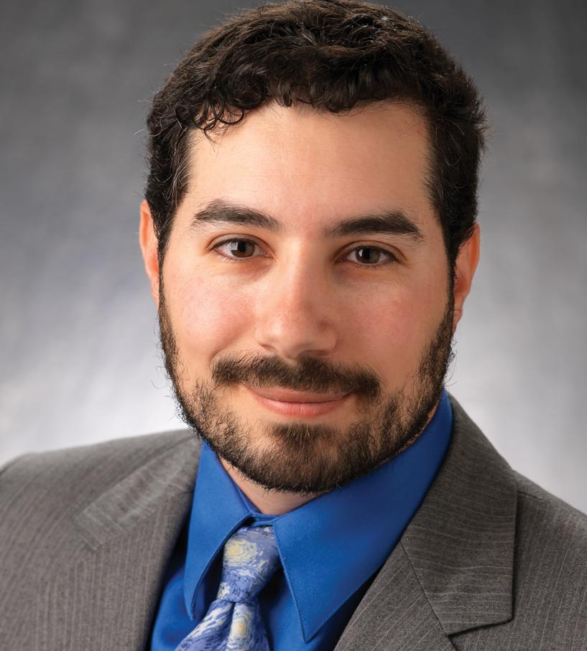
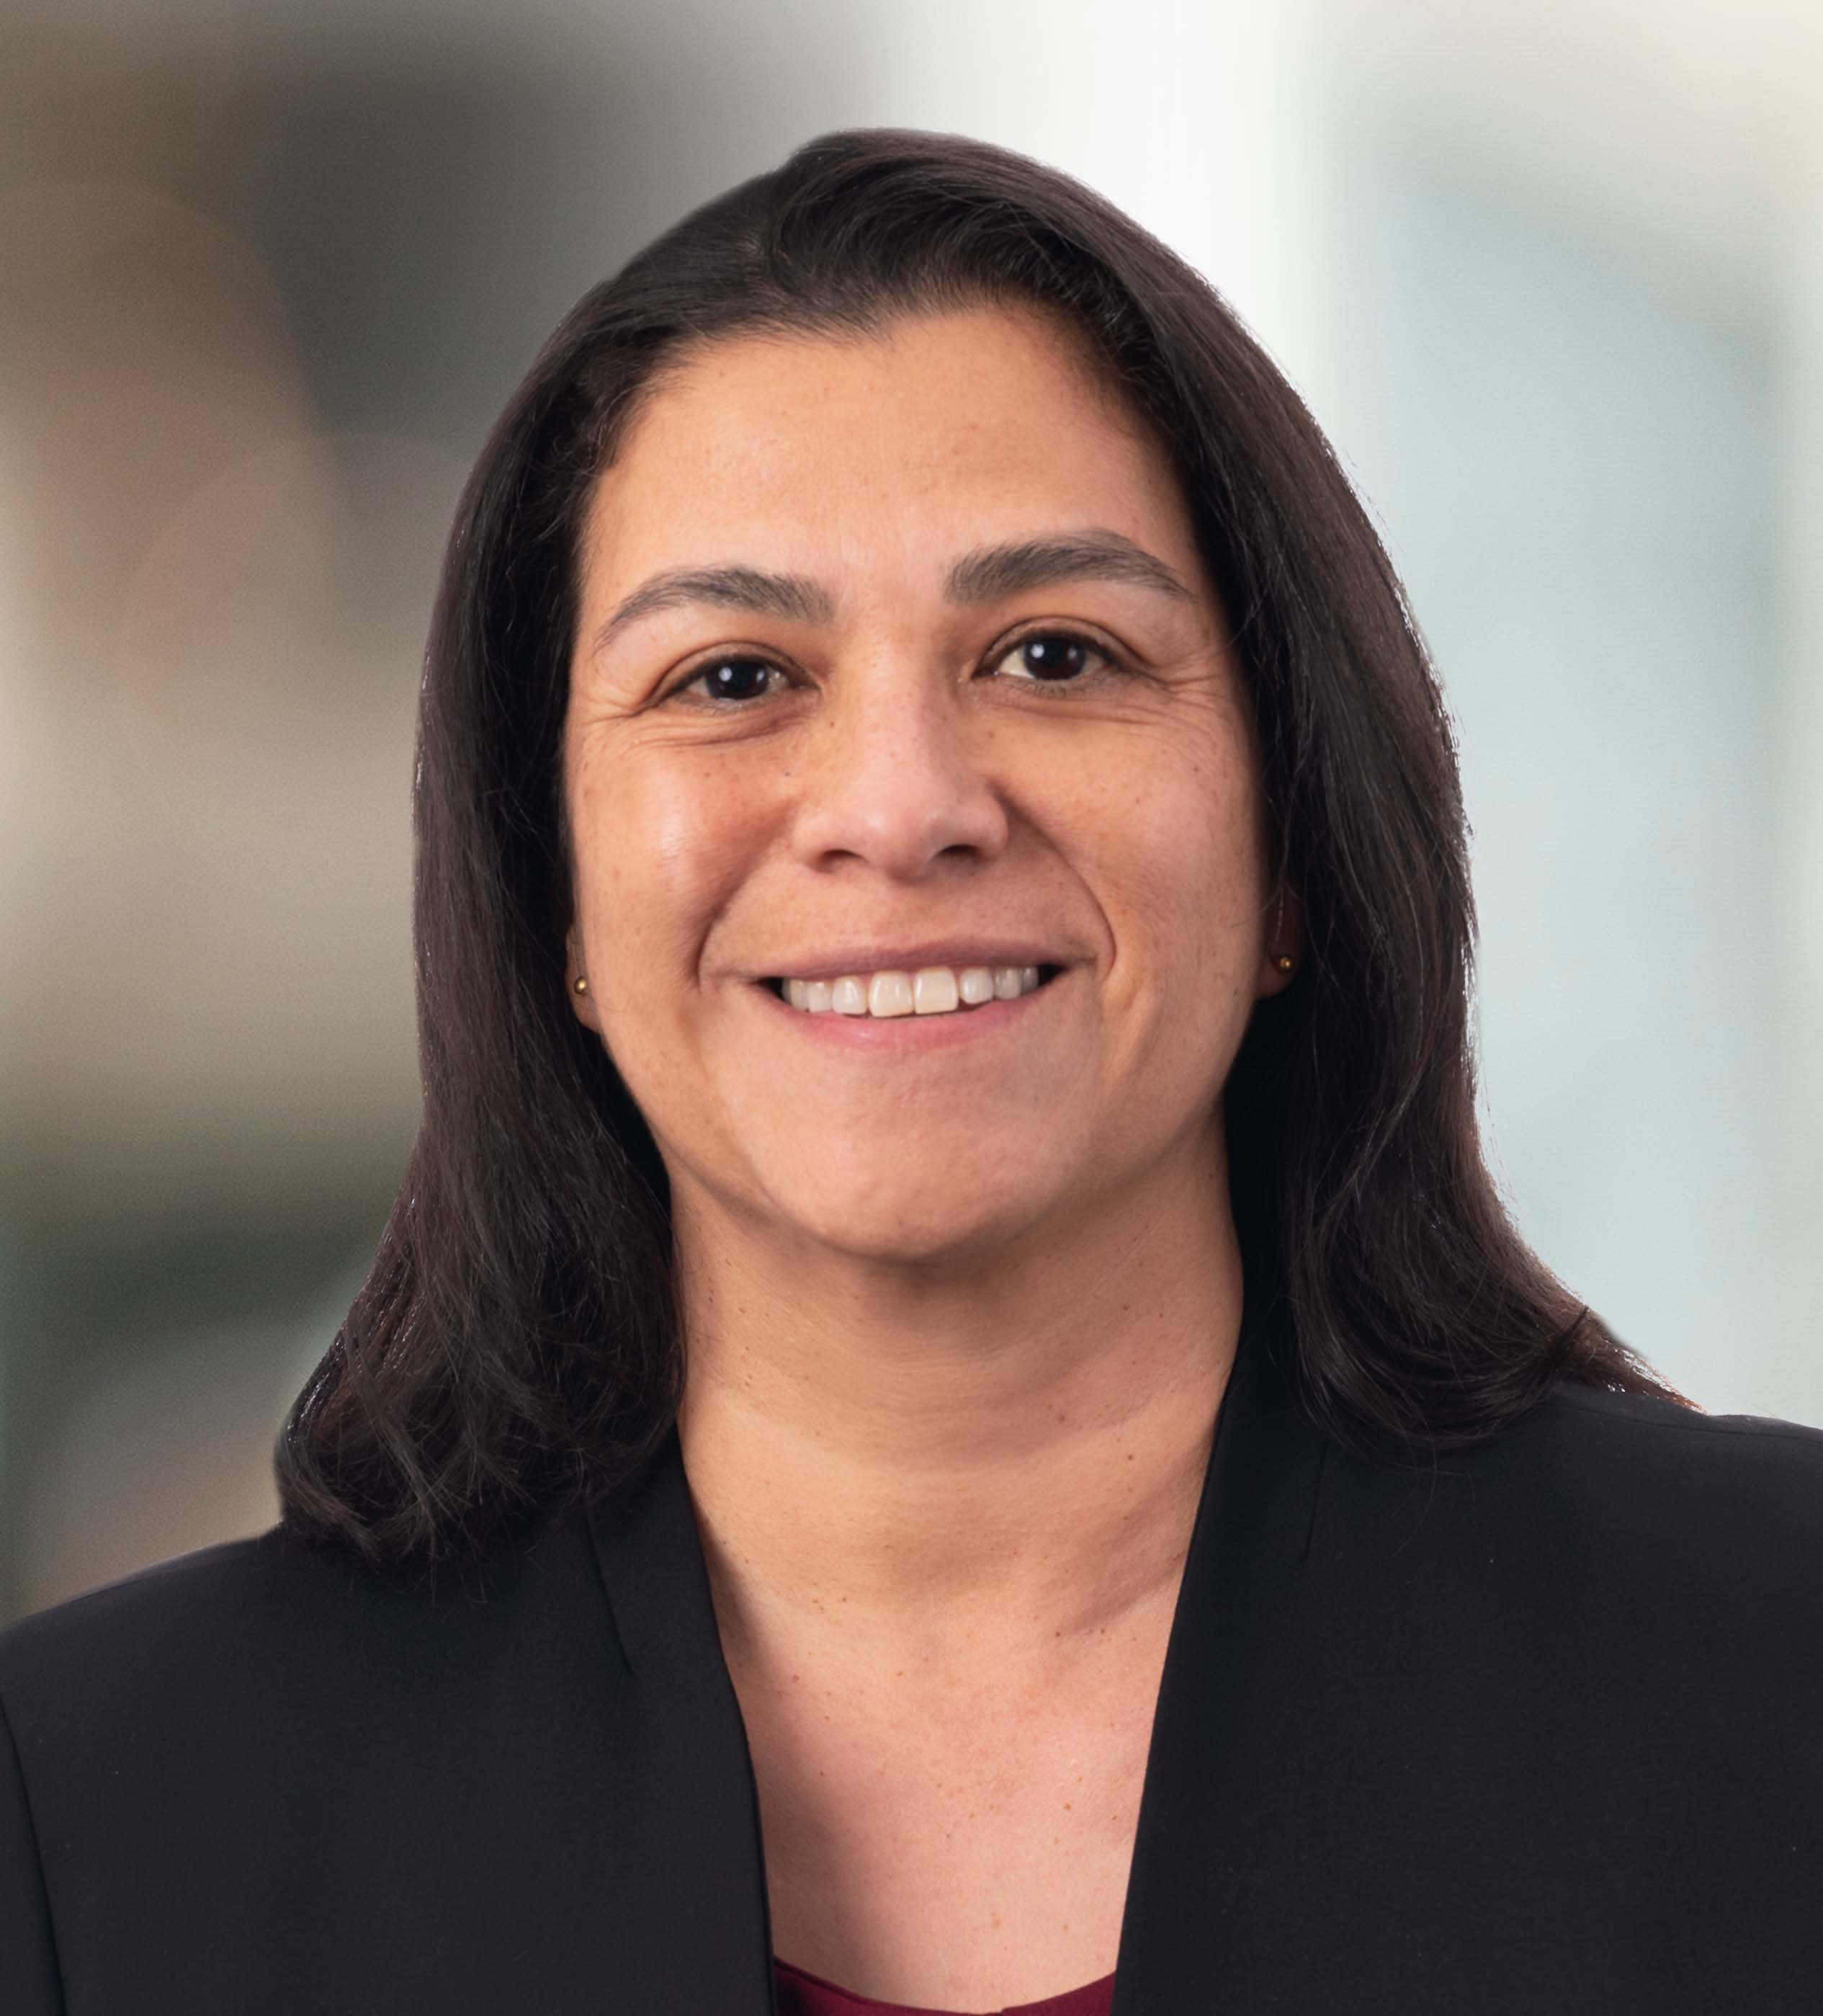
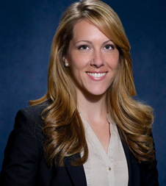
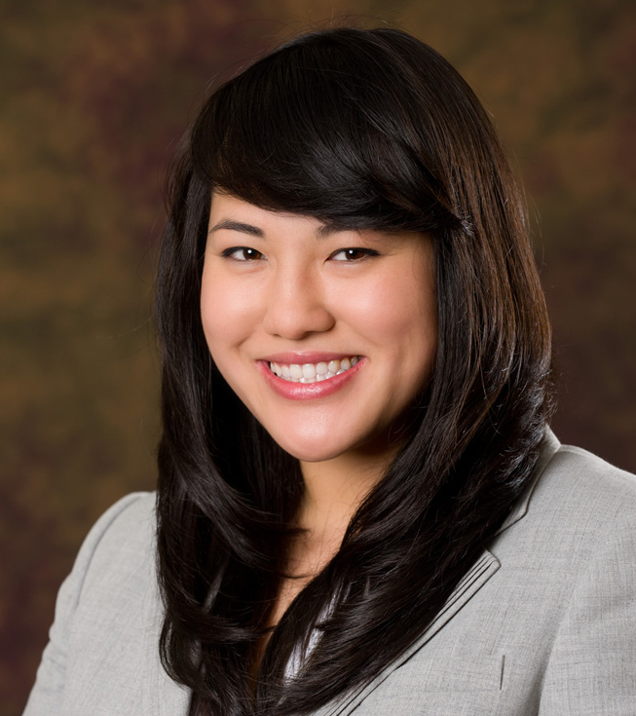
Infrastructure LA
Sustainable Waste and Recycling Management
  Legislative Update, SB 1383 Implementation Update, & Rate Survey
  Coby Skye
  Assistant Deputy Director
  LA County Public Works
  CSkye@pw.lacounty.gov
  Angela Ovalle
  Chief, Administrative Operations
  County of Los Angeles
  AOvalle@pw.lacounty.gov
  Faith Conley
  Legislative Representative
  County of Los Angeles
  FConley@ceo.lacounty.gov
  April Hamud
  Project Manager
  HF&H Consultants LLC
  AHamud@hfh-consultants.com

Slide 3
Bipartisan Infrastructure Law Funding Opportunities

Slide 4
BIPARTISAN INFRASTRUCTURE LAW
(BIL)
$1 trillion over 5 years (through FY 2026)
Funding for transportation, water, power and energy, environmental remediation, public lands, broadband and resilience
$550 billion included for new investments
At least 40 percent of benefits from investments in climate and clean energy to disadvantaged communities

Slide 5


BIL FUNDING STREAMS
Formula Programs
Competitive Grant Programs
Notes:
EXAMPLES:
Federal-aid Highway Formula Funding and Bridge Formula Program
The Federal Highway Administration distributes both Federal-aid Highway Formula funding and Bridge Formula Program funding to State departments of transportation. State Departments of Transportation then program projects (select them for funding) through statewide and metropolitan transportation planning processes.
The majority of the water funding will move through the State Revolving Fund programs.
Competitive Grant Programs –
The Bridge Investment Program, RAISE, MEGA, and INFRA are competitive grant programs that local jurisdictions can directly apply for.

Slide 6
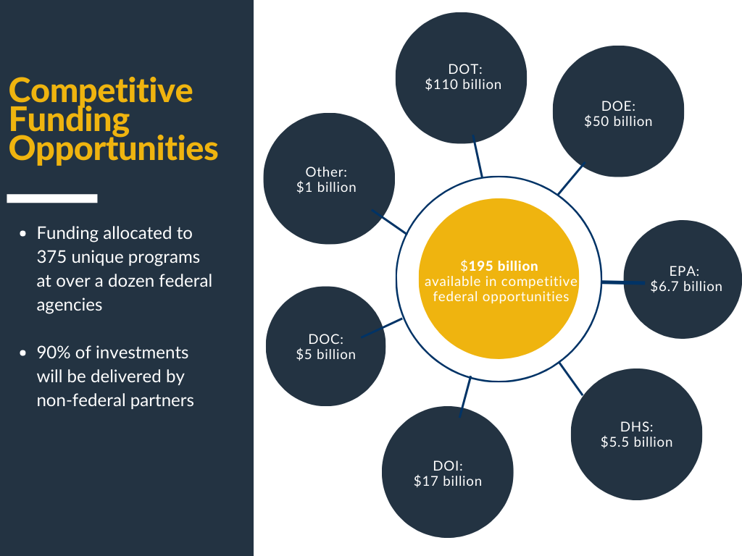

Slide 7
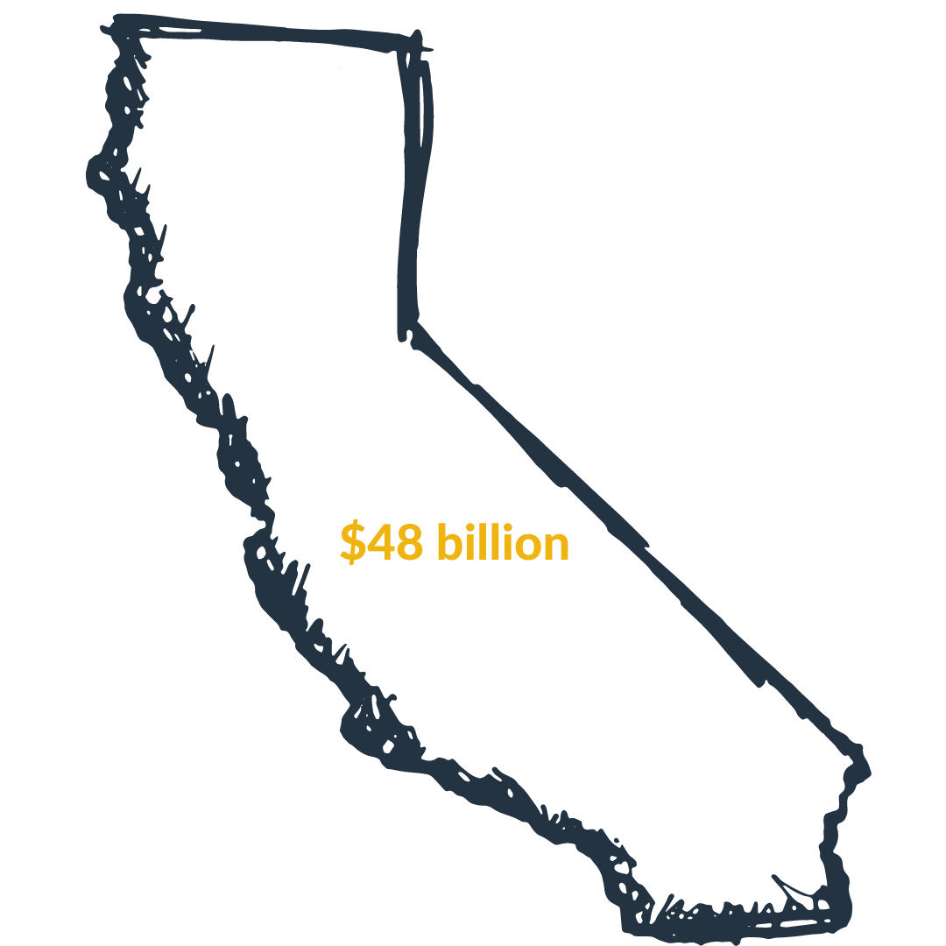
FORMULA FUNDING
GUARANTEED FUNDING FOR CALIFORNIA
$41 billion
Transportation
$3 billion
Broadband
$3.5 billion
Water
$500 million
Climate, Energy, and Other

Slide 8
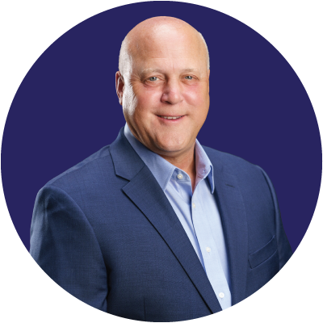
ADMNISTRATION IS FOCUSED ON IMPLEMENTATON
Mitch Landrieu
Senior Advisor
Infrastructure Implementation Coordinator
Notes:
PW is reviewing guidebook

Slide 9
RECOMMENDATIONS FROM ADMNISTRATION
Work with stakeholders to prepare priority project lists now.
  This includes clearly defining funding gaps and/or how funding would be used.
Talk to state agencies.
Engage with federal agencies.
Notes:
Key word is now: applications and notices of funding opportunities are being released as early as this month and many expected this spring.
- example, Issue of Notice of Funding Opportunity for FY 22 Airport Terminal Program expected this month
The Administration strongly encourages working with local stakeholders and focusing on projects that serve disadvantaged communities.

Slide 10
ADDITIONAL FUNDING
OPPORTUNITIES
The State Legislature is working on the FY 23 budget through May.
  Member selected projects are expected again.
Notes:
Key word is now: applications and notices of funding opportunities are being released as early as this month and many expected this spring.
- example, Issue of Notice of Funding Opportunity for FY 22 Airport Terminal Program expected this month
The Administration strongly encourages working with local stakeholders and focusing on projects that serve disadvantaged communities.

Slide 11
Infrastructure LA
Sustainable Waste and Recycling Management
  Legislative Update, SB 1383 Implementation Update, & Rate Survey
  Coby Skye
  Assistant Deputy Director
  LA County Public Works
  CSkye@pw.lacounty.gov
  Angela Ovalle
  Chief, Administrative Operations
  County of Los Angeles
  AOvalle@pw.lacounty.gov
  Faith Conley
  Legislative Representative
  County of Los Angeles
  FConley@ceo.lacounty.gov
  April Hamud
  Project Manager
  HF&H Consultants LLC
  AHamud@hfh-consultants.com

Slide 12
SWARM February Subcommittee Meeting
SB 1383 Implementation
Notes:
Before today’s meeting, we sent out a survey to check in with jurisdictions on their SB 1383 implementation status.
If you haven’t responded to the survey yet, please do so to let us know what challenges you are facing and how we can assist you.
Today I want to provide an overview of what the County has been working on to implement SB 1383.
As we all know, the SB 1383 requirements are extensive, so I won’t have time to go into a lot of detail on each aspect of our implementation effort.
However, if there is anything you would like to learn more about or discuss further, please feel free to contact me and I can put you in touch with my team.

Slide 13
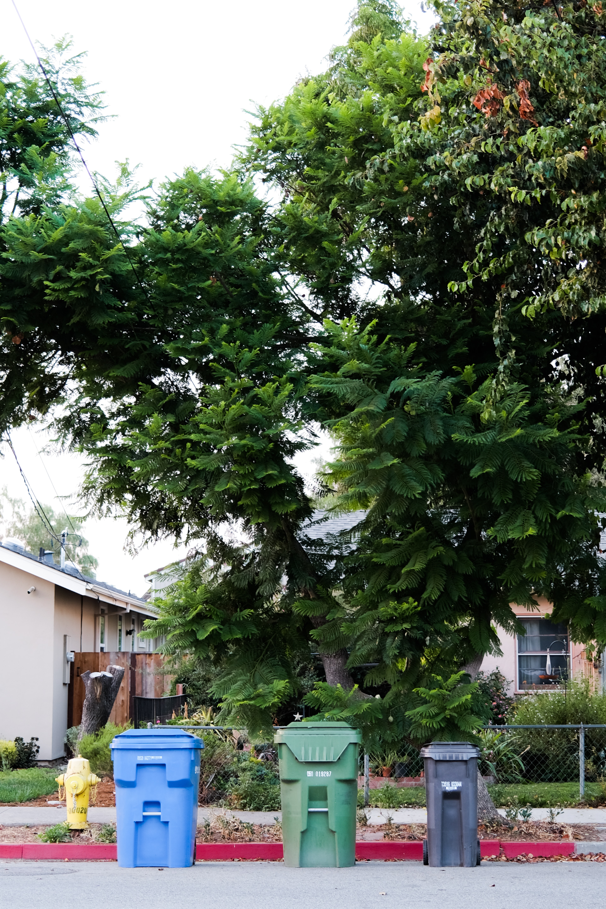
Mandatory Organic Waste Disposal Reduction Ordinance
Require organic waste collection service for residents and businesses/property owners
Establish self-hauler requirements
Require large edible food generating businesses to recover/donate excess edible food
Establish reporting requirements for edible food recovery organizations
Establish enforcement procedures such as correction notices and penalties
Notes:
In November 2021, the County Board of Supervisors adopted a mandatory organic waste disposal reduction ordinance that took effect on January 1, 2022.
The ordinance requires all residents as well as businesses and/or property owners to subscribe to organic waste collection service, or to manage their organic waste through self-hauling or on-site management.
It also requires certain large edible food generating businesses to recover excess edible food and contract with edible food recovery organizations.
The ordinance also requires edible food recovery organizations to report to the County.
The ordinance allows the County to enforce the requirements and, starting in the year 2024, impose monetary penalties if necessary.

Slide 14
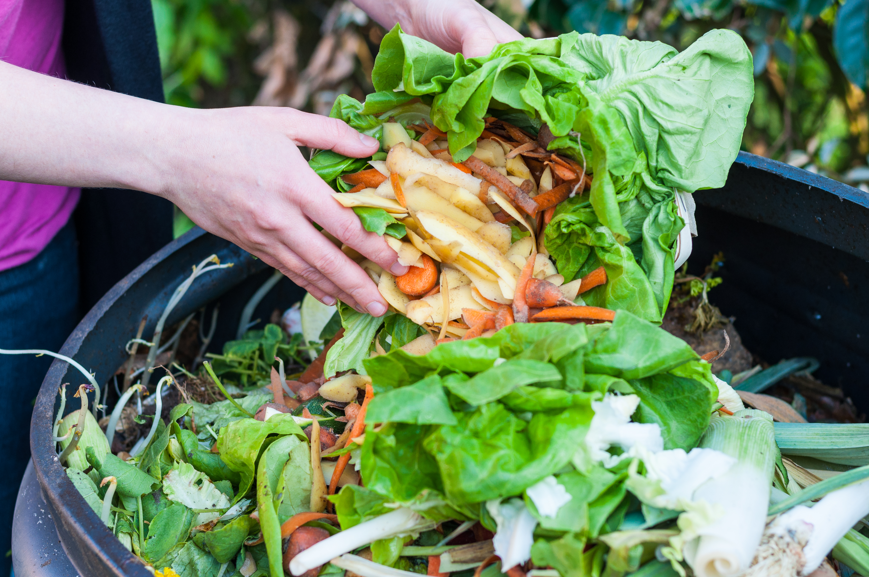
Guidelines for Generators
Guidelines for self hauling and managing organic waste on site
Guidelines for commercial edible food generators
Waiver guidelines – de minimis and physical space
Notes:
We are currently finalizing guidelines for generators to comply with SB 1383.
The guidelines will provide more information on self-hauling organic waste and managing organic waste on site.
They will also provide information for businesses donating excess edible food.
The guidelines also include information on applying for waivers if a business does not generate enough organic waste to require collection services. Businesses or multi-family residences that lack physical space for additional containers may also apply for waivers.

Slide 15
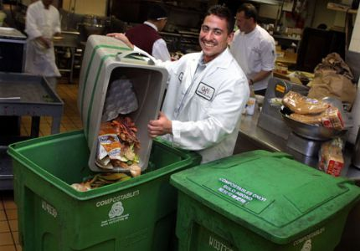
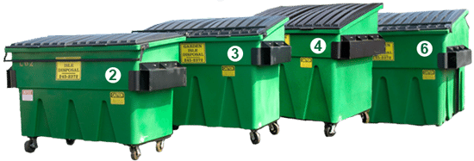
Exclusive Commercial Franchise System
Effective by August 1, 2022
8 exclusive zones
Facilitates implementation of SB 1383 requirements
Encourages infrastructure development
  Secured waste volumes for haulers
  Flow control provisions
  Procurement requirements
Notes:
Currently, commercial waste haulers providing service in the County have a non-exclusive franchise agreement.
We plan to transition to an exclusive franchise system with 8 exclusive zones by August 1, 2022.
The RFP was released on November 10, 2021, and proposals were due on February 1, 2022.
The exclusive system will help the County implement SB 1383 requirements for commercial customers.
The exclusive system will allow waste haulers to have secured waste volumes, give the County the ability to implement flow control, and include a procurement requirement.
These measures will enhance the opportunity for organic waste infrastructure development.

Slide 16
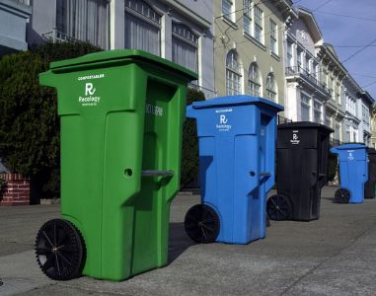
Residential Franchises and Garbage Disposal Districts
Residential Franchise Areas
  13 of our 20 contracts have been updated to include SB 1383 requirements
  The other contracts will be updated by August 2022
Garbage Disposal Districts (GDDs)
  3 of our 7 existing contracts have been updated to include SB 1383 requirements
  The other contracts will be updated by April 2022
  Developing 4 new GDDs in open market areas
  New GDDs will be developed by the end of 2023
Notes:
We are also taking steps to provide organic waste collection services for residents.
We have 20 exclusive residential franchise areas.
The contracts for 13 of them have been updated to include the SB 1383 requirements, and the remaining contracts will be updated by August of this year.
We also provide waste collection service to residents and businesses in Garbage Disposal Districts.
In GDDs, customers pay for their waste collection costs as part of their property tax bill.
The contracts for 3 of our GDDs have been updated to include the SB 1383 requirements, and the remaining contracts will be updated by April 2022.
There are some open market areas in the Antelope Valley.
In these areas, we are planning to develop 4 Garbage Disposal Districts or GDDs.
We are preparing an invitation for bids to determine the cost impacts to customers, which we will use during the Proposition 218 process.
We expect the GDDs to be developed by late 2023.

Slide 17
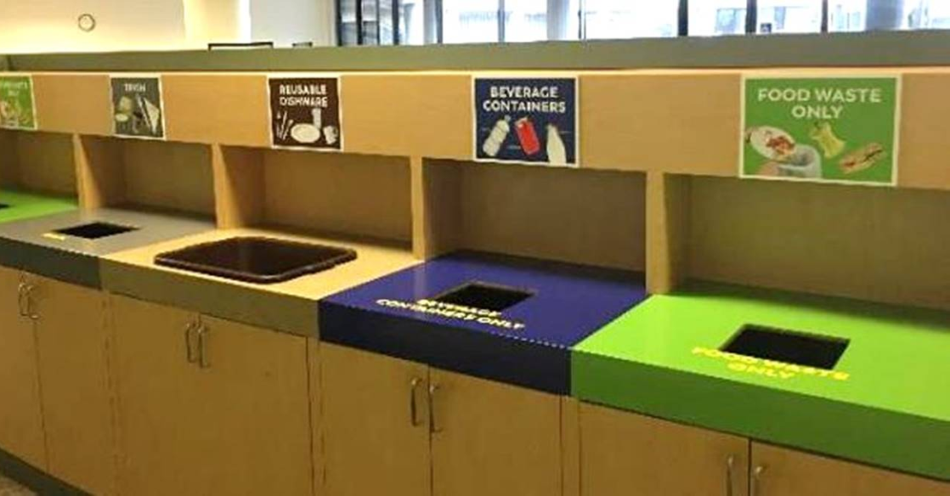
Organic Waste Policy for County Departments
Requires County Departments to:
  Subscribe to organic waste collection services, manage organic waste on-site, or self-haul organic waste
  Donate edible food
  Procure recovered organic waste products
  Purchase paper with 30% minimum recycled content
  Report on organic waste collection, edible food donation, and procurement
  Update food service, landscaping, and procurement contracts to include these requirements
Notes:
The Board recently adopted a policy that requires County Departments to comply with the SB 1383 requirements.
The policy requires County facilities to subscribe to organic waste collection services through the County’s master agreement or through the jurisdiction in which the facility is located.
Similar to other generators, County facilities have the option to manage their organic waste on-site or self-haul their organic waste.
County facilities that generate a large amount of edible food are required to donate excess edible food.
County facilities are encouraged to procure recovered organic waste products, such as compost, mulch, or renewable natural gas fuel, wherever feasible.
County facilities are required to purchase and use paper with a 30% minimum recycled content.
Lastly, the policy requires County facilities to report on these activities to Public Works and update any applicable contracts to include these requirements.

Slide 18

Single-Use Plastics Policy and Ordinances
Policy requires County facilities to:
  Use reusables as a first option, and compostable products if single use products are needed
  Plan all County-sponsored events as zero waste events
Single-Use Plastics Ordinances
  Provide disposable food service accessories only upon request of the customer (including 3rd-party, app-based delivery platforms)
  Require restaurants and food service providers to eliminate single-use plastic food service ware
Notes:
The Board also adopted a policy that requires County facilities to use reusables as a first option.
If single use products are needed, County facilities should use compostable products that are certified by a third party, such as BPI or CMA, and also free from PFAS.
The policy requires all County sponsored events to be zero waste.
The Chief Sustainability Office, Public Works, and other County Departments have been collaborating on the development of two ordinances to reduce single use plastics.
The first was adopted in June 2021 and requires restaurants and food service providers to only provide disposable food service accessories upon request of the customer, including on third-party food delivery apps.
The second will require restaurants and other food service providers to eliminate single use plastic food service ware and replace it with reusable, recyclable, or compostable alternatives. It is expected to go before the Board later this year.

Slide 19

Education and Outreach
Cities – capacity planning workshops
Residents – postcards, letters, website,
annual community meetings, door-to-door drop
offs of kitchen pails
Businesses – flyers, website, community workshops,
site visits
County facilities – sample outreach, website, recycling
coordinators
Notes:
We are conducting significant education and outreach to all stakeholders.
We host regular workshops with Cities about the capacity planning requirements.
We are sending postcards and letters to residents as well as posting information online.
We will be hosting annual community meetings to provide information to residents.
We will also be visiting residents to drop off kitchen pails that residents can use to separate their food waste until trash collection day.
For our businesses, we are also sending out flyers, posting information online, and hosting community workshops.
In addition, we will be conducting site visits to our businesses to help them implement the requirements.
We started a food waste collection program at our Public Works Headquarters building over 4 years ago.
We are providing sample outreach from our program to other County facilities for their use and posting relevant information on our County organic waste recycling website.
We also have regular contact with representatives from Public Works field facilities and other County Departments to ensure that all facilities have the information needed to comply.
We have included links to our websites here in case you would like more information.

Slide 20
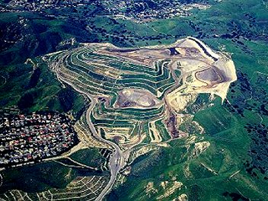
Infrastructure Development
Calabasas Landfill Anaerobic Digestion (AD) Facility
  Landfill is owned by the County and operated by County Sanitation Districts
  Extensive feasibility analysis for commercial-scale AD
  Developed through public-private partnership
  Showcase project to encourage additional infrastructure investment
Feasibility analysis for closed landfill sites
Notes:
Public Works is finalizing a request for proposals (RFP) to engage a private partner in developing an anerobic digestion (AD) facility to process organic waste at the Calabasas Landfill.
The Calabasas Landfill is owned by the County and operated by the County Sanitation Districts.
Public Works completed an extensive multi-year feasibility analysis of the site and determined that it is suitable for a commercial-scale AD facility.
The AD facility would be designed, built, owned, and operated by a private partner.
The AD facility will serve as a model for public-private partnerships for solid waste and organic waste processing infrastructure and will encourage further infrastructure investment in the region.
We hope to release the RFP very soon.
We are also analyzing four closed landfill sites in the County to assess the feasibility of siting additional facilities using a similar public-private partnership model.

Slide 21

Senate Bill 619
Authorizes jurisdiction to submit a Notification of Intent to Comply (NOIC) and an adopted resolution to CalRecycle by March 1, 2022
Because the GDDs will not be established until 2023, the County is submitting an NOIC for the AV
The Board adopted a resolution on February 8, 2022
NOICs must include:
  Justification for non-compliance
  Impacts of COVID-19 (if any)
  Actions and timeline for compliance
Notes:
SB 619 authorizes a jurisdiction having difficulty implementing the SB 1383 regulations and facing continuing violations that commence during the 2022 calendar year to submit a Notification of intent to Comply and an adopted resolution to CalRecycle by March 1, 2022.
Because the GDDs will not be established until next year, the County is submitting an NOIC to CalRecycle for the Antelope Valley areas.
To that end, the Board adopted a resolution on February 8, 2022.
Jurisdictions who want to submit an NOIC to CalRecycle need to include:
A justification for why they are not yet in compliance with certain aspects of the SB 1383 regulations
Any impacts of the COVID-19 pandemic on compliance
Actions and proposed timeline for compliance.

Slide 22
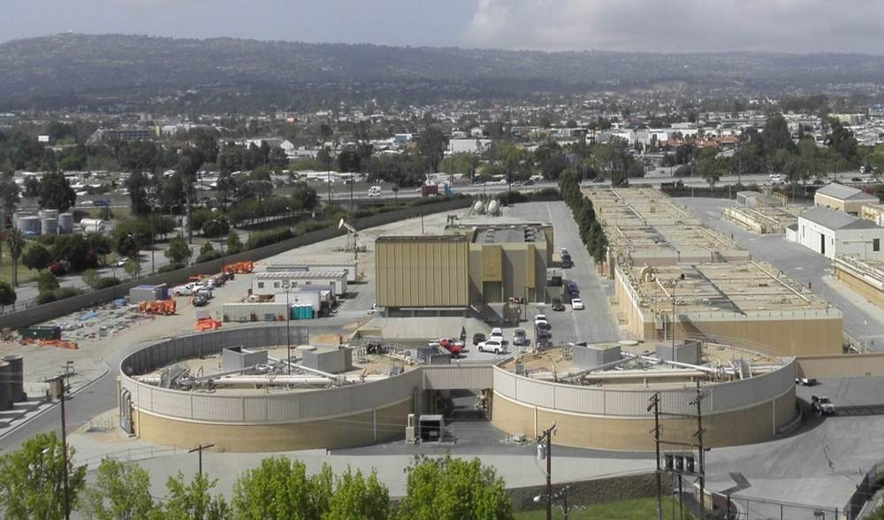
CalRecycle Grants
Local Assistance Grant - $57 M
  SB 1383 implementation
  Applications were due Feb 1, 2022
  Grants will be awarded in Apr & Sep 2022
Co-Digestion Grant Program - $19 M
  New/expanded food waste co-digestion projects at existing wastewater treatment plants
  Application period = Feb - Apr 2022
  Grants will be awarded in Jul & Aug 2022
Notes:
The last topic I wanted to discuss today is funding.
The SB 1383 regulations will cost an estimated $40 billion to implement statewide.
CalRecycle is providing grant funding to assist with the costs.
The local assistance grant is a one-time grant that will help local jurisdictions implement the SB 1383 regulations.
CalRecycle will provide $57 million to local jurisdictions.
The applications were due on the first of this month, and the grants will be awarded in April and September 2022.
CalRecycle is also providing $19 million to build new and expanded food waste co-digestion projects at existing wastewater treatment plants.
The applications are expected to open later this month and the grants will be awarded in July or August of 2022.

Slide 23
Survey Results
Priority issues – rate increases, ordinances, franchise agreements, infrastructure, education/outreach, procurement
Barriers to new infrastructure – costs, flow control, franchise agreements
Current implementation efforts – education and outreach
Needs – staff and time
Other issues – illegal dumping
Notes:
As I mentioned, we sent out a survey before this meeting to find out your priorities relating to SB 1383 implementation and waste management.
In the interest of time, I will provide a high level overview of the responses.
The priority issues for jurisdictions are rate increases, new ordinances, franchise agreements, infrastructure, education/outreach, and procurement.
Jurisdictions are facing barriers to site new infrastructure, including costs, flow control, and franchise agreements.
Cities are currently conducting education and outreach for SB 1383.
In order to fully implement SB 1383, cities need additional staff and time.
Cities are also experiencing the effects of illegal dumping.
This concludes my update on SB 1383 implementation.
As I said earlier, if you are interested to learn more about any of these topics, please contact me.

Slide 24
Infrastructure LA
Sustainable Waste and Recycling Management
  Legislative Update, SB 1383 Implementation Update, & Rate Survey
  Coby Skye
  Assistant Deputy Director
  LA County Public Works
  CSkye@pw.lacounty.gov
  Angela Ovalle
  Chief, Administrative Operations
  County of Los Angeles
  AOvalle@pw.lacounty.gov
  Faith Conley
  Legislative Representative
  County of Los Angeles
  FConley@ceo.lacounty.gov
  April Hamud
  Project Manager
  HF&H Consultants LLC
  AHamud@hfh-consultants.com

Slide 25
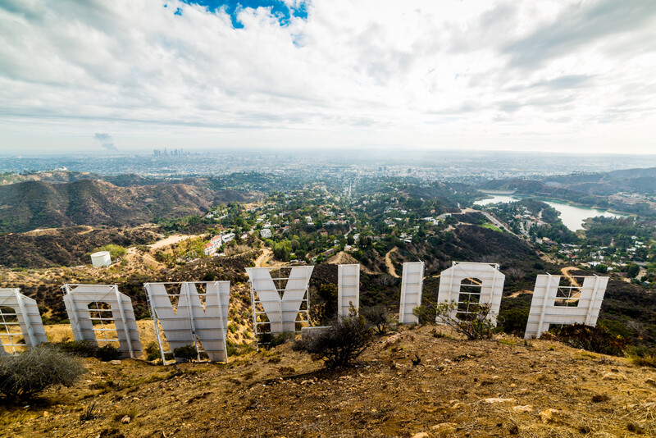



Los Angeles County
Survey of Solid Waste Rates and Services as of July 1, 2021
Presented to Sustainable Waste and Recycling Management Subcommittee (SWARM)
February 22, 2022
April Hamud
Project Manager
(949) 251-8586
Laith Ezzet
Senior Vice President
(949) 251-8902
Sam Irwin
Associate Analyst
(949) 418-9273
HF&H Consultants
2081 Business Center Drive, Suite 265, Irvine CA 92612
www.hfh-consultants.com

Slide 26
Objectives
The Los Angeles County Public Works’ goal is to understand the cost impacts to customers throughout the County as jurisdictions start to incorporate SB 1383 requirements in their waste hauling agreements.
The objectives of the study were to assess SB 1383 implementation, availability of organics diversion programs, and collection rates as of July 1, 2021 within the 88 cities of Los Angeles County.

Slide 27





Methodology
Initially contacted all 88 cities within Los Angeles County through emails and telephone calls.
Gathered the franchise agreement, amendments, and rate schedules.
Verified all city completed surveys with the city’s franchise agreement and rate schedule to ensure accuracy.
Gathered survey data from non-responsive cities using the franchise agreement, amendments, rate schedules obtained through public records requests, and/or City and hauler websites.
Compiled results and analyzed data.

Slide 28
Rate differences
Differences in rates may be due to the following:
Route density
Access to solid waste facilities
Solid waste quantities
Rate structures
Fees retained by cities
Timing of compliance with SB 1383 requirements
Special services (bulky items, street sweeping, city-wide clean up days)
Cost allocation decisions
Phase-in strategies
Contracting approach
Notes:
Note that some

Slide 29
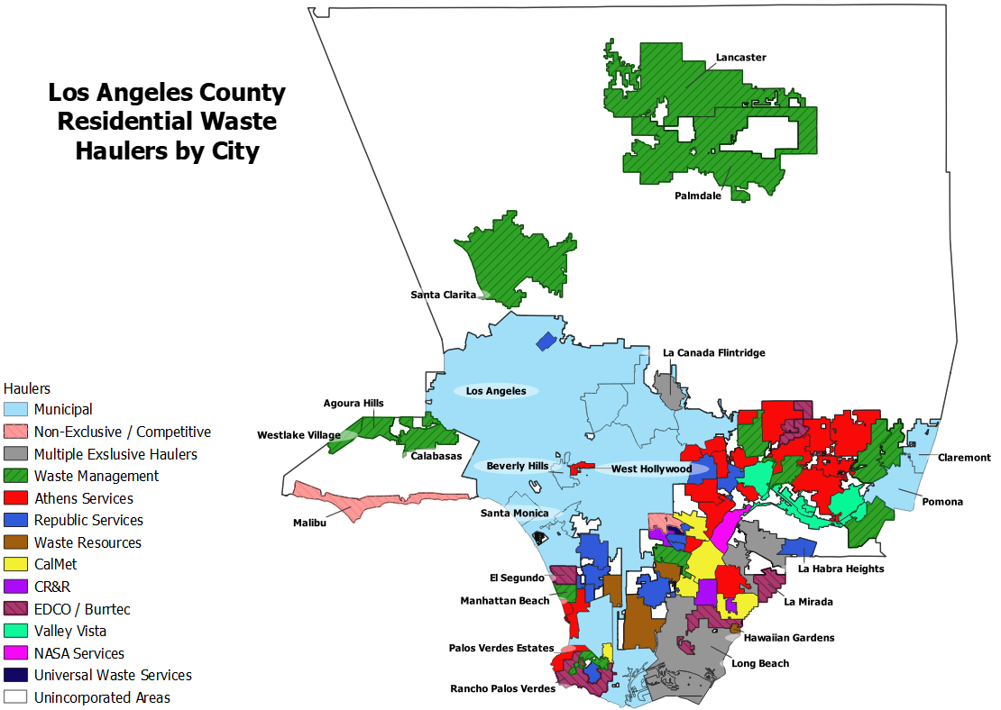

Slide 30
RESIDENTIAL MARKET SHARE WITHIN La County as of July 1, 2021
By Population
By Number of Cities
Notes:
Other is all haulers that represent less than 5% of the pie
By population other is: CalMet, Waste Resources, Edco/Burrtec, Valley Vista, CR&R, NASA Services, Non-Exclusive / Competitive, Universal Waste Services
By number of cities Other is: Waste Resources, Valley Vista, Multiple Exclusive Haulers, CR&R, NASA Services, Universal Waste Services, Non-Exclusive / Competitive

Slide 31






Types of Residential Organics Programs as of July 1, 2021
If your City has a food waste program, which of the following best represents City's food waste diversion for residential services?
Food Waste Must be Bagged and Placed in Green Waste Cart
Food Waste and Green Waste Placed in same Organics Bin (with no bag required)
Source-separated Food Waste Cart (separate from GW cart)
Food Waste is recovered from Mixed Waste
Other
If other, describe:
If your City has a food waste program, which of the following best represents City's food waste diversion for residential services?
Food Waste Must be Bagged and Placed in Green Waste Cart
Food Waste and Green Waste Placed in same Organics Bin (with no bag required)
Source-separated Food Waste Cart (separate from GW cart)
Food Waste is recovered from Mixed Waste
Other
If other, describe:
If your City has a food waste program, which of the following best represents City's food waste diversion for residential services?
Food Waste Must be Bagged and Placed in Green Waste Cart
Food Waste and Green Waste Placed in same Organics Bin (with no bag required)
Source-separated Food Waste Cart (separate from GW cart)
Food Waste is recovered from Mixed Waste
Other
If other, describe:
Out of 88 Cities:
20 Cities (24%) have a residential food waste diversion program
19 Cities collect residential food waste and green waste in the same Organics container (with no bag required)
1 City recovers food waste from the mixed waste stream
68 Cities (76%) do not have a residential food waste diversion program
6 additional cities planned to divert food waste by January 1, 2022
Notes:
Paramount corrected to “do not have a residential food waste diversion program.” Website discusses the implementation of collection of FW combined with GW, but does not give implementation date.
Irwindale recovers food waste from mixed waste, and both residential and commercial mixed waste are taken to the Athens Services City of Industry MRF/TS.

Slide 32
Monthly Residential Rates
Based on a 95 Gallon Refuse Container, as of July 1, 2021

Slide 33
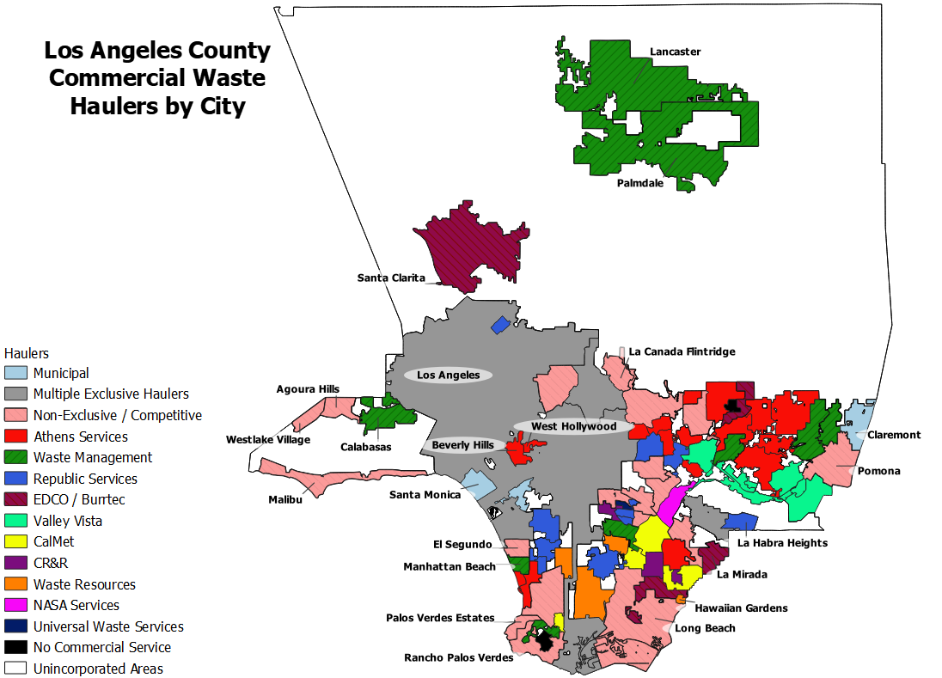

Slide 34
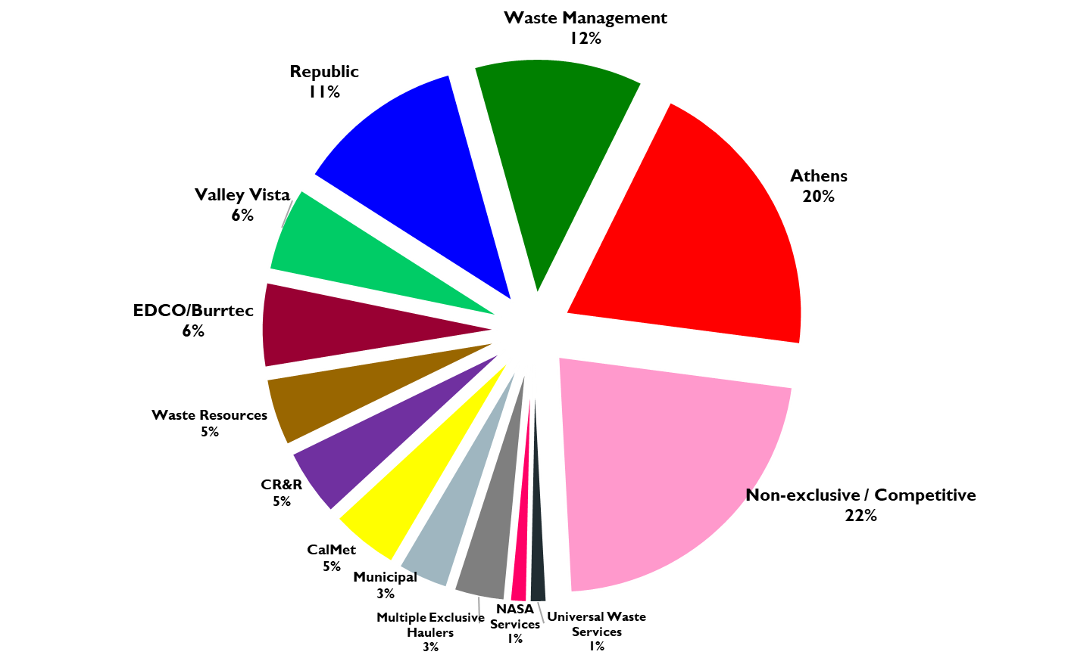
Commercial market share within La county based on number of Cities, as of July 1, 2021

Slide 35
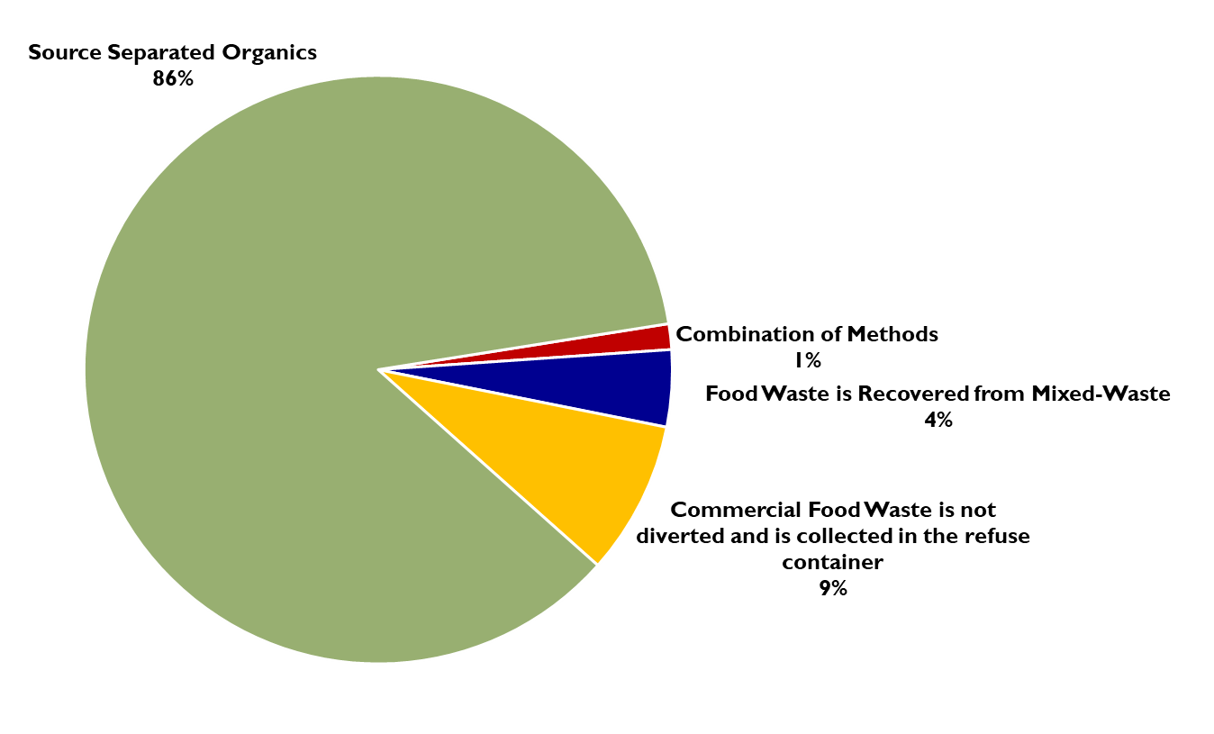
Commercial Food Waste Diversion programs*
As of July 1, 2021
*Based on 71 Cities whose commercial food waste diversion program could be determined
Notes:
Food Waste is Recovered from Mixed-Waste- 3 Cities: Maywood, South El Monte and West Hollywood
FW is not diverted- 6 Cities: Avalon, Burbank, Hidden Hills, La Habra Heights, South Pasadena, and Walnut.
Combination of Methods – Beverly Hills has mixed waste for restaurants (due to spatial constraints) and source-separated food waste for other businesses
Note some city’s FW diversion could not be determined because they had multiple haulers, did not have commercial service, or not enough information was publicly available.

Slide 36
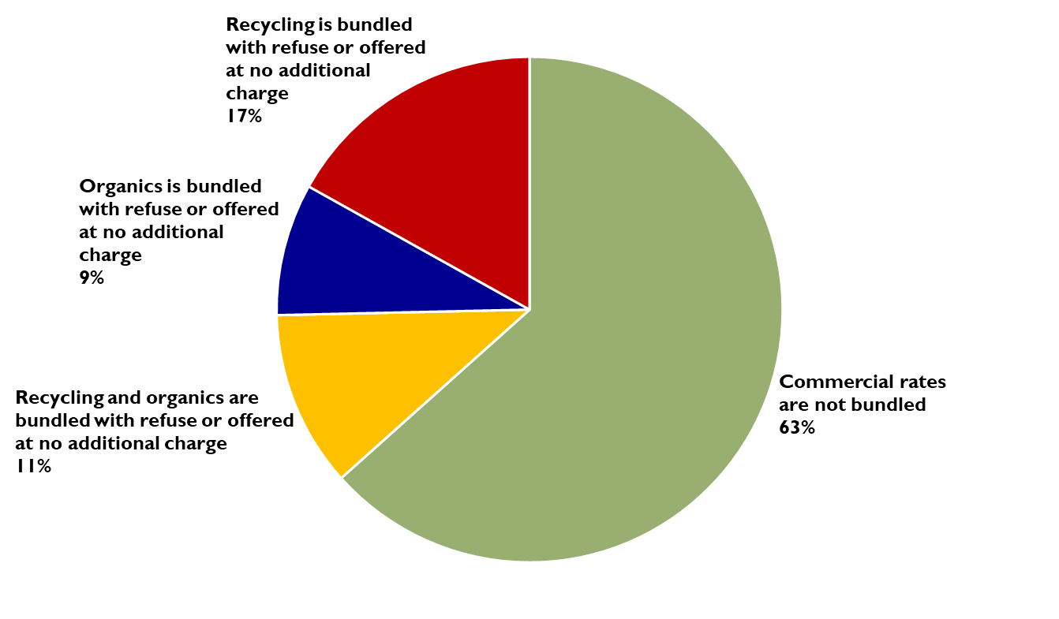
Are Exclusive Franchise commercial rates Bundled?

Slide 37
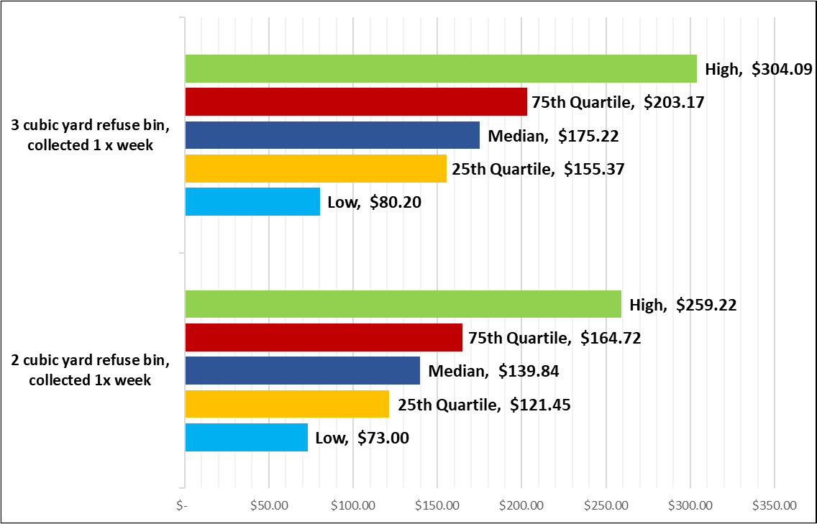
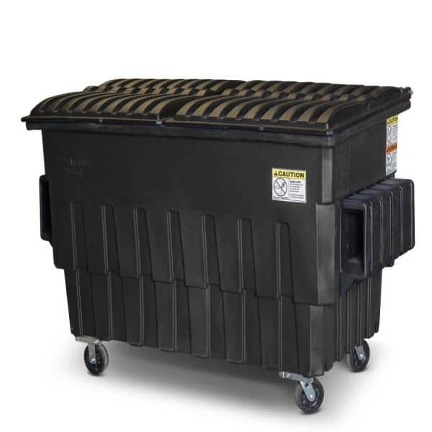
Monthly Commercial Refuse Rates
As of July 1, 2021
3 CY
2 CY

Slide 38
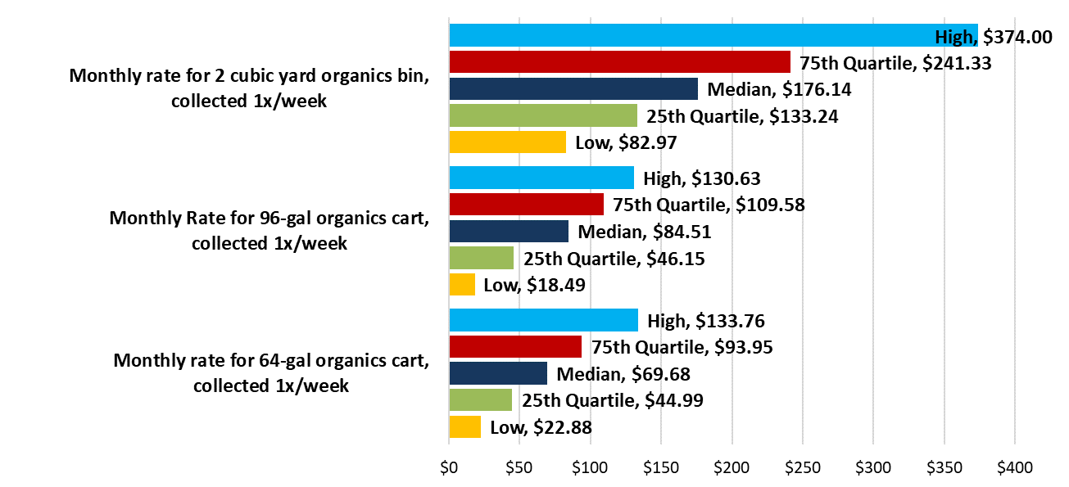



Monthly Commercial Organics rates
2 CY
96
64

Slide 39
General INDUSTRY OBSERVATIONS
  SB 1383 regulations
  Organics processing costs
  Recycling commodity revenues
  Labor costs (union and minimum wage)
  Covid impacts
  Consolidation/competition
96
64
Notes:
Currently working with County to finalize the report. Report will be delivered to participating cities.

Slide 40
Questions & Discussion
  Legislative Update, SB 1383 Implementation Update, & Rate Survey
  Coby Skye
  Assistant Deputy Director
  LA County Public Works
  CSkye@pw.lacounty.gov
  Angela Ovalle
  Chief, Administrative Operations
  County of Los Angeles
  AOvalle@pw.lacounty.gov
  Faith Conley
  Legislative Representative
  County of Los Angeles
  FConley@ceo.lacounty.gov
  April Hamud
  Project Manager
  HF&H Consultants LLC
  AHamud@hfh-consultants.com

Slide 41
Infrastructure LA
Thank you for joining today’s call!
For more information on Infrastructure LA and to sign up for email updates about future calls visit the website at: www.infrastructurela.org
Email: InfrastructureLA@pw.lacounty.gov

