Slide 1
Infrastructure LA
Sustainable Waste and Recycling Management
Thank you for joining us the meeting will start in a few moments
REMINDERS
Please mute your line during the call
There will be Q&A opportunities during the meeting
Use the chat feature to ask questions and comments
You can also raise your hand during the Q&A and we will call on you to unmute and share
The meeting is scheduled for one hour

Slide 2
Infrastructure LA
Sustainable Waste and Recycling Management
April Committee Meeting

Slide 3
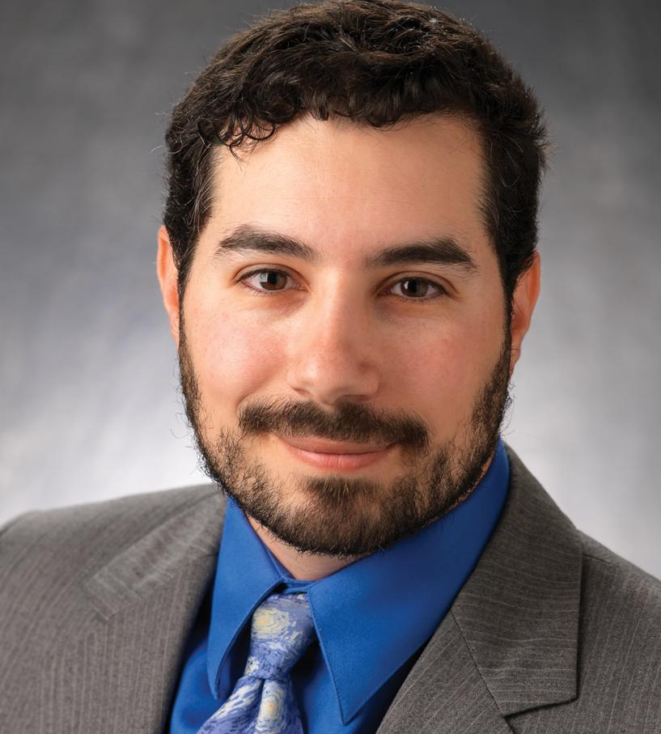

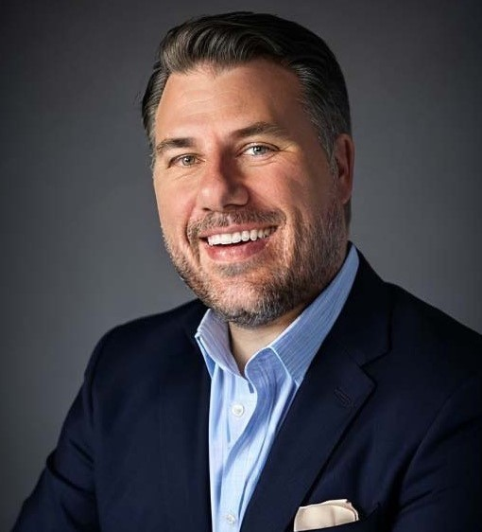
Infrastructure LA
Sustainable Waste and Recycling Management
  Single-Use Plastics
  Coby Skye
  Assistant Deputy Director
  LA County Public Works
  CSkye@pw.lacounty.gov
  Rita Kampalath
  Chief Sustainability Officer
  County of Los Angeles
  RKampalath@ceo.lacounty.gov
  Sean Singletary
  Environmental Programs & Operations Manager
  City of Culver City
  Sean.Singletary@culvercity.org

Slide 4
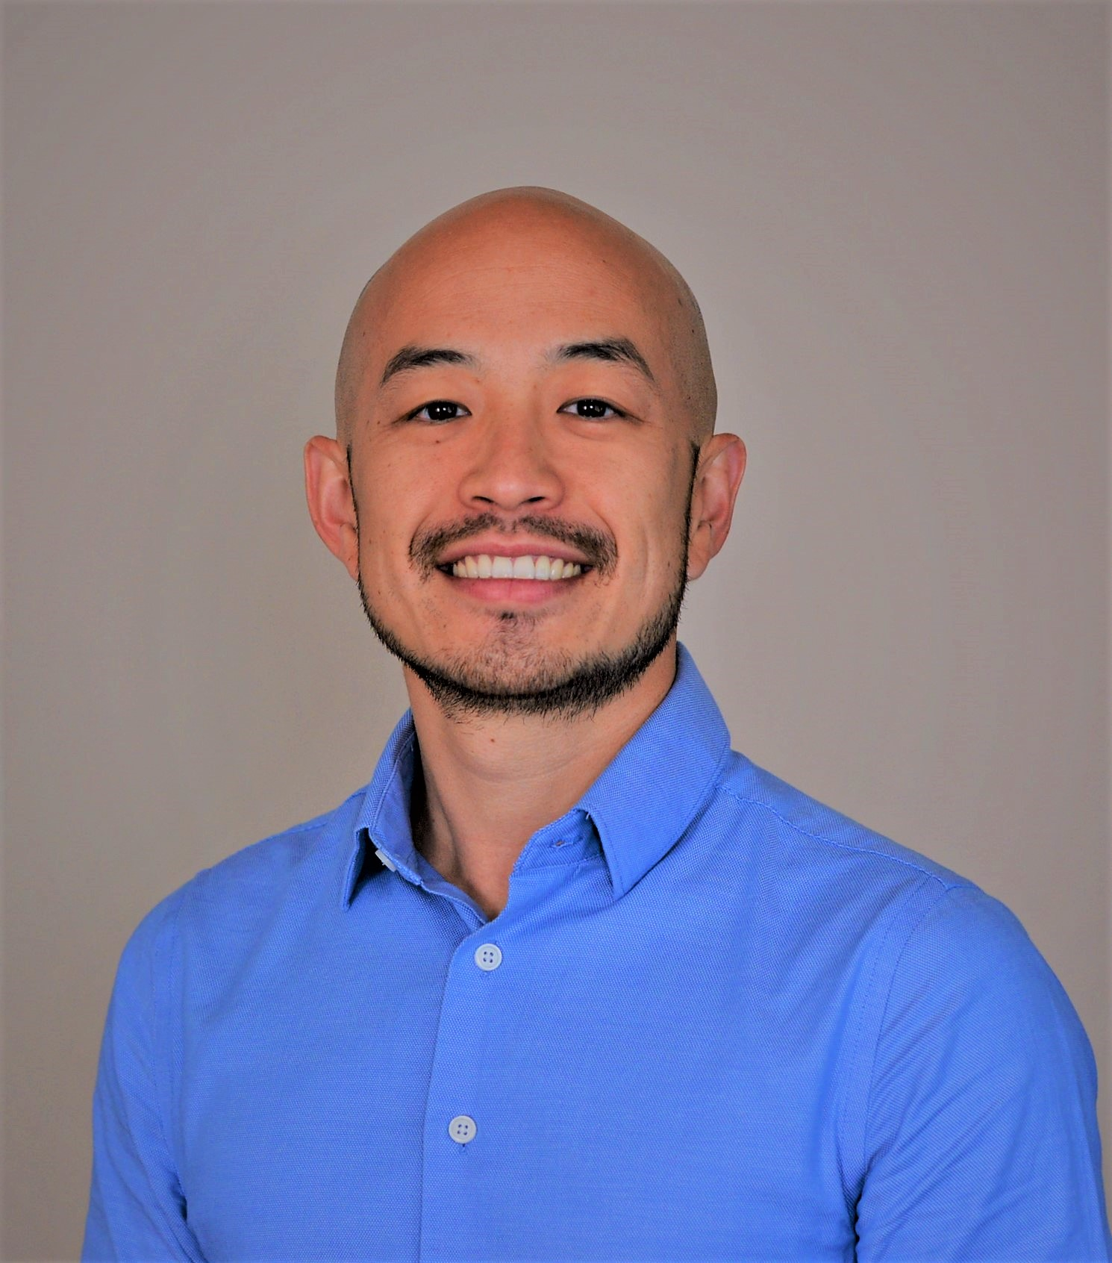
Infrastructure LA
Sustainable Waste and Recycling Management
  Will Chen
  Division Engineer
  LA County Sanitation Districts
  Wchen@lacsd.org

Slide 5
Infrastructure LA
Sustainable Waste and Recycling Management
  Single-Use Plastics
  Coby Skye
  Assistant Deputy Director
  LA County Public Works
  CSkye@pw.lacounty.gov
  Rita Kampalath
  Chief Sustainability Officer
  County of Los Angeles
  RKampalath@ceo.lacounty.gov
  Sean Singletary
  Environmental Programs & Operations Manager
  City of Culver City
  Sean.Singletary@culvercity.org

Slide 6
Los Angeles County
Single Use Plastic Food Service Ware Ordinance
LA County Chief Sustainability Office
April 2023

Slide 7

OurCounty Sustainability Plan
High level strategic plan adopted in August 2019 by Board of Supervisors, and designated as the Board’s Policy on sustainability
Sustainability named as one of seven Board Directed priorities for the County
Plan is organized into 12 high level, cross-cutting goals, with 159 specific actions
Action 107 calls for an “equitable strategy to phase out single use plastics”
  Prioritized for implementation each year since the Plan’s adoption

Slide 8
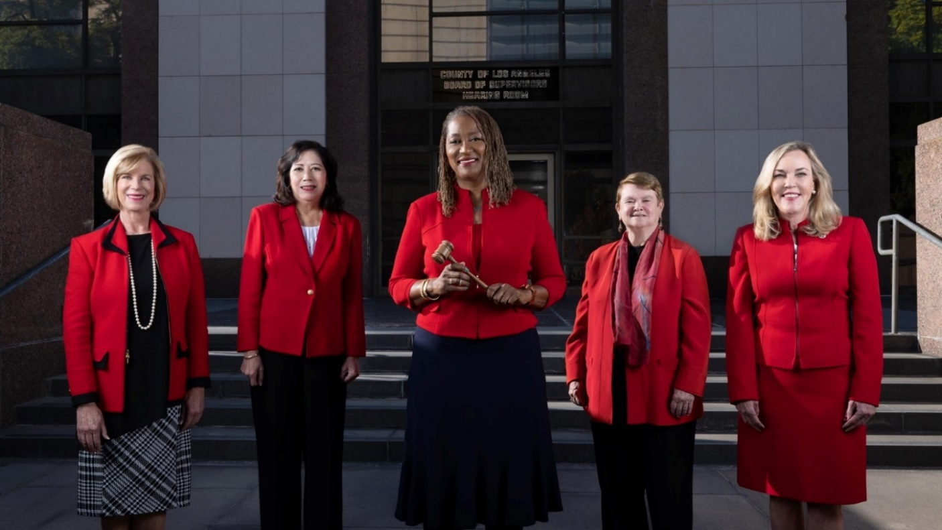
Board of Supervisors motion
Adopted in October 2019
Highlights concerns with litter as well as challenges to waste management
Directives:
  Contract with UCLA Luskin School to prepare report on state of recycling markets;
  Stakeholder engagement; and
  Preparation of an ordinance to prohibit single-use plastics and other materials that cannot be or are not recycled.

Slide 9
Ordinance Development Process
Stakeholder meetings held prior to ordinance development in December 2019
UCLA released report in January 2020
Ordinance development put on hold from April 2020 to fall of 2021
Started restaurant surveys in January 2022
Sent summary of draft ordinance to stakeholders for review and comment in January 2022
Held two listening sessions in February 2022
Various meetings and presentations with stakeholders throughout process
Ordinance adopted by Board in April 2022
Notes:
On “various meetings” – this includes environmental and environmental justice groups, business associations and individual businesses, waste operators, town councils, local jurisdictions

Slide 10
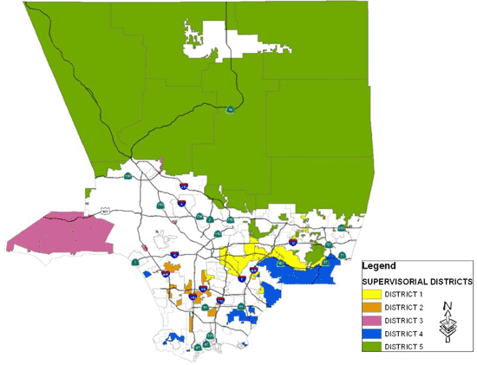
Ordinance Provisions: Applicability
Applies solely to unincorporated portions of Los Angeles County
Applies to “food facilities” and retail establishments
  “Food facilities” include, but are not limited to, restaurants, coffee shops, fast food restaurants, food carts, grocery stores, supermarkets, convenience stores, school cafeterias, snack bars, food trucks, juice bars, farmers markets, and temporary food facilities that participate in fairs or events.
Street vendors are exempted from ordinance requirements.
Notes:
Note that map doesn’t reflect redistricting

Slide 11
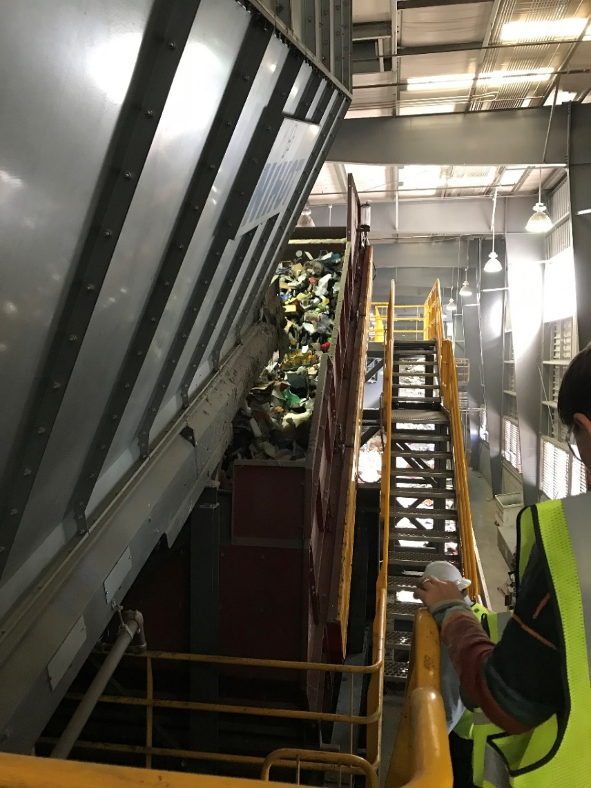
Ordinance Provisions: Requirements
Disposable food service ware provided with ready-to-eat foods, food trays, and egg cartons must be either “recyclable” or “compostable.”
Retail sale or rental of expanded polystyrene (foam) products prohibited.
Full-service restaurants must use reusable food service ware for dine-in customers
  A “full-service restaurant” is defined as defined as food facilities where food may be consumed on the premises, customers are escorted or assigned to an eating area, food and beverage orders are delivered directly to customers (except for food in a buffet or salad bar), and servers bring items to customers if requested.
Businesses must maintain records showing compliance for three years
Notes:
Retail sale or rental of expanded polystyrene (foam) products such as coolers, packaging and peanuts, pool toys, or single use food service ware is prohibited, unless the products are encased in a durable material.
Food facilities, third-party online food ordering platforms, and retail establishments shall maintain written records evidencing compliance with the ordinance for a period of three years and shall make them available for inspection upon request.

Slide 12
Ordinance Provisions: Exceptions and Waivers
The following products are exempted from the ordinance requirements:
  Articles included in food or beverages that are packaged off the premises of the food facility. (e.g., forks in a salad prepared and packaged offsite or straw attached to a juice box)
  Emergency supplies and articles used as part of food service for patients in health facilities.
Exemptions may be granted for items if no appropriate compostable or recyclable alternative exists.
Full-service restaurants that do not have adequate dishwashing facilities may request a waiver from the requirement to use reusable food service ware for dine-in customers.
Waivers from the ordinance requirements may also be granted on a limited basis in the case of undue hardships, including but not limited to financial hardship.

Slide 13
Ordinance Provisions: Implementation Timeline
Food facilities that operate in a permanent structure and serve food to customers on-site, as well as retail establishments: one year after ordinance adoption
Food trucks: eighteen months after ordinance adoption
Temporary food facilities (e.g. community events, caterers, and farmers markets): two years after ordinance adoption
Notes:
Businesses that operate solely as food trucks will have eighteen months after ordinance adoption to meet requirements.
Businesses that operate solely as temporary food facilities, such as community events, caterers, and farmers markets will have two years after ordinance adoption to meet requirements.

Slide 14
Ordinance Provisions: Enforcement
County Department of Public Works will be enforcement lead with support from Department of Public Health
  Initially complaint-based
  County will evaluate whether a more proactive approach is needed during first year of implementation
Department of Public Health will assist with education and outreach
Enforcement will prioritize education and working with businesses to bring them into compliance rather than using a punitive approach.
In instances where this approach does not work, violators may be subject to fines up to $100 per day per violation up to a maximum of $1000 per year.

Slide 15
Ordinance Implementation
Board adopted an implementation motion along with the ordinance directing:
  Outreach and education campaign
  Develop resource list for businesses of compliant products
  Explore programs to support businesses through financial assistance
Internal County working group to discuss implementation
DPH assisting with outreach through mailing lists and health inspectors
Public Works received grant from Ocean Protection Council for enhanced restaurant outreach
Public Works launched ordinance website: http://pw.lacounty.gov/epd/eps/

Slide 17
Infrastructure LA
Sustainable Waste and Recycling Management
  Single-Use Plastics
  Coby Skye
  Assistant Deputy Director
  LA County Public Works
  CSkye@pw.lacounty.gov
  Rita Kampalath
  Chief Sustainability Officer
  County of Los Angeles
  RKampalath@ceo.lacounty.gov
  Sean Singletary
  Environmental Programs & Operations Manager
  City of Culver City
  Sean.Singletary@culvercity.org

Slide 18

City of Culver City
Waste Reduction Regulations (Polystyrene Amendment)
Sean Singletary, Environmental Programs & Operations Manager
City of Culver City

Slide 19
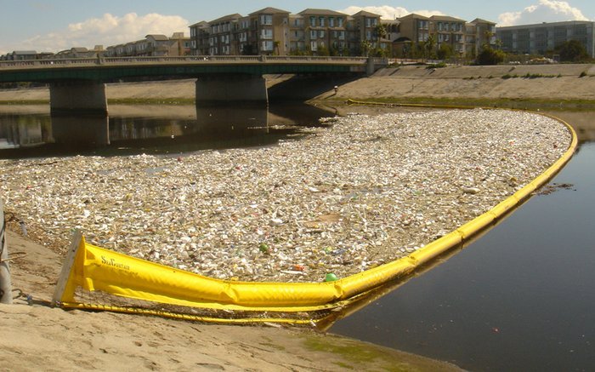
How The Ban Started (Polystyrene)
Community-Driven Effort
  Ballona Creek Renaissance, Heal the Bay, Surfrider
  Despite being stamped with the #6 recycling label, polystyrene and expanded polystyrene are very difficult and costly to recycle, it also does not biodegrade
  Sustainability Committee in 2016
Staff surveyed 800 food service providers to determine for/against the ban
Staff directed to find alternatives and product costs

Slide 20

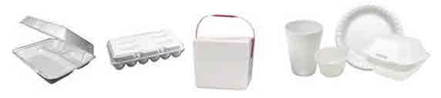
What the Ban Included
Expanded (Foam) Polystyrene
Hard/Solid Plastic Polystyrene
Hot Cups
Plates
Bowls
Clamshells
Utensils
Straws
Water cups
Hot Cup lids
Clamshells
Sauce containers

Slide 21
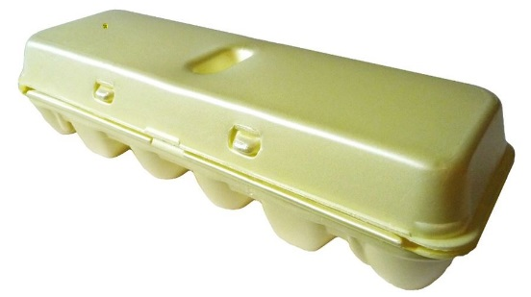
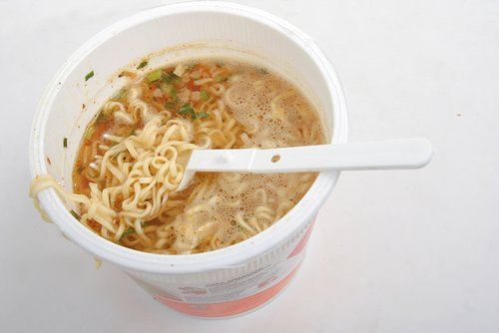
What did the ban exclude?
The use or sale of meat trays, egg cartons, and packing material
All unprepared food using polystyrene foodware may be sold by City retailers and food service providers (raw meat/fish trays, egg cartons, Cup of Noodles-Ramen)

Slide 22
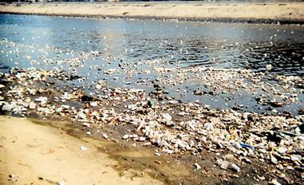
How The Ban Expanded
Due to Plastic’s continuing prevalence
  Ballona Creek Renaissance proposed additional restrictions in 2019
Sustainability Subcommittee in 2020
China’s Policy Change in 2018 drove the cost of recycling much higher and added an economic factor to the ban
Phased in Ban was passed in May 2021, however due to a policy gap between the repeal of prior polystyrene regulations Chapter 11.18 and new expanded plastic regulations in Chapter 5.07, it was amended in June 2021 to ensure the timeline of the regulations did not allow a gap wherein polystyrene was allowed.

Slide 23
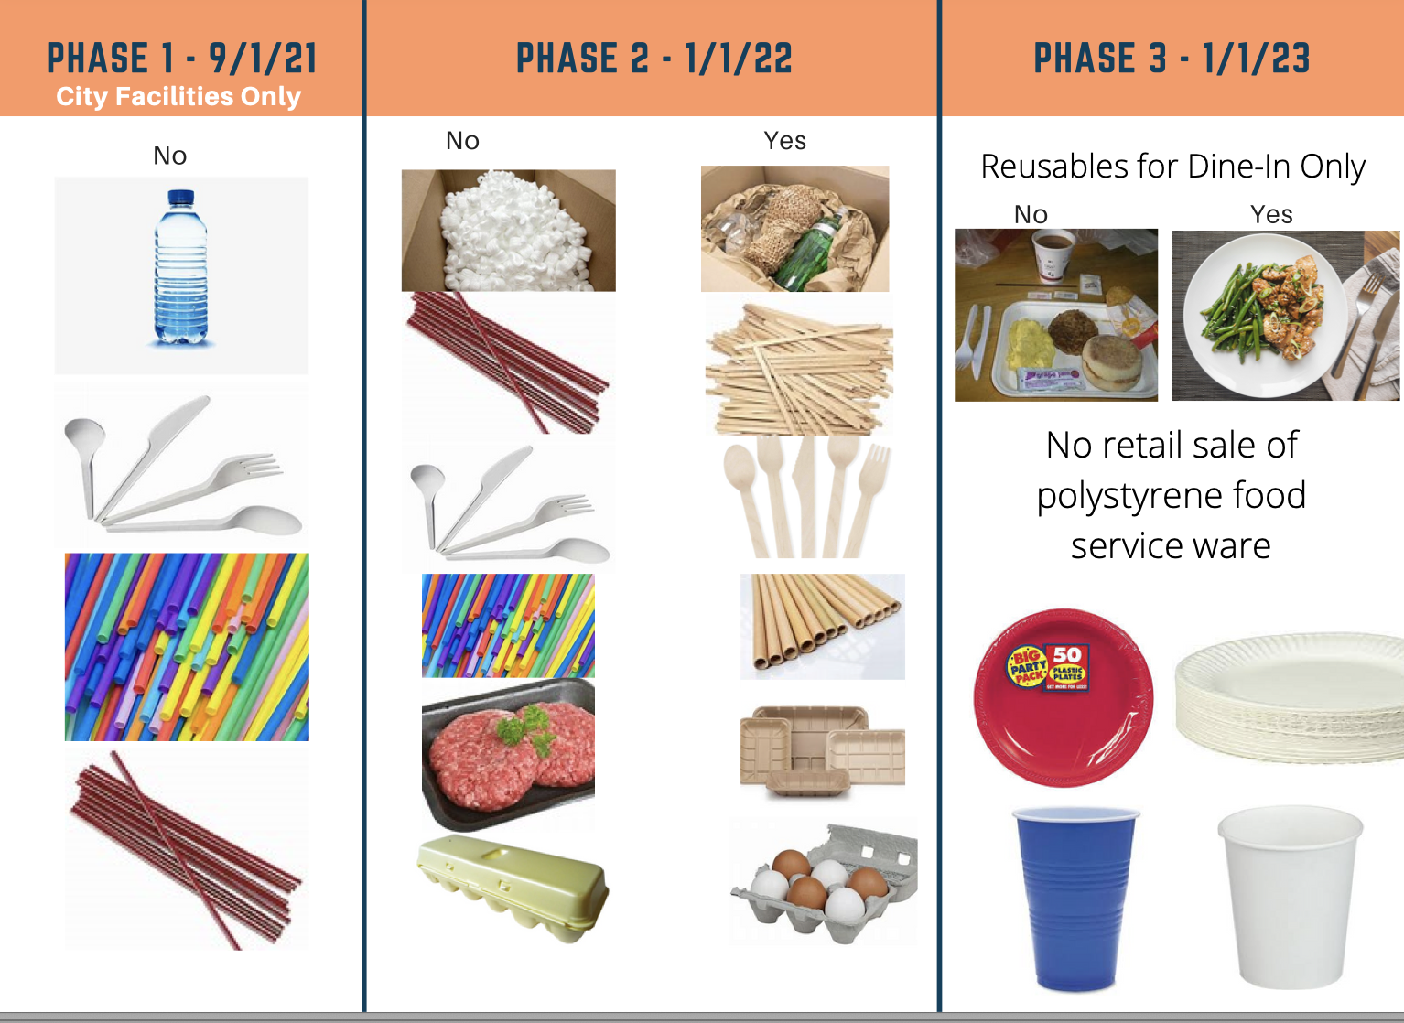
On May 10, 2021, City Council voted 4-1 to introduce the Ordinance resulting in the final components:

Slide 24


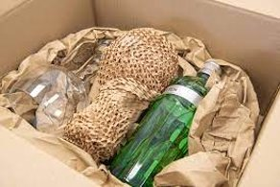
Plastic Regulations, Effective January 1, 2022:
Any regulated entity shall only use, sell or distribute utensils, stirring sticks or straws made from materials which are acceptable by the City's organics collection program and only upon a customer's request for any of those items. Anyone, however, may provide a plastic straw as an accommodation to a person with a disability who requests a plastic straw in order to enjoy equal access to the food or beverages being provided by the regulated entity subject to this provision.
Packing Material Regulations, Effective January 1, 2022:
No regulated entity shall sell, distribute or use polystyrene packing material, including, but not limited to, foam, peanuts, packing peanuts, foam popcorn, packing noodles or shipping boxes; provided, however, that the disposal of any polystyrene packing materials which were part of any shipment originating outside of the City shall not constitute a prohibited use under this provision.
Packing materials which are reusable, acceptable to the City's recycling program or acceptable to the City's organics collection program are allowed.
Any regulated entity using polystyrene packing material for shipping medical devices is exempt from the requirement of Section 5.07.035.A.

Slide 25
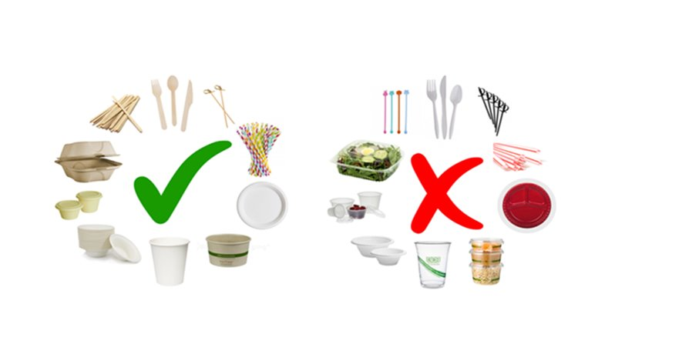
Take-Out and Delivery Regulations, Effective January 1, 2022. ​
Disposable food service ware used by any regulated entity for take-out or delivery must be acceptable to the City's organics collection program and be free of fluorinated chemicals, as certified by the Biodegradable Product institute or other independent, third-party certifying organization or agency recognized by the City. However, paper liners, paper napkins or foil wrappers acceptable to the City's recyclables and/or organics collections program may be used when the food item being served requires paper or foil to contain and/or form the food item being served.​
​

Slide 26
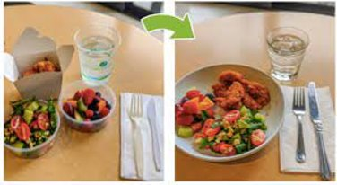
Food Service Ware Regulations for On-Premises Dining, Effective January 1, 2023.
Food or beverages served for consumption on the premises of any regulated entity shall only be served on or in food service ware that is reusable. However, paper liners, paper napkins or foil wrappers acceptable to the City's recyclables and/or organics collections program may be used when the food item being served requires paper liners, paper napkins or foil wrappers to contain and/or form the food item being served. To be deemed "reusable" under this provision, food service ware must be manufactured of durable materials specifically designed and manufactured to be safely and repeatedly washed, sanitized and reused over an extended period of time.
Polystyrene Prohibitions, Effective January 1, 2023.
No person or regulated entity shall sell any polystyrene food service ware.

Slide 27
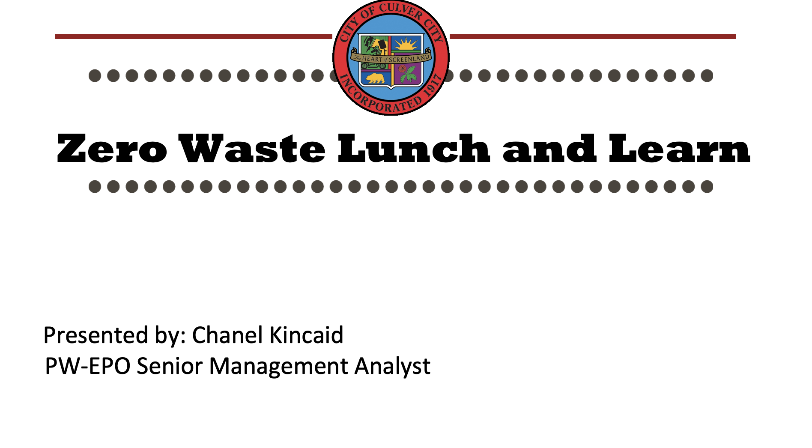
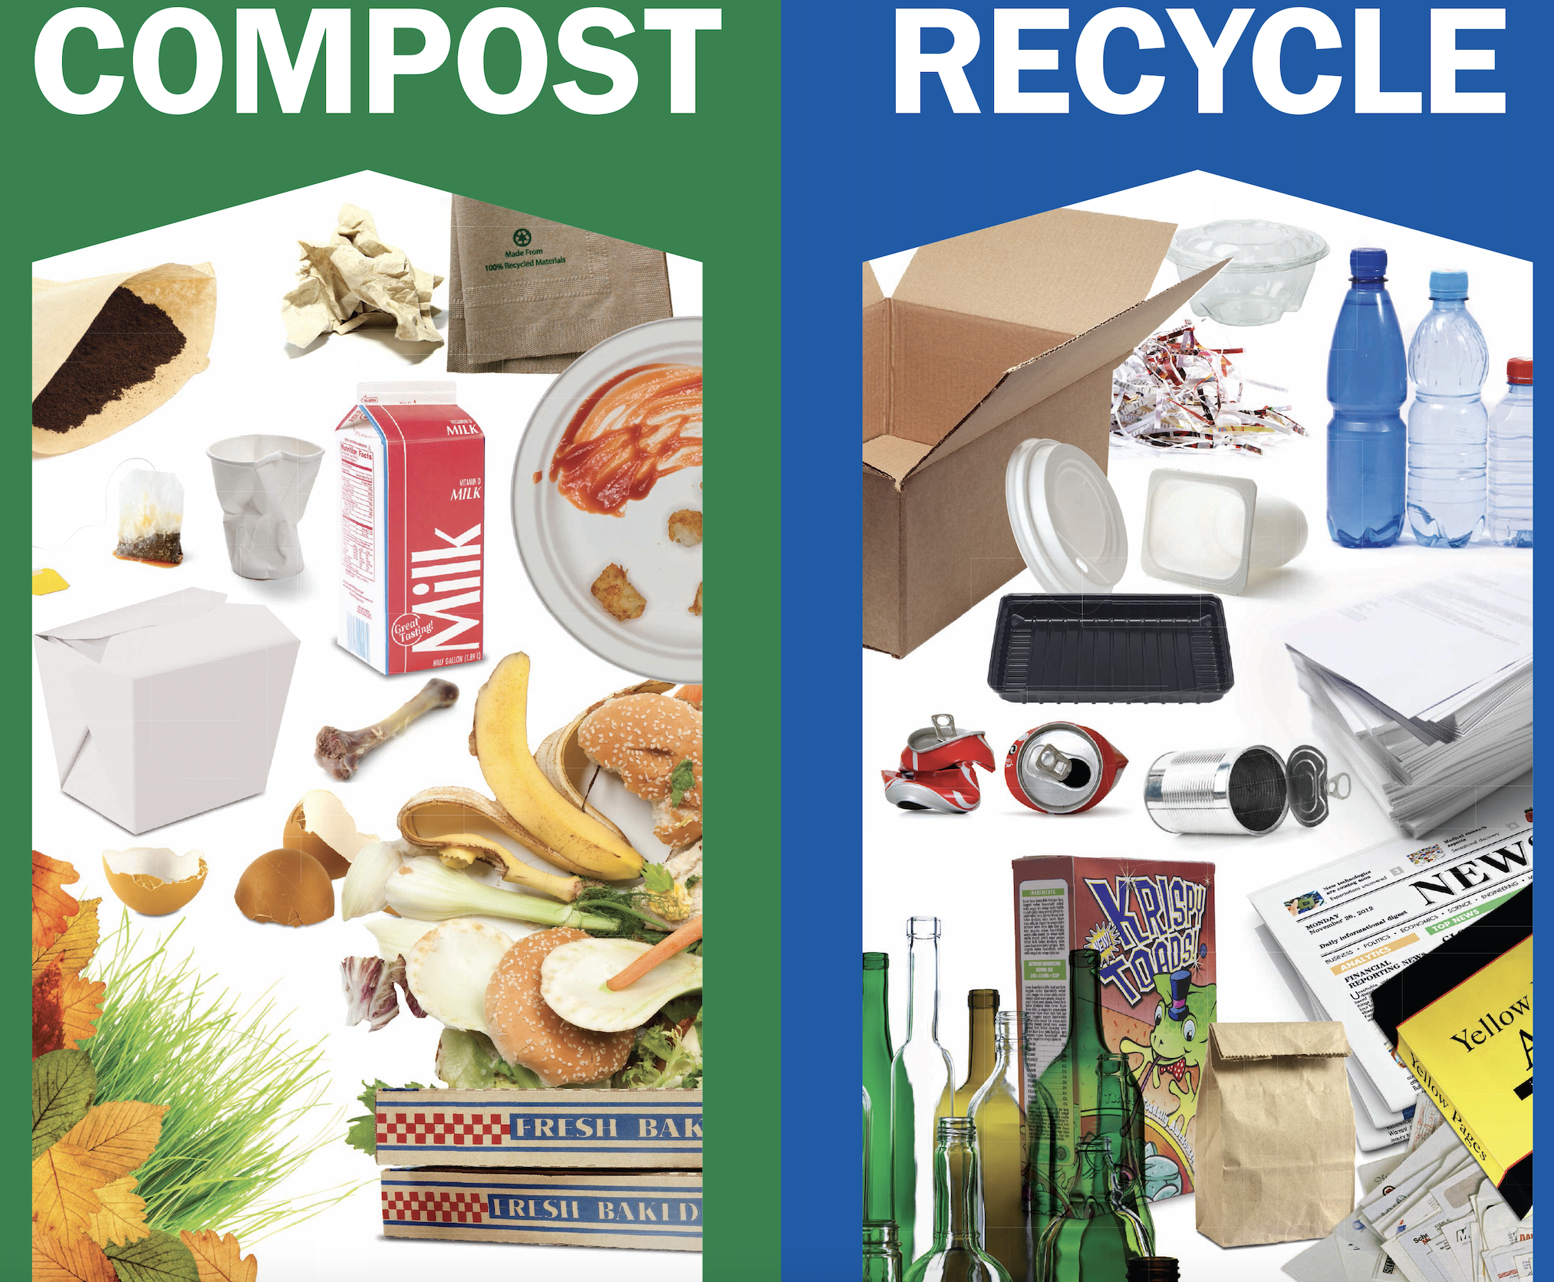
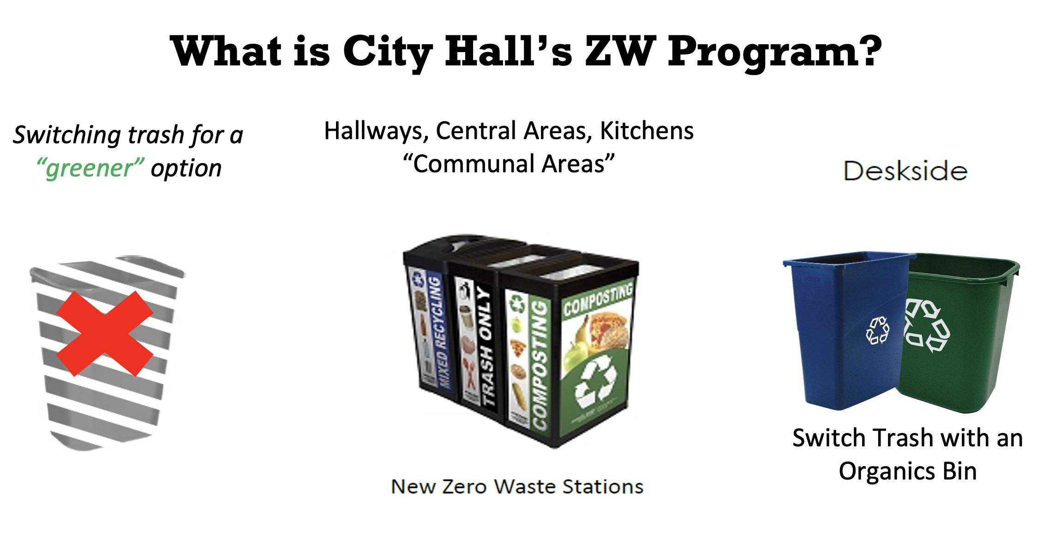
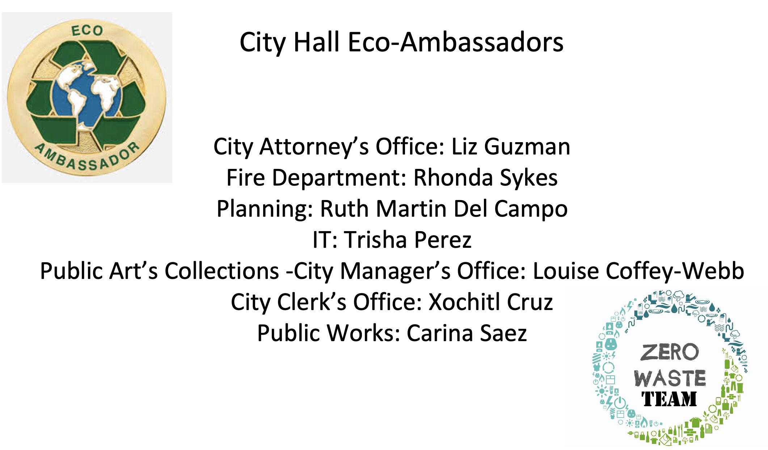
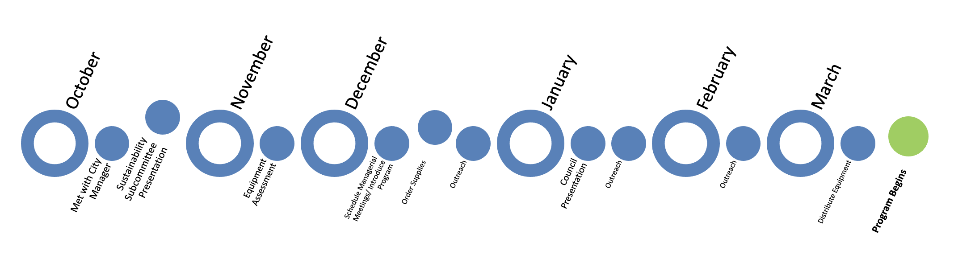

Slide 28
Communication and Partnership with Local Businesses and Franchisees:
- CCUSD
- DBA
- Chamber of Commerce
- Apple
- Tik Tok
- Sony
- Taco Bell

Slide 29
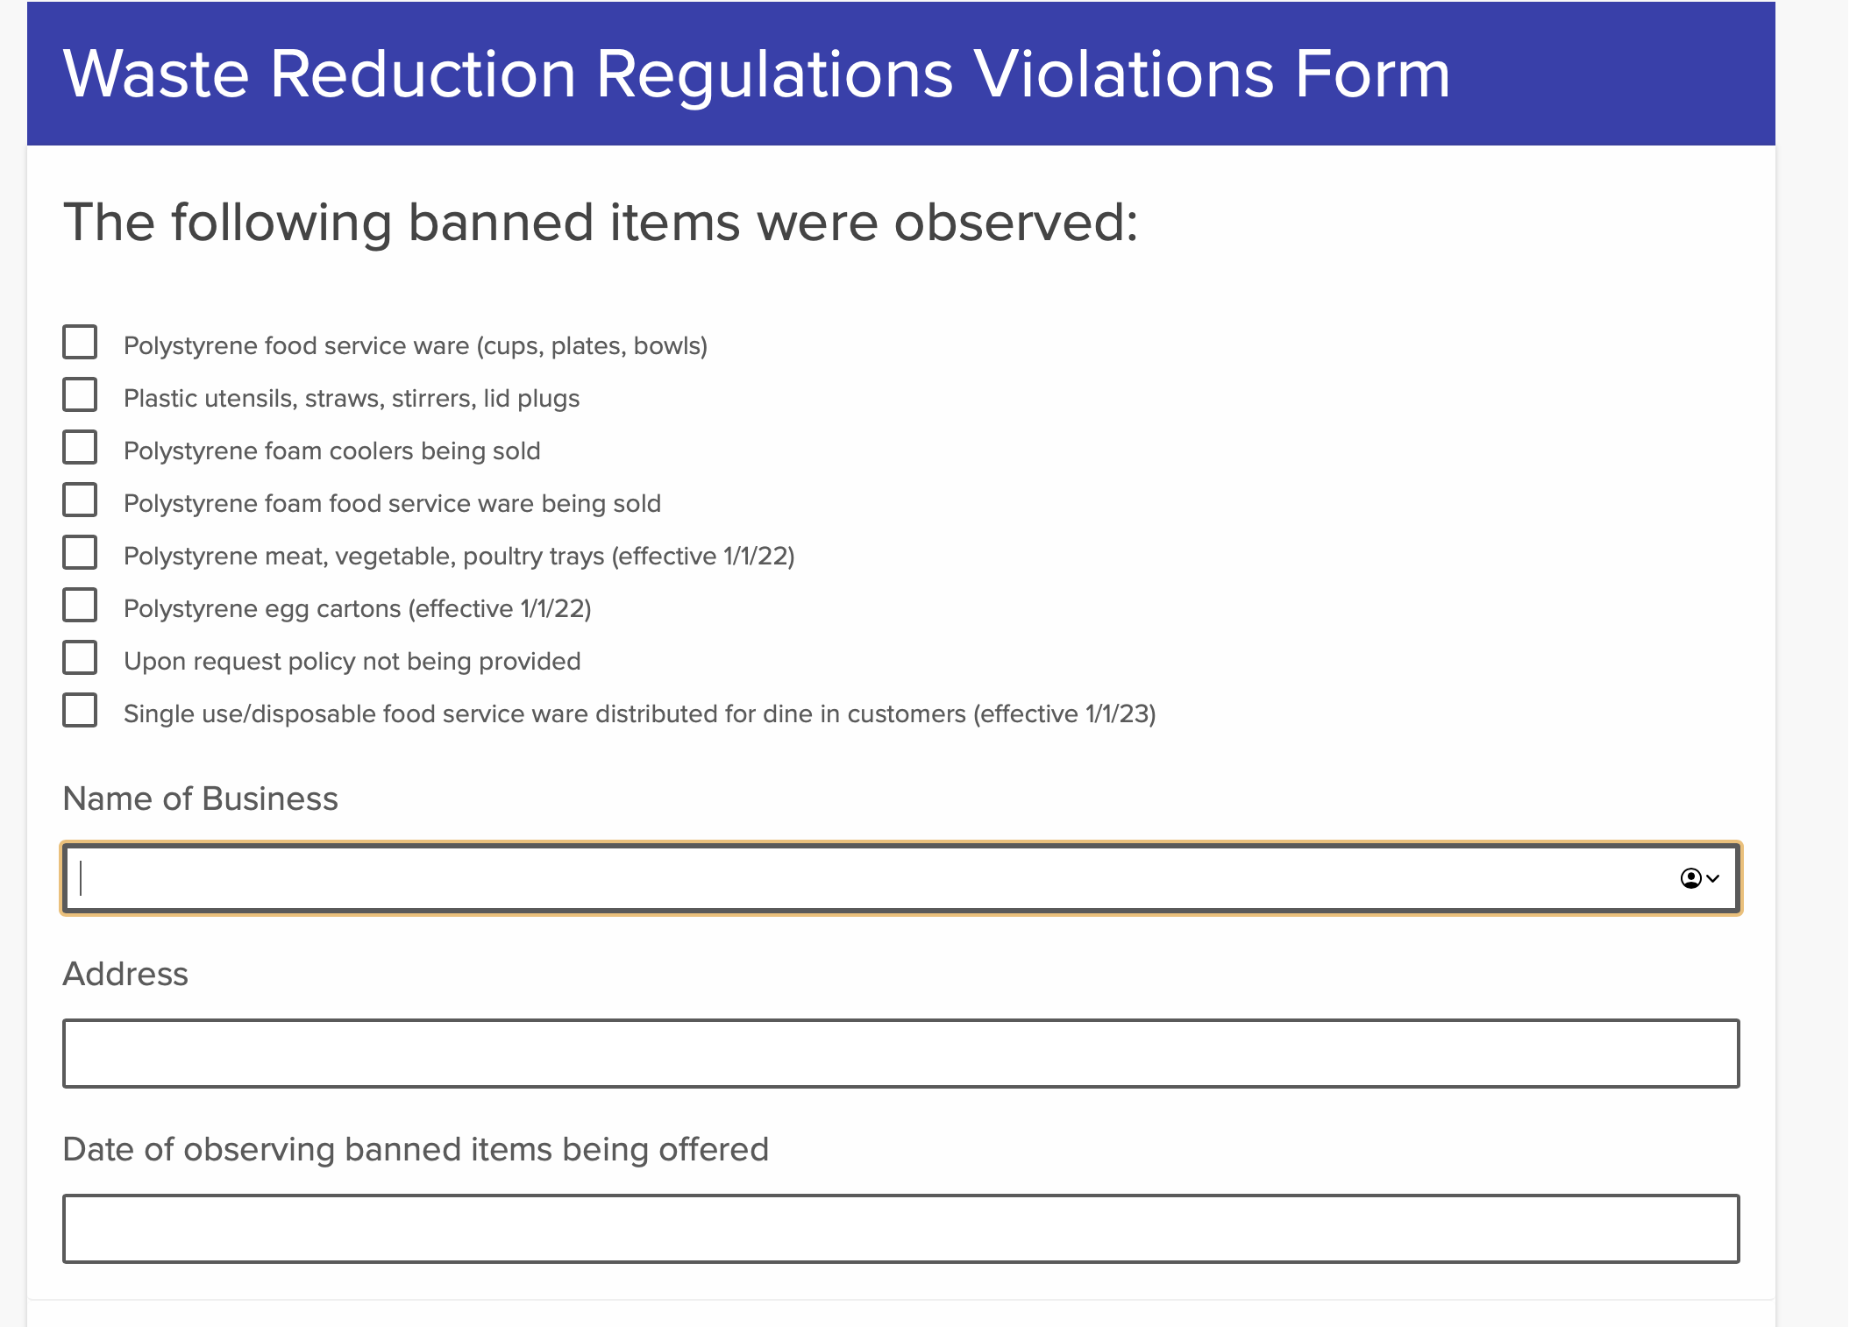
Enforcement
Education
- Social Media
- Press Releases
- Newsletters
- Outreach Events

Slide 30
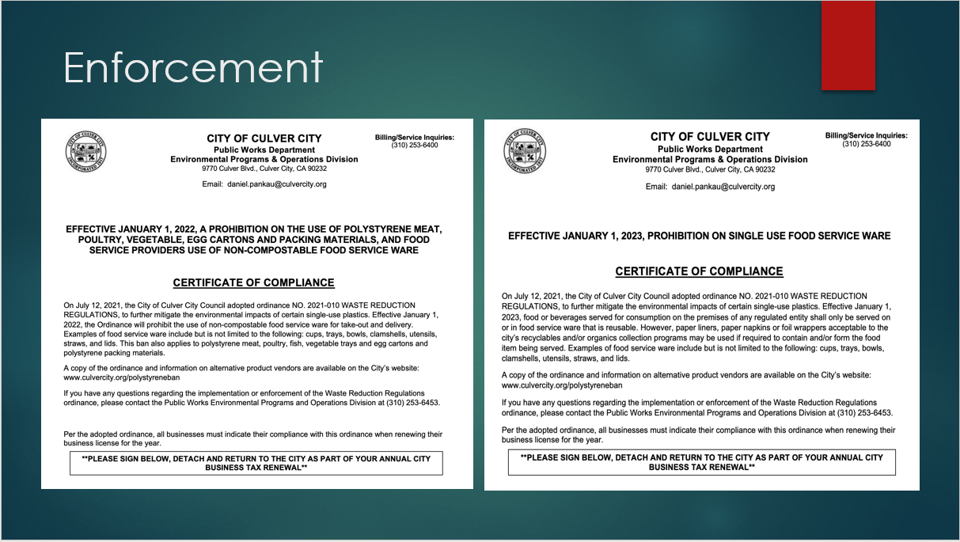

Slide 31
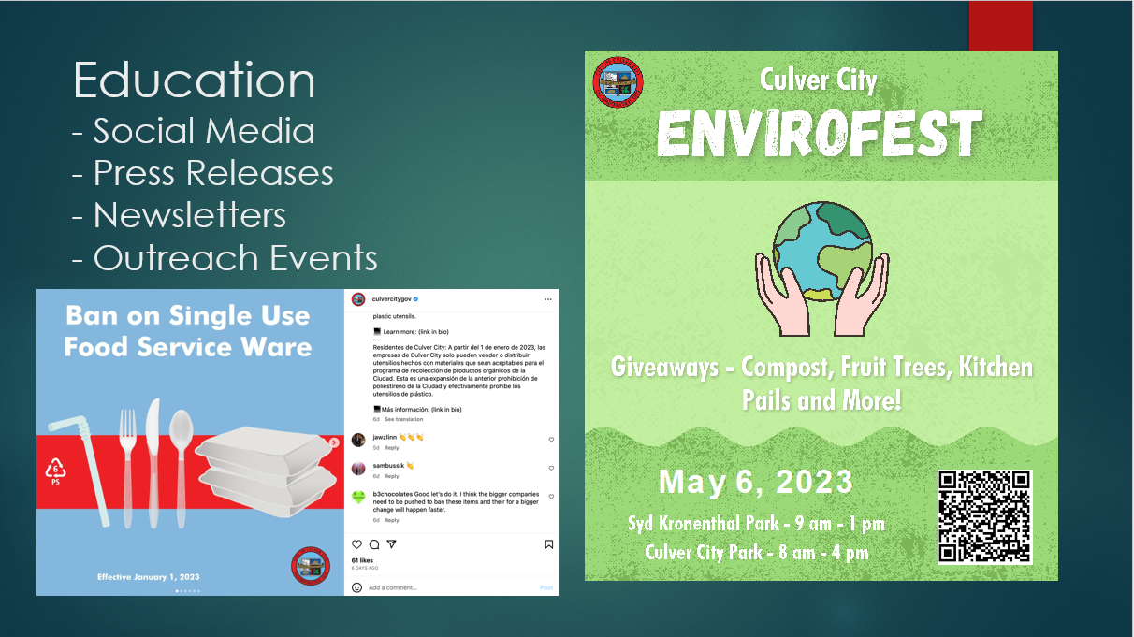

Slide 32
Possible Next Steps
Proposal to Sustainability Committee in March 2022 to Further Ban:
- Single Use Plastic Beverage Bottles
- Single Use Plastic Bags Not Pre-Empted by State Law
- Balloons

Slide 33
Infrastructure LA
Sustainable Waste and Recycling Management
  Single-Use Plastics
  Coby Skye
  Assistant Deputy Director
  LA County Public Works
  CSkye@pw.lacounty.gov
  Rita Kampalath
  Chief Sustainability Officer
  County of Los Angeles
  RKampalath@ceo.lacounty.gov
  Sean Singletary
  Environmental Programs & Operations Manager
  City of Culver City
  Sean.Singletary@culvercity.org

Slide 34
Infrastructure LA
Sustainable Waste and Recycling Management
Thank you for joining today’s call!
For more information on Infrastructure LA and to sign up for email updates about future calls visit the website at: www.infrastructurela.org
Email: InfrastructureLA@pw.lacounty.gov

